Slide 1

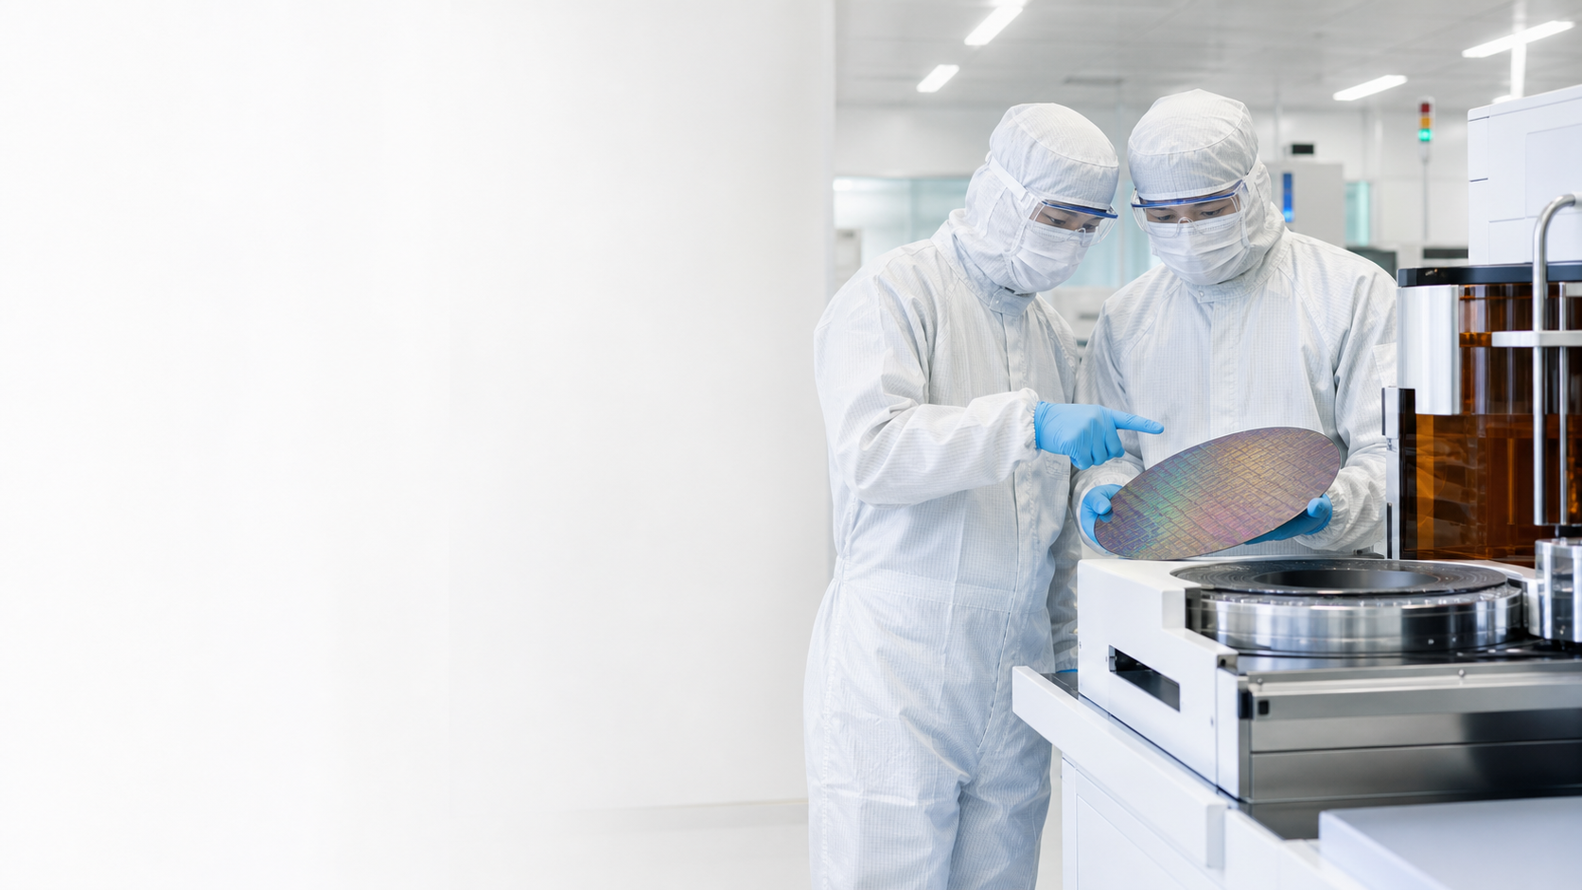
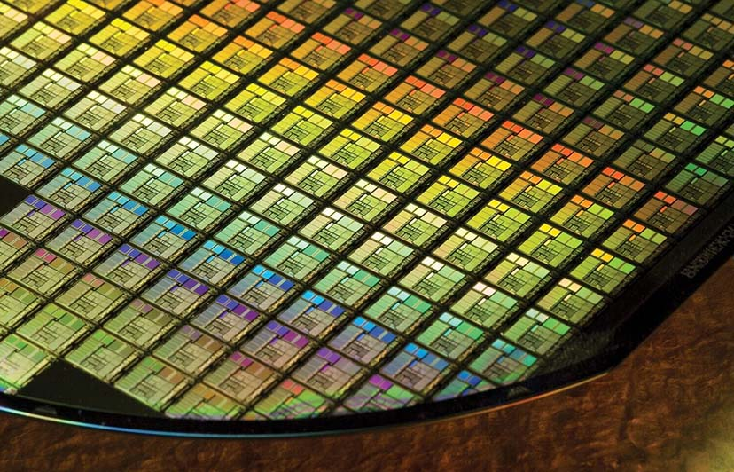
NON-WSQ COURSE
Semiconductor Device and Process Integration Masterclass
Connect device behaviour to the process decisions that create it.
C605
Version 1.0 · 1 Oct 2026
Trainer: ____________________
Tertiary Infotech Academy Pte Ltd
UEN 201200696W
Semiconductor Device and Process Integration Masterclass · C605
© 2026 Tertiary Infotech Academy Pte Ltd
1
Notes:
[Sources]
- OpenAI ImageGen local asset: semiconductor-cover-hero-v2.png
- Course metadata: Tertiary Infotech Academy course record
[/Sources]

Slide 2
ADMIN · TRAINER
About the Trainer
NAME
____________________________
?
TITLE / DESIGNATION
____________________________
QUALIFICATIONS
____________________________
General Trainer
Complete before delivery
AREAS OF EXPERTISE
____________________________
TRAINING & INDUSTRY EXPERIENCE
____________________________
CONTACT
____________________________
Semiconductor Device and Process Integration Masterclass · C605
© 2026 Tertiary Infotech Academy Pte Ltd
2
Notes:
[Sources]
- Internal course metadata, approved TSC mapping and v5 legacy courseware
[/Sources]

Slide 3
ADMIN · TRAINER
About the Trainer
NAME
Dr Alfred Ang
AA
TITLE / DESIGNATION
Founder and Senior Educator
QUALIFICATIONS
PhD in Physics · ACTA/ACLP equivalent adult education experience
Dr Alfred Ang
Founder · Senior Educator · PhD in Physics
AREAS OF EXPERTISE
Device physics · semiconductor processing · applied AI
TRAINING & INDUSTRY EXPERIENCE
Decades of STEM teaching and technical training
CONTACT
enquiry@tertiaryinfotech.com
Semiconductor Device and Process Integration Masterclass · C605
© 2026 Tertiary Infotech Academy Pte Ltd
3
Notes:
[Sources]
- Internal course metadata, approved TSC mapping and v5 legacy courseware
[/Sources]

Slide 4

ADMIN · INTRODUCTION
Let's Know Each Other
1
Your role
What part of semiconductor design, manufacturing, test or quality do you work with?
2
Your experience
Which process module or device topic is most familiar to you?
3
Your challenge
What yield, performance or reliability problem would you like to understand better?
4
Your goal
What decision should you be able to make by the end of Day 2?
Semiconductor Device and Process Integration Masterclass · C605
© 2026 Tertiary Infotech Academy Pte Ltd
4
Notes:
[Sources]
- Internal course metadata, approved TSC mapping and v5 legacy courseware
[/Sources]

Slide 5
ADMIN · LEARNING ENVIRONMENT
Ground Rules
1
Be present
2
Participate
Set mobile phones to silent and step out quietly for urgent calls.
Ask questions, test ideas and contribute process or device examples.
3
Respect evidence
4
Protect information
Challenge the reasoning, not the person; distinguish data from assumptions.
Use only approved, de-identified workplace examples during discussion.
Semiconductor Device and Process Integration Masterclass · C605
© 2026 Tertiary Infotech Academy Pte Ltd
5
Notes:
[Sources]
- Internal course metadata, approved TSC mapping and v5 legacy courseware
[/Sources]

Slide 6
ADMIN · TWO LEARNING UNITS
Course Outline
LU1
LU2
Fundamentals of Device Physics and Device Fabrication
Process Integration Issues
Semiconductor physics · process modules · manufacturing flows · layout and design rules
Yield · device performance · reliability · packaging · follow-up actions
Topic 1
Topic 2
Semiconductor Device and Process Integration Masterclass · C605
© 2026 Tertiary Infotech Academy Pte Ltd
6
Notes:
[Sources]
- Internal course metadata, approved TSC mapping and v5 legacy courseware
[/Sources]

Slide 7
ADMIN · 2 DAYS · 15 HOURS
Lesson Plan
1
2
3
4
Day 1 AM
▶
Day 1 PM
▶
Day 2 AM
▶
Day 2 PM
Admin, materials, carrier physics, junctions and devices
Process modules, CMOS flow, design rules and Activities 1-3
Integration interactions, yield, performance and Activities 4-6
Reliability, packaging, Activities 7-8 and recap
Each day runs 9:30 AM – 5:30 PM · 7.5 instructional hours
Semiconductor Device and Process Integration Masterclass · C605
© 2026 Tertiary Infotech Academy Pte Ltd
7
Notes:
[Sources]
- Internal course metadata, approved TSC mapping and v5 legacy courseware
[/Sources]

Slide 8
ADMIN · LEARNER MATERIALS
Access the Course Activities
OPTION A
OPTION B
Clone the repository
Download the ZIP
git clone https://github.com/tertiarycourses/C605-Semiconductor-Device-and-Process-Integration-Masterclass.git
Open GitHub · choose Code · Download ZIP · extract the activities folder
https://github.com/tertiarycourses/C605-Semiconductor-Device-and-Process-Integration-Masterclass
Semiconductor Device and Process Integration Masterclass · C605
© 2026 Tertiary Infotech Academy Pte Ltd
8
Notes:
[Sources]
- Internal course metadata, approved TSC mapping and v5 legacy courseware
[/Sources]

Slide 9
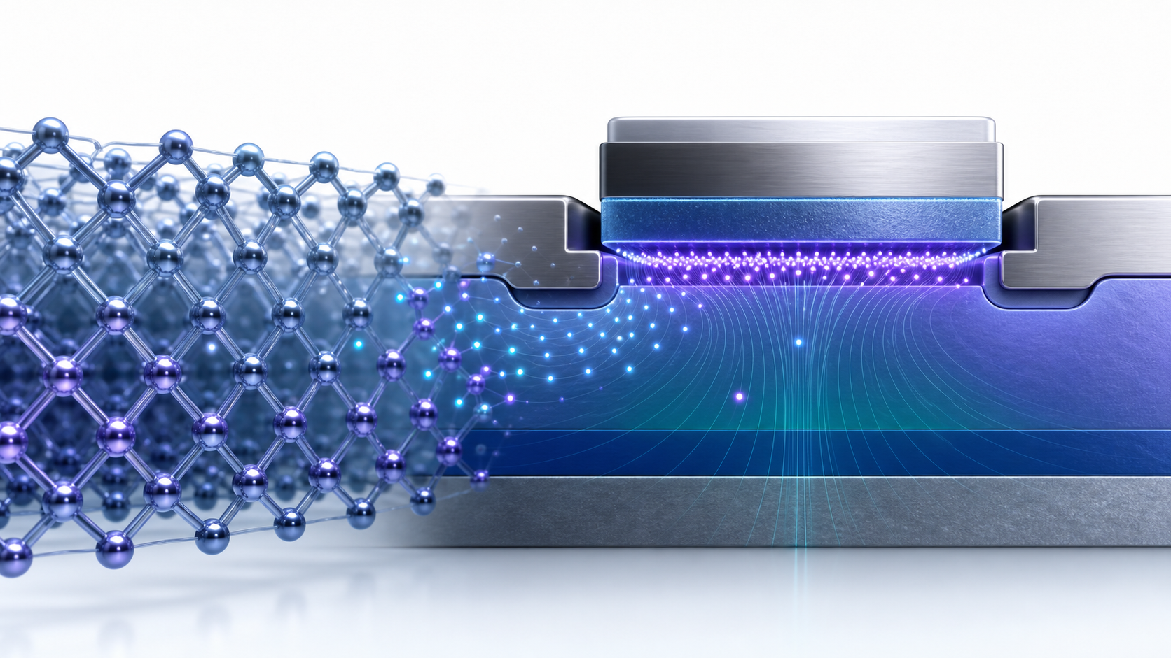
01
TOPIC 01
Fundamentals of Device Physics and Device Fabrication
Concepts · mechanisms · process evidence · integration decisions
Semiconductor Device and Process Integration Masterclass · C605
© 2026 Tertiary Infotech Academy Pte Ltd
9
Notes:
[Sources]
- Legacy v5 source slide 16
- OpenAI ImageGen local asset: device-physics-hero-v2.png
[/Sources]

Slide 10
TOPIC 01
Topics
1
Introduction to semiconductor device physics
Introduction to semiconductor device physics
Introduction to process modules
Basic manufacturing process flows
Layout and design rules
Semiconductor Device and Process Integration Masterclass · C605
© 2026 Tertiary Infotech Academy Pte Ltd
10
Notes:
[Sources]
- Legacy v5 source slides 17; content and embedded images retained and reflowed without stretching
[/Sources]

Slide 11
TOPIC 01
Semiconductor Materials and Carrier Physics
Concepts · mechanisms · process evidence · integration decisions
Semiconductor Device and Process Integration Masterclass · C605
© 2026 Tertiary Infotech Academy Pte Ltd
11
Notes:
[Sources]
- Legacy v5 source slide 18
- OpenAI ImageGen local asset: device-physics-hero-v2.png
[/Sources]

Slide 12
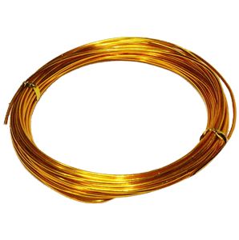
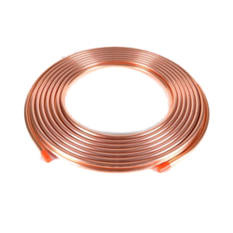
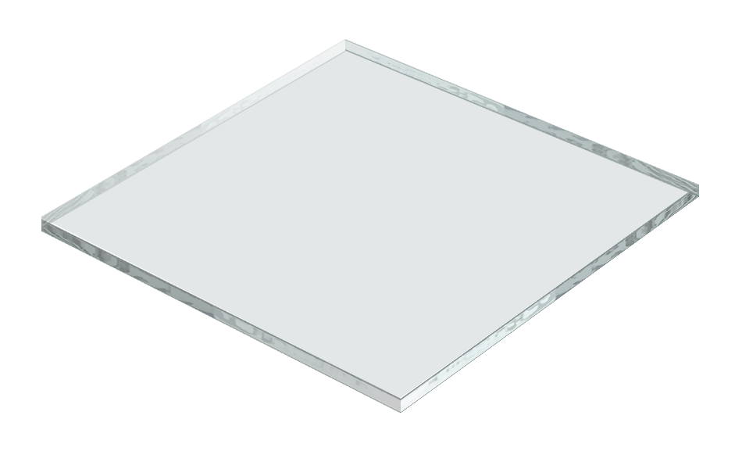

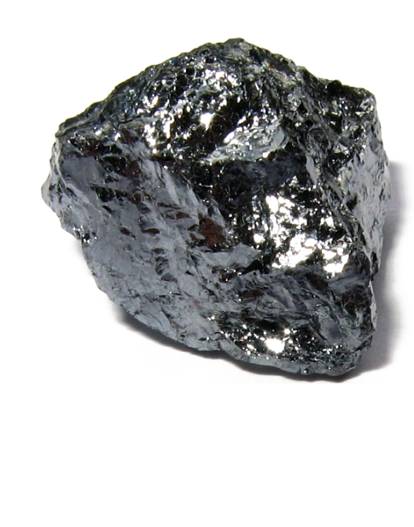
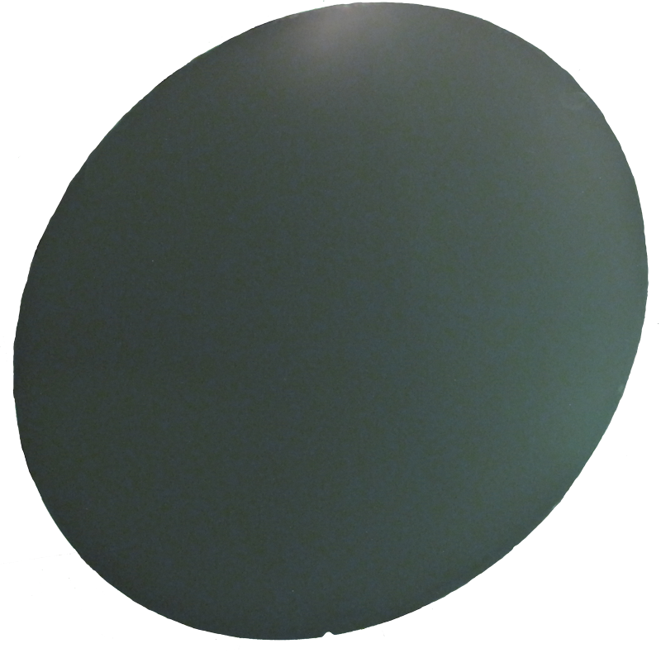
TOPIC 01
What are Semiconductors?
1
Evidence 1
Semiconductors are materials whose electrical properties lie between Conductors and Insulators
Eg. Silicon and Germanium
2
Conductors
Conductors
3
Insulators
Insulators
4
Semiconductors
Semiconductors
Semiconductor Device and Process Integration Masterclass · C605
© 2026 Tertiary Infotech Academy Pte Ltd
12
Notes:
[Sources]
- Legacy v5 source slides 19; content and embedded images retained and reflowed without stretching
[/Sources]

Slide 13
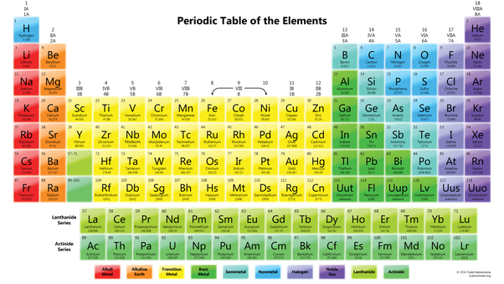
TOPIC 01
Semiconductors are elements
with 4 valence electrons
Semiconductor Device and Process Integration Masterclass · C605
© 2026 Tertiary Infotech Academy Pte Ltd
13
Notes:
[Sources]
- Legacy v5 source slides 20; content and embedded images retained and reflowed without stretching
[/Sources]

Slide 14
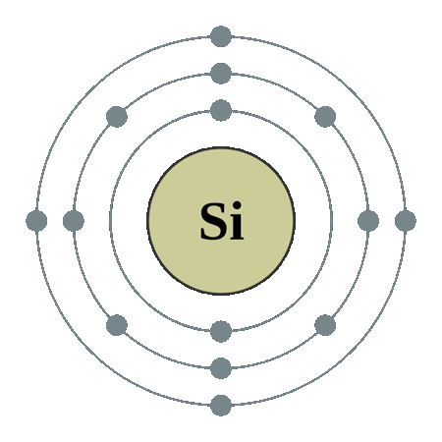
TOPIC 01
Silicon
1
Silicon is the most widely used semiconductor
Silicon is the most widely used semiconductor
It is cheap and readily available
Silicon dioxide is also a very stable insulator
Semiconductor Device and Process Integration Masterclass · C605
© 2026 Tertiary Infotech Academy Pte Ltd
14
Notes:
[Sources]
- Legacy v5 source slides 21; content and embedded images retained and reflowed without stretching
[/Sources]

Slide 15
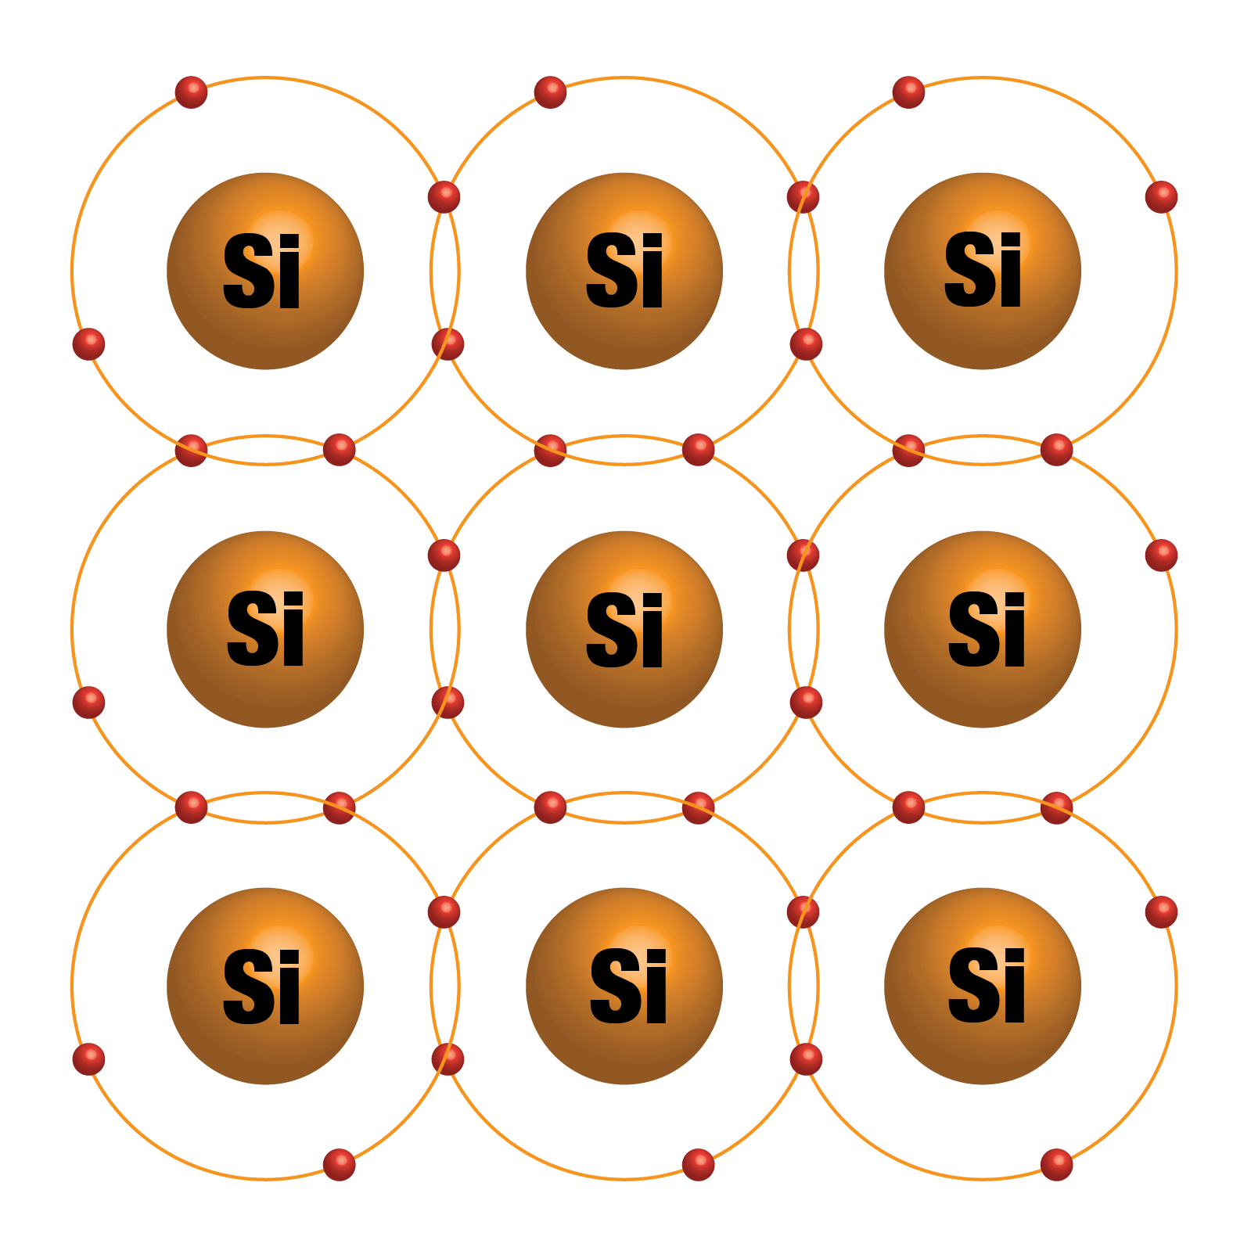
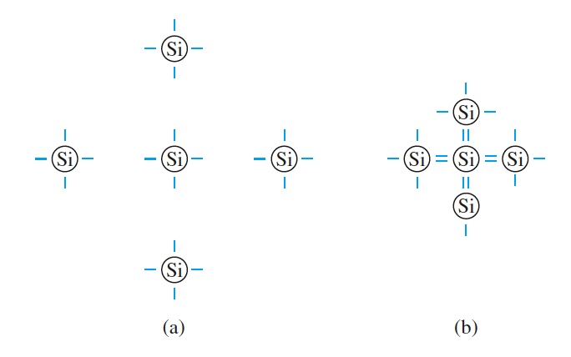
TOPIC 01
Silicon Crystal
1
Evidence 1
Silicon atoms in a crystal are bonded by covalent bonds
Semiconductor Device and Process Integration Masterclass · C605
© 2026 Tertiary Infotech Academy Pte Ltd
15
Notes:
[Sources]
- Legacy v5 source slides 22; content and embedded images retained and reflowed without stretching
[/Sources]

Slide 16
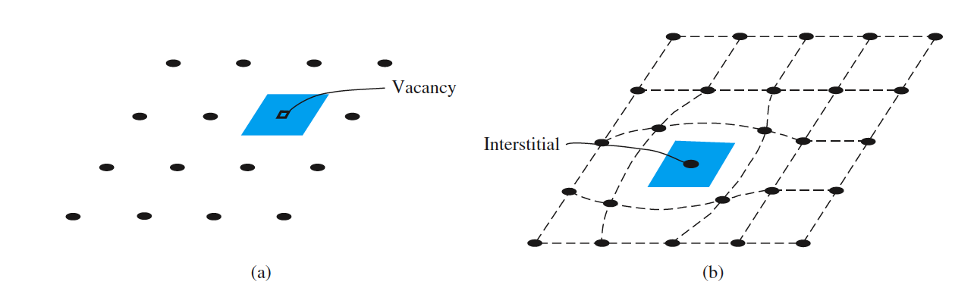
TOPIC 01
Defects
1
Evidence 1
Two-dimensional representation of a single-crystal lattice showing (a) a vacancy defect and (b) an interstitial defect.
Semiconductor Device and Process Integration Masterclass · C605
© 2026 Tertiary Infotech Academy Pte Ltd
16
Notes:
[Sources]
- Legacy v5 source slides 23; content and embedded images retained and reflowed without stretching
[/Sources]

Slide 17
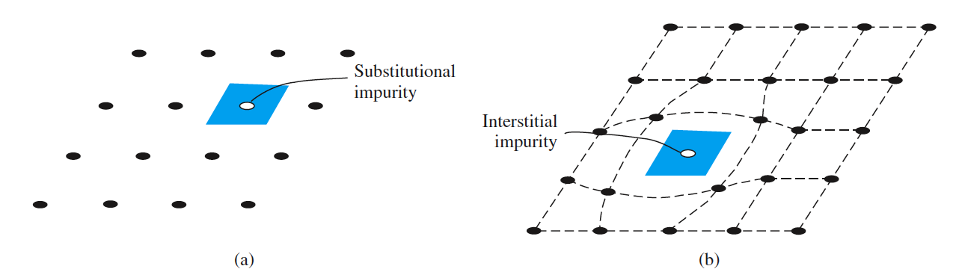
TOPIC 01
Impurities
1
Evidence 1
Two-dimensional representation of a single-crystal lattice showing (a) a substitutional impurity and (b) an intersitital impurity.
Semiconductor Device and Process Integration Masterclass · C605
© 2026 Tertiary Infotech Academy Pte Ltd
17
Notes:
[Sources]
- Legacy v5 source slides 24; content and embedded images retained and reflowed without stretching
[/Sources]

Slide 18
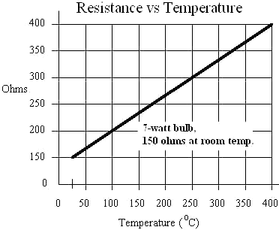
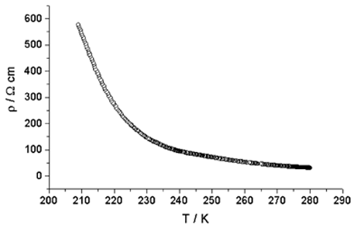
TOPIC 01
Semiconductor Resistivity
1
Evidence 1
A semiconductor crystal with no impurities is known as an intrinsic semiconductor.
Unlike conductor, the conductivity of an intrinsic semiconductor increases with temperature.
2
Conductor
Conductor
3
Semiconductor
Semiconductor
Semiconductor Device and Process Integration Masterclass · C605
© 2026 Tertiary Infotech Academy Pte Ltd
18
Notes:
[Sources]
- Legacy v5 source slides 25; content and embedded images retained and reflowed without stretching
[/Sources]

Slide 19
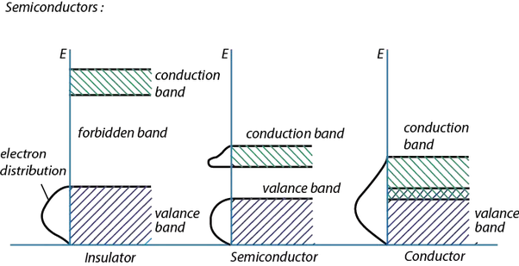
TOPIC 01
Energy Band Model
1
Evidence 1
To explain the semiconductor resistivity, a new theory known as the band theory is introduced in 1930's.
Semiconductor Device and Process Integration Masterclass · C605
© 2026 Tertiary Infotech Academy Pte Ltd
19
Notes:
[Sources]
- Legacy v5 source slides 26; content and embedded images retained and reflowed without stretching
[/Sources]

Slide 20
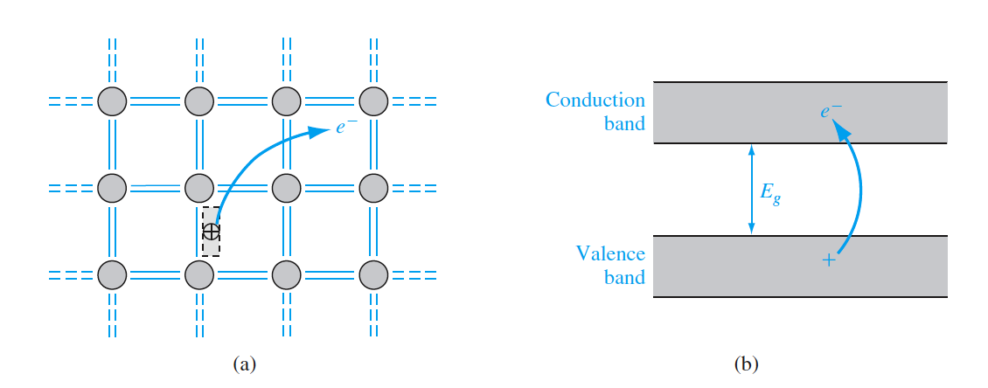
TOPIC 01
Semiconductor Band Theory
1
Evidence 1
Semiconductor energy gaps is typically smaller than about 1 electron volt, therefore it is possible for enough electrons to be excited thermally into the conduction band, so that an applied electric field can produce a modest current.
This explains why the resistivity reduces with increasing temperature
Semiconductor Device and Process Integration Masterclass · C605
© 2026 Tertiary Infotech Academy Pte Ltd
20
Notes:
[Sources]
- Legacy v5 source slides 27; content and embedded images retained and reflowed without stretching
[/Sources]

Slide 21
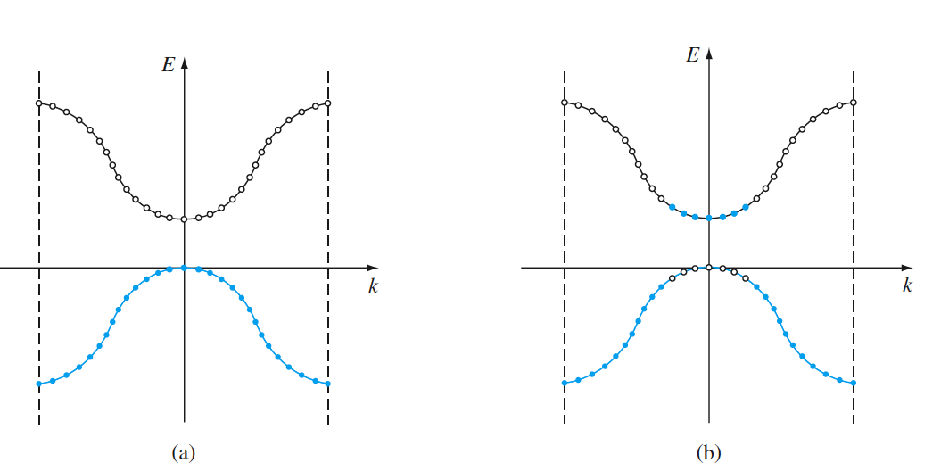
TOPIC 01
Semiconductor Band Theory
1
Evidence 1
The E versus k diagram of the conduction and valence bands of a semiconductor at (a) T=0 K and (b) T >0 K.
Semiconductor Device and Process Integration Masterclass · C605
© 2026 Tertiary Infotech Academy Pte Ltd
21
Notes:
[Sources]
- Legacy v5 source slides 28; content and embedded images retained and reflowed without stretching
[/Sources]

Slide 22
TOPIC 01
Holes
Positively charged "empty state" created when a valence electron moves to the conduction band
At T > 0 K, valence electrons gain thermal energy and may hop into empty states
Movement of electrons into empty states creates the appearance of positive charge movement
This moving positive charge is called a hole, acting as a second charge carrier
Holes can be modeled as classical particles using Newtonian mechanics
Semiconductor Device and Process Integration Masterclass · C605
© 2026 Tertiary Infotech Academy Pte Ltd
22
Notes:
[Sources]
- Legacy v5 source slides 29; content and embedded images retained and reflowed without stretching
[/Sources]

Slide 23
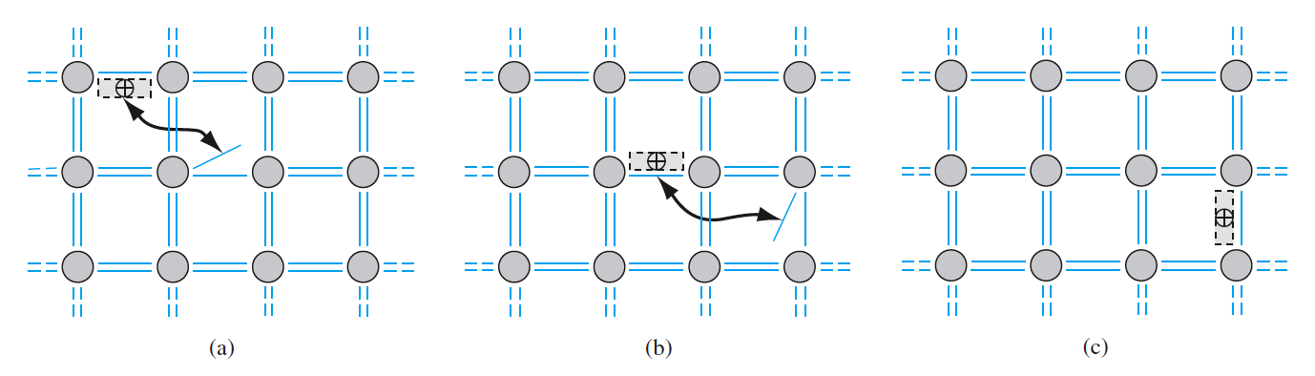
TOPIC 01
Holes
1
Evidence 1
Visualization of the movement of a hole in a semiconductor.
Semiconductor Device and Process Integration Masterclass · C605
© 2026 Tertiary Infotech Academy Pte Ltd
23
Notes:
[Sources]
- Legacy v5 source slides 30; content and embedded images retained and reflowed without stretching
[/Sources]

Slide 24
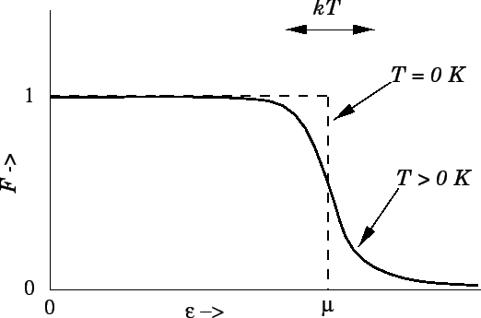
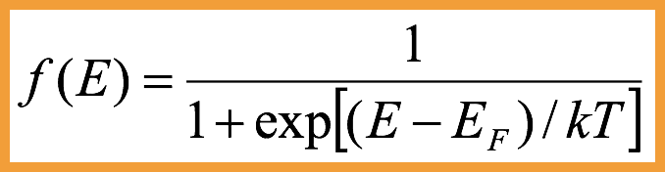
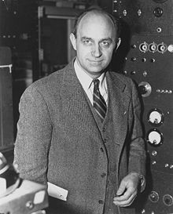
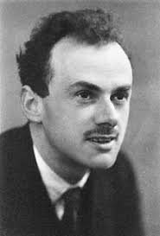
TOPIC 01
Fermi-Dirac Distribution
1
EF is called Fermi level
EF is called Fermi level
Semiconductor Device and Process Integration Masterclass · C605
© 2026 Tertiary Infotech Academy Pte Ltd
24
Notes:
[Sources]
- Legacy v5 source slides 31; content and embedded images retained and reflowed without stretching
[/Sources]

Slide 25
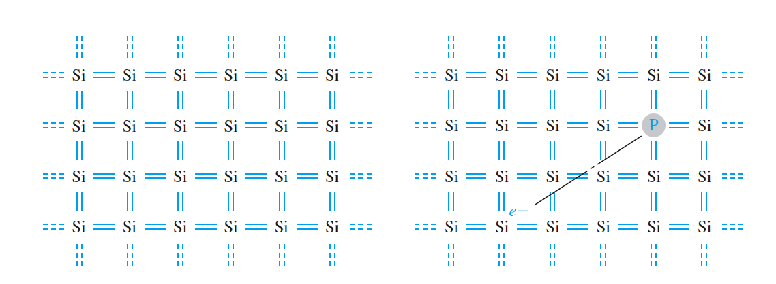
TOPIC 01
Doping
1
Evidence 1
By doping the intrinsic material, the material can be altered to have more electrons or holes.
There are two types of doped material
n-type (doped with P => electrons)
p-type (doped with B => holes)
Semiconductor Device and Process Integration Masterclass · C605
© 2026 Tertiary Infotech Academy Pte Ltd
25
Notes:
[Sources]
- Legacy v5 source slides 32; content and embedded images retained and reflowed without stretching
[/Sources]

Slide 26
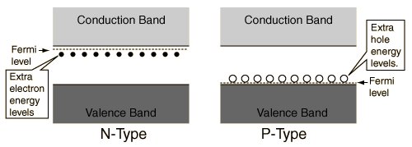
TOPIC 01
Doping on Energy Bands
1
Evidence 1
For N-type semiconductor, the fermi level is near to the conduction band
For P-type semiconductor, the fermi level is near to the valence band
Semiconductor Device and Process Integration Masterclass · C605
© 2026 Tertiary Infotech Academy Pte Ltd
26
Notes:
[Sources]
- Legacy v5 source slides 33; content and embedded images retained and reflowed without stretching
[/Sources]

Slide 27
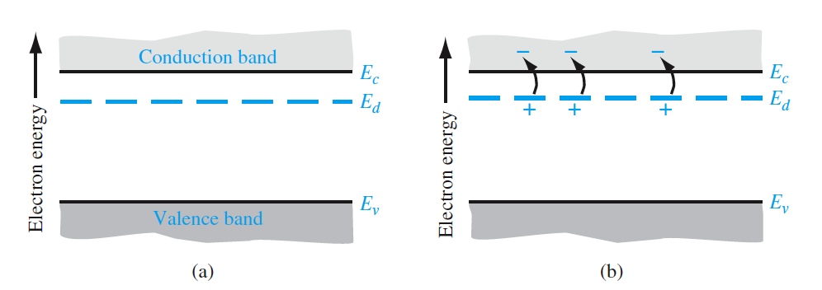
TOPIC 01
Doping on Energy Bands
1
Evidence 1
The energy-band diagram showing (a) the discrete donor energy state and (b) the effect of a donor state being ionized.
Semiconductor Device and Process Integration Masterclass · C605
© 2026 Tertiary Infotech Academy Pte Ltd
27
Notes:
[Sources]
- Legacy v5 source slides 34; content and embedded images retained and reflowed without stretching
[/Sources]

Slide 28
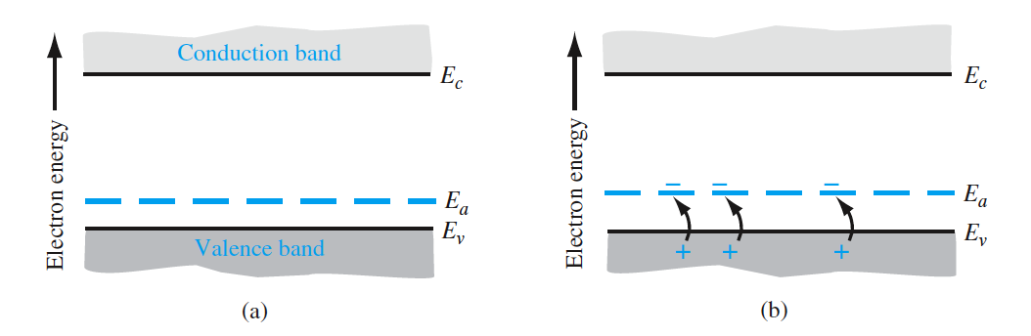
TOPIC 01
Doping on Energy Bands
1
Evidence 1
The energy-band diagram showing (a) the discrete acceptor energy state and (b) the effect of an acceptor state being ionized.
Semiconductor Device and Process Integration Masterclass · C605
© 2026 Tertiary Infotech Academy Pte Ltd
28
Notes:
[Sources]
- Legacy v5 source slides 35; content and embedded images retained and reflowed without stretching
[/Sources]

Slide 29
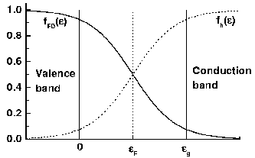
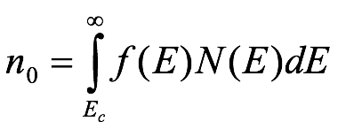
TOPIC 01
Electron Concentration
1
Evidence 1
The Fermi distribution function can be used to calculate the concentrations of electrons and holes in a semiconductor if the densities of available states in the valence and conduction bands are known.
Semiconductor Device and Process Integration Masterclass · C605
© 2026 Tertiary Infotech Academy Pte Ltd
29
Notes:
[Sources]
- Legacy v5 source slides 36; content and embedded images retained and reflowed without stretching
[/Sources]

Slide 30
TOPIC 01
Why Does Doping Matter?
1
N-Type
2
P-Type
3
Diode
4
Transistor
N-Type
P-Type
Diode
Doping allows one to build complex devices like diodes and transistors.
Transistor
Semiconductor Device and Process Integration Masterclass · C605
© 2026 Tertiary Infotech Academy Pte Ltd
30
Notes:
[Sources]
- Legacy v5 source slides 37; content and embedded images retained and reflowed without stretching
[/Sources]

Slide 31
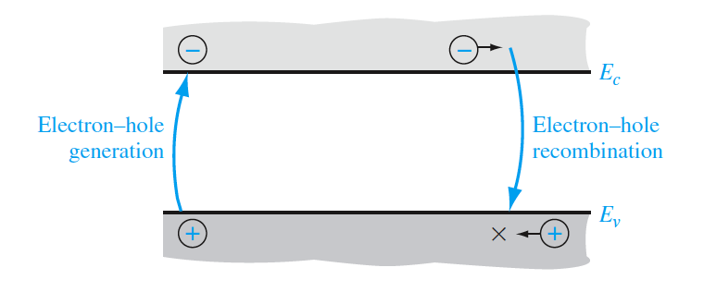
TOPIC 01
Electron–hole generation and recombination
1
Evidence 1
Thermal equilibrium maintains constant electron and hole concentrations
Electrons are thermally excited from the valence to conduction band
Recombination occurs when conduction electrons fall into holes in the valence band
In equilibrium, generation and recombination rates of electrons and holes are equal
Semiconductor Device and Process Integration Masterclass · C605
© 2026 Tertiary Infotech Academy Pte Ltd
31
Notes:
[Sources]
- Legacy v5 source slides 38; content and embedded images retained and reflowed without stretching
[/Sources]

Slide 32
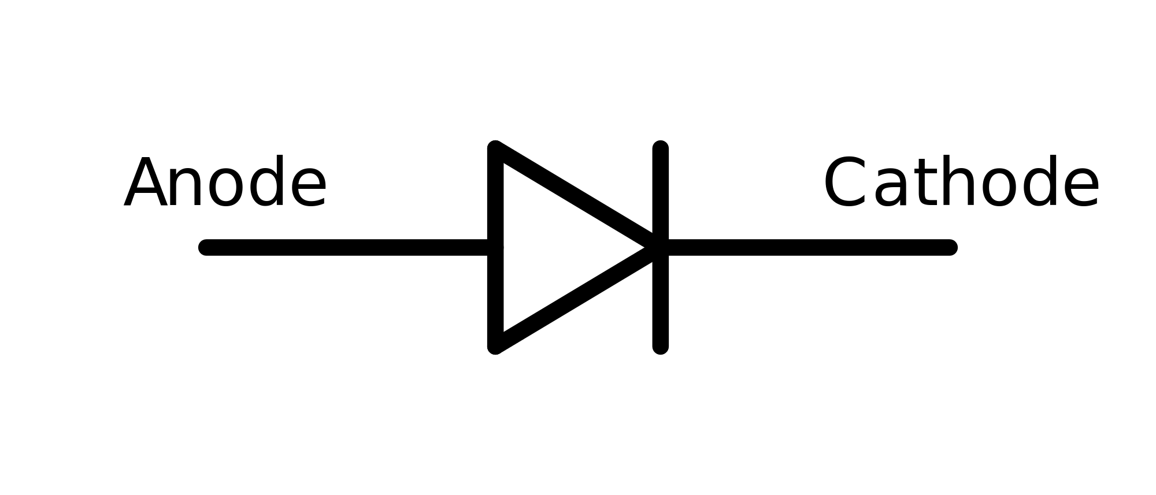
TOPIC 01
PN Junctions and Diode Behaviour
Concepts · mechanisms · process evidence · integration decisions
Semiconductor Device and Process Integration Masterclass · C605
© 2026 Tertiary Infotech Academy Pte Ltd
32
Notes:
[Sources]
- Legacy v5 source slide 39; embedded transition image(s) retained without stretching
[/Sources]

Slide 33
TOPIC 01
What is a Diode?
1
The diode is formed by a PN junction
The diode is formed by a PN junction
2
N-Type
N-Type
3
P-Type
P-Type
4
+
+
-
Semiconductor Device and Process Integration Masterclass · C605
© 2026 Tertiary Infotech Academy Pte Ltd
33
Notes:
[Sources]
- Legacy v5 source slides 40; content and embedded images retained and reflowed without stretching
[/Sources]

Slide 34
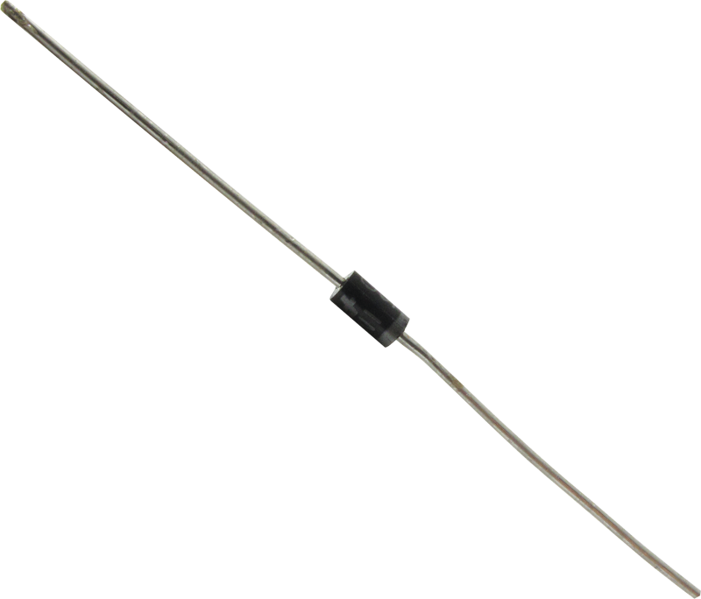
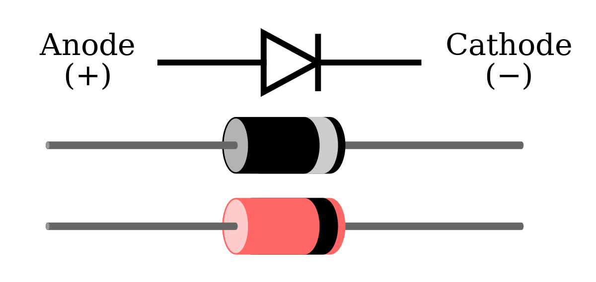
TOPIC 01
Diode
Semiconductor Device and Process Integration Masterclass · C605
© 2026 Tertiary Infotech Academy Pte Ltd
34
Notes:
[Sources]
- Legacy v5 source slides 41; content and embedded images retained and reflowed without stretching
[/Sources]

Slide 35
TOPIC 01
BASIC STRUCTURE OF THE pn JUNCTION
Step junction has uniform doping with an abrupt change at the junction
Large initial density gradient of electrons and holes at the junction
Majority electrons from the n region diffuse into the p region, and holes from p diffuse into n
Diffusion creates net positive charge in n region (donor atoms) and net negative charge in p region (acceptor atoms)
Resulting positive and negative charges induce an electric field near the junction
Semiconductor Device and Process Integration Masterclass · C605
© 2026 Tertiary Infotech Academy Pte Ltd
35
Notes:
[Sources]
- Legacy v5 source slides 42; content and embedded images retained and reflowed without stretching
[/Sources]

Slide 36
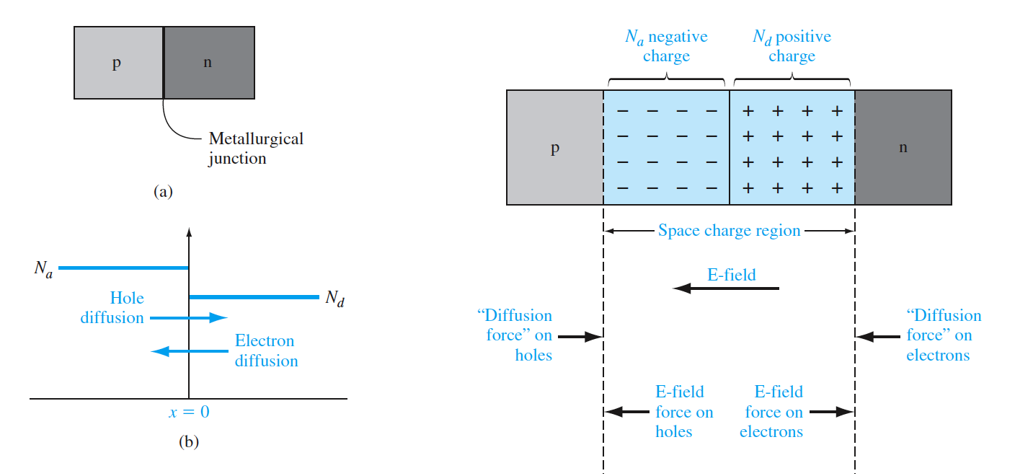
TOPIC 01
BASIC STRUCTURE OF THE pn JUNCTION
Semiconductor Device and Process Integration Masterclass · C605
© 2026 Tertiary Infotech Academy Pte Ltd
36
Notes:
[Sources]
- Legacy v5 source slides 43; content and embedded images retained and reflowed without stretching
[/Sources]

Slide 37
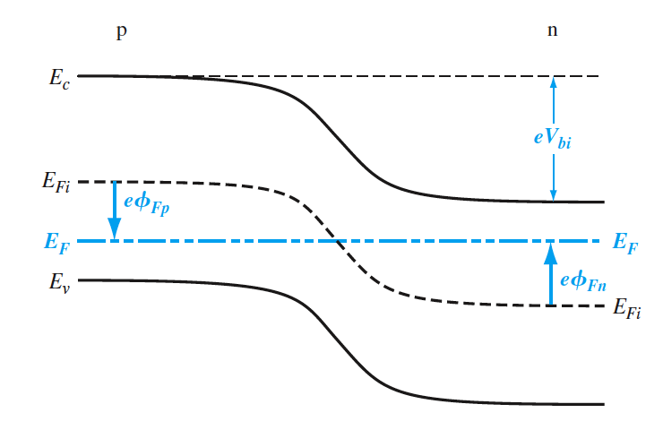
TOPIC 01
ZERO APPLIED BIAS
1
Evidence 1
In thermal equilibrium, no voltage is applied across the pn junction
Fermi energy level remains constant throughout the system
Conduction and valence band energies bend across the space charge region
Band bending occurs due to changes in the relative position of the conduction and valence bands between p and n regions
Semiconductor Device and Process Integration Masterclass · C605
© 2026 Tertiary Infotech Academy Pte Ltd
37
Notes:
[Sources]
- Legacy v5 source slides 44; content and embedded images retained and reflowed without stretching
[/Sources]

Slide 38
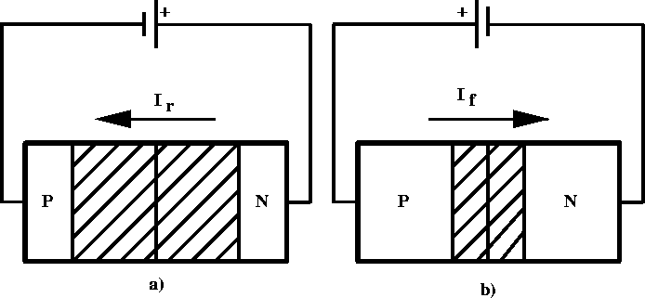
TOPIC 01
Forward Bias and Reverse Bias
1
Forward Bias: Connect positive to Anode - ON
Forward Bias: Connect positive to Anode - ON
Reverse Bias: Connect positive to Cathode - OFF
2
Reverse Bias
Reverse Bias
3
Forward Bias
Forward Bias
Semiconductor Device and Process Integration Masterclass · C605
© 2026 Tertiary Infotech Academy Pte Ltd
38
Notes:
[Sources]
- Legacy v5 source slides 45; content and embedded images retained and reflowed without stretching
[/Sources]

Slide 39
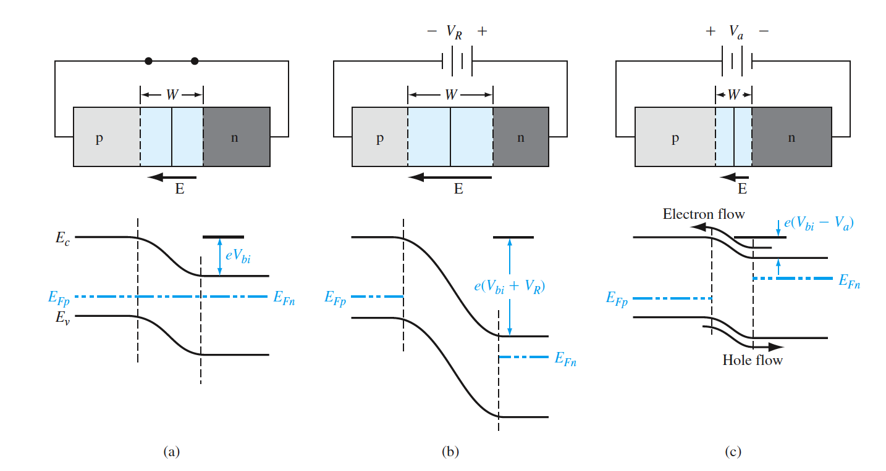
TOPIC 01
Charge Flow in a pn Junction
1
Evidence 1
A pn junction and its associated energy-band diagram for (a) zero bias, (b) reverse bias, and (c) forward bias.
Semiconductor Device and Process Integration Masterclass · C605
© 2026 Tertiary Infotech Academy Pte Ltd
39
Notes:
[Sources]
- Legacy v5 source slides 46; content and embedded images retained and reflowed without stretching
[/Sources]

Slide 40
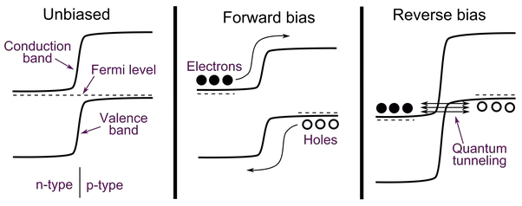
TOPIC 01
How Does Diode Work?
1
Evidence 1
Fermi level is like the water level of a lake. If two different parts of the lake have different water level, water will flow until the water level of the lake is uniform. It’s the same with electrons and the Fermi level.
Semiconductor Device and Process Integration Masterclass · C605
© 2026 Tertiary Infotech Academy Pte Ltd
40
Notes:
[Sources]
- Legacy v5 source slides 47; content and embedded images retained and reflowed without stretching
[/Sources]

Slide 41
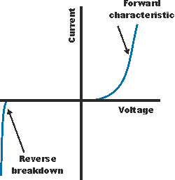
TOPIC 01
IV Characteristics of Diode
1
VF ~ 0.7V
VF ~ 0.7V
2
VBR ~ -100V
VBR ~ -100V
Semiconductor Device and Process Integration Masterclass · C605
© 2026 Tertiary Infotech Academy Pte Ltd
41
Notes:
[Sources]
- Legacy v5 source slides 48; content and embedded images retained and reflowed without stretching
[/Sources]

Slide 42
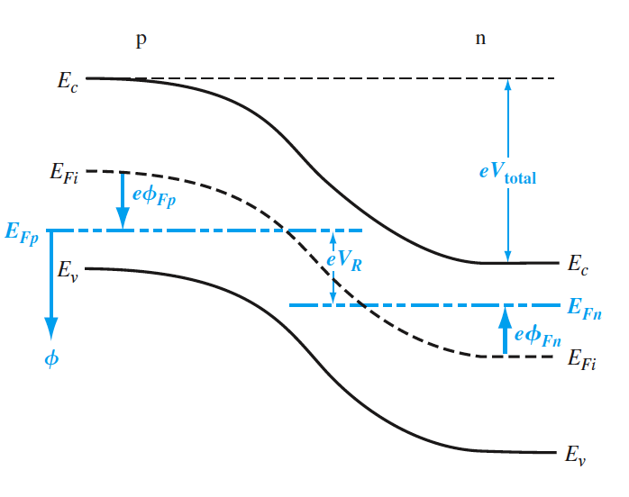
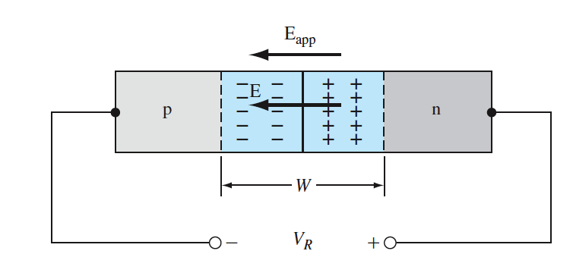
TOPIC 01
REVERSE APPLIED BIAS
1
Evidence 1
Applying a voltage across the pn junction disrupts thermal equilibrium
Fermi energy level is no longer constant throughout the system
Positive voltage applied to the n region lowers the Fermi level on the n side below that of the p side
The difference in Fermi levels equals the applied voltage (in energy units
Semiconductor Device and Process Integration Masterclass · C605
© 2026 Tertiary Infotech Academy Pte Ltd
42
Notes:
[Sources]
- Legacy v5 source slides 49; content and embedded images retained and reflowed without stretching
[/Sources]

Slide 43
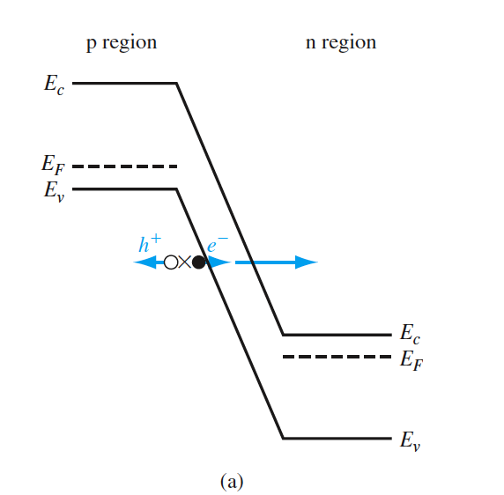
TOPIC 01
JUNCTION BREAKDOWN
1
Evidence 1
Reverse-biased breakdown in a pn junction occurs via the Zener effect and avalanche effect
Zener breakdown happens in highly doped junctions through electron tunneling
In reverse bias, conduction and valence bands are close enough for electrons to tunnel from the p-side valence band to the n-side conduction band
Semiconductor Device and Process Integration Masterclass · C605
© 2026 Tertiary Infotech Academy Pte Ltd
43
Notes:
[Sources]
- Legacy v5 source slides 50; content and embedded images retained and reflowed without stretching
[/Sources]

Slide 44
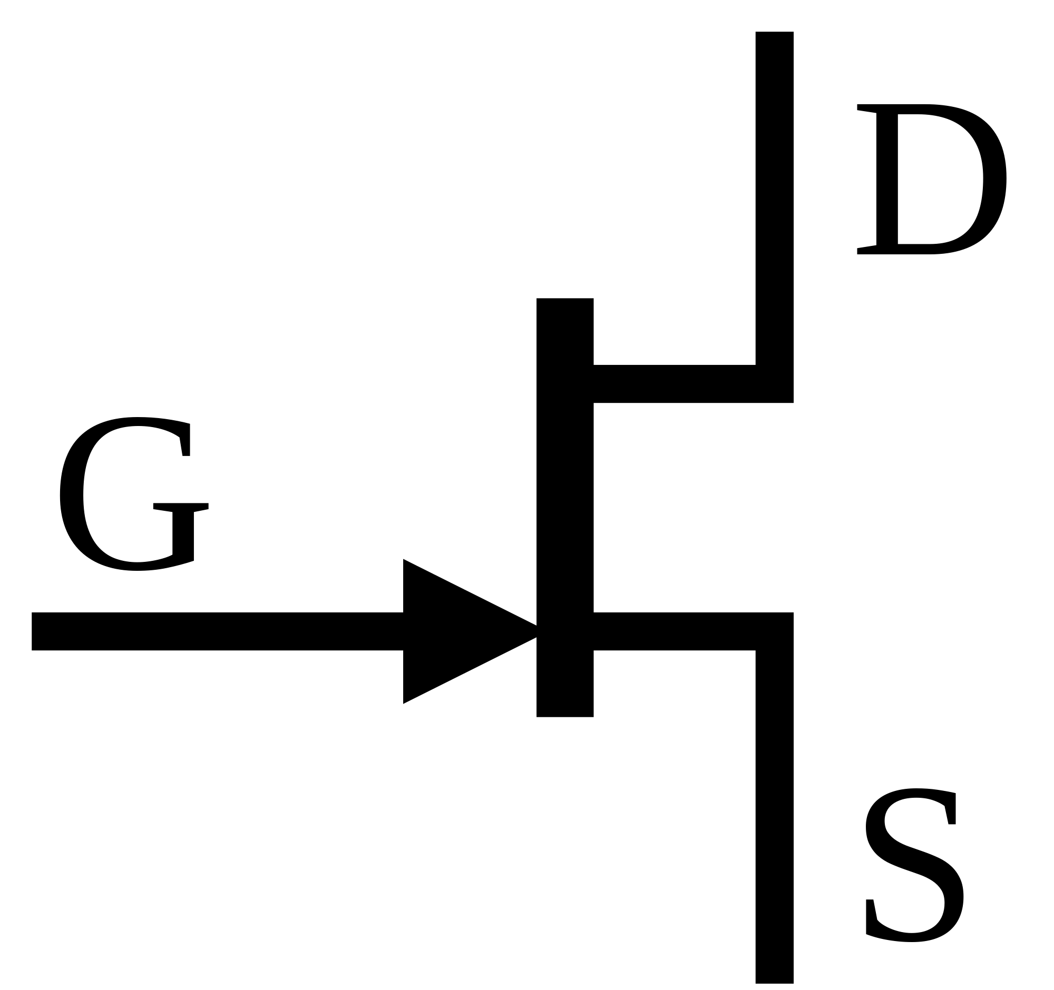
TOPIC 01
Field Effect Transistor
Concepts · mechanisms · process evidence · integration decisions
Semiconductor Device and Process Integration Masterclass · C605
© 2026 Tertiary Infotech Academy Pte Ltd
44
Notes:
[Sources]
- Legacy v5 source slide 51; embedded transition image(s) retained without stretching
[/Sources]

Slide 45

TOPIC 01
What is a Transistor
1
Transistor is like a water faucet. There are 3 modes
Transistor is like a water faucet. There are 3 modes
Semiconductor Device and Process Integration Masterclass · C605
© 2026 Tertiary Infotech Academy Pte Ltd
45
Notes:
[Sources]
- Legacy v5 source slides 52; content and embedded images retained and reflowed without stretching
[/Sources]

Slide 46
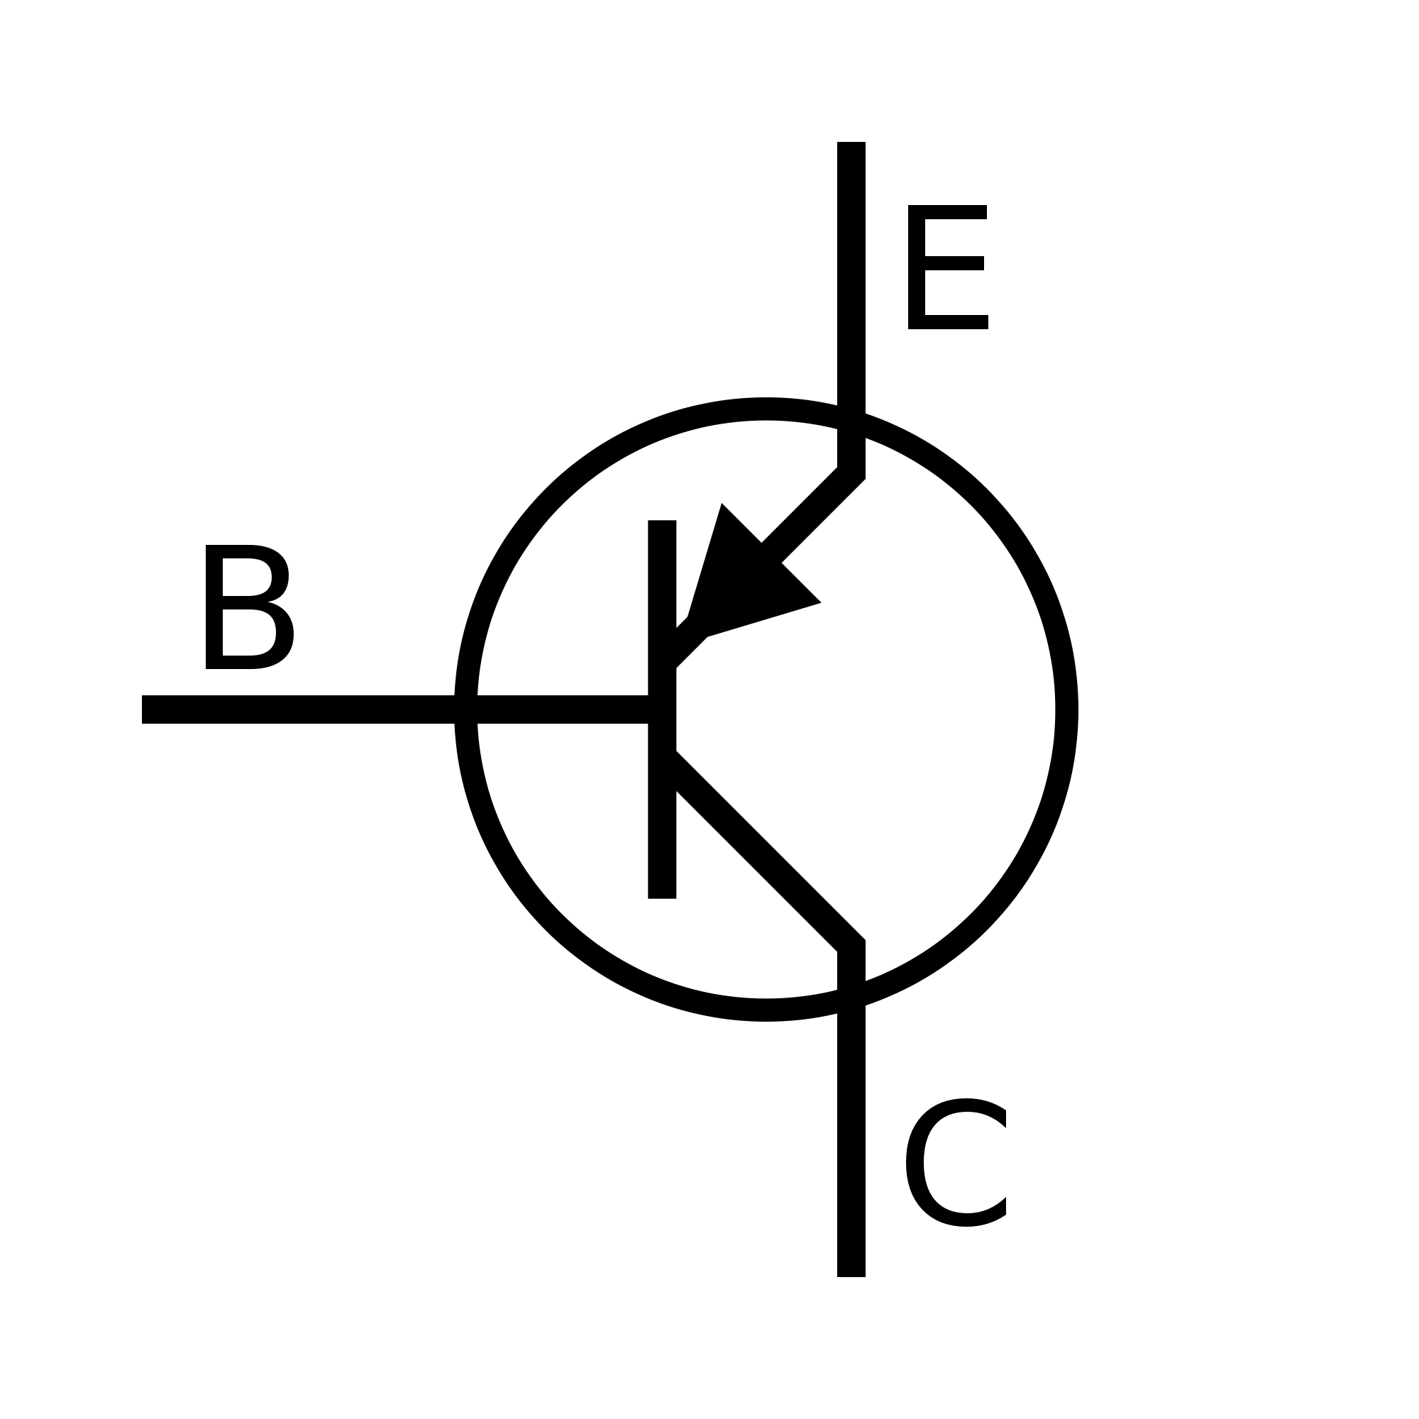
TOPIC 01
BJT and FET
1
Evidence 1
The base of BJT and the gate of FET acts like the valve.
They control the current flow
2
Current
Current
Semiconductor Device and Process Integration Masterclass · C605
© 2026 Tertiary Infotech Academy Pte Ltd
46
Notes:
[Sources]
- Legacy v5 source slides 53; content and embedded images retained and reflowed without stretching
[/Sources]

Slide 47
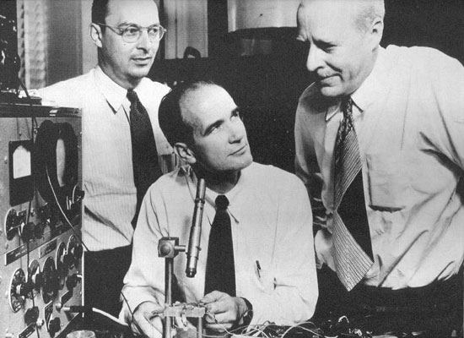

TOPIC 01
Who invented Solid State Transistor?
1
Evidence 1
Solid State Transistor was invented by John Bardeen, Walter Brattain and William Shockley at AT&T's Bell Labs in 1948
They were awarded the Nobel prize in Physics on 1956
Semiconductor Device and Process Integration Masterclass · C605
© 2026 Tertiary Infotech Academy Pte Ltd
47
Notes:
[Sources]
- Legacy v5 source slides 54, 55; content and embedded images retained and reflowed without stretching
[/Sources]

Slide 48
TOPIC 01
BJT and FET
1
There are two types of transistors
There are two types of transistors
Bipolar Junction Transistor (BJT)
Field Effect Transistor (FET)
2
BJT
BJT
(Collector)
(Source)
3
FET
FET
(Base)
(Gate)
4
(Emitter)
(Emitter)
(Drain)
Semiconductor Device and Process Integration Masterclass · C605
© 2026 Tertiary Infotech Academy Pte Ltd
48
Notes:
[Sources]
- Legacy v5 source slides 56; content and embedded images retained and reflowed without stretching
[/Sources]

Slide 49
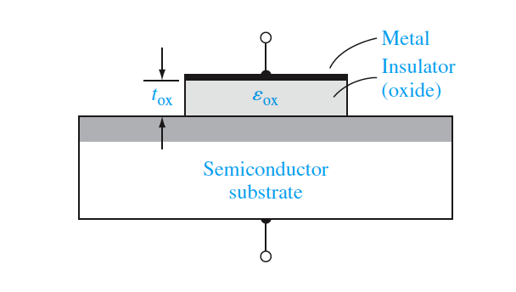
TOPIC 01
MOS Capacitor
1
Evidence 1
MOS structure can be understood using a parallel-plate capacitor model
Negative voltage on the top plate induces a negative charge, with positive charge on the bottom plate
An electric field is created between the plates
Capacitance per unit area: 𝐶 = 𝜖/𝑑
Charge per unit area: 𝑄 = 𝐶 × 𝑉
Semiconductor Device and Process Integration Masterclass · C605
© 2026 Tertiary Infotech Academy Pte Ltd
49
Notes:
[Sources]
- Legacy v5 source slides 57; content and embedded images retained and reflowed without stretching
[/Sources]

Slide 50
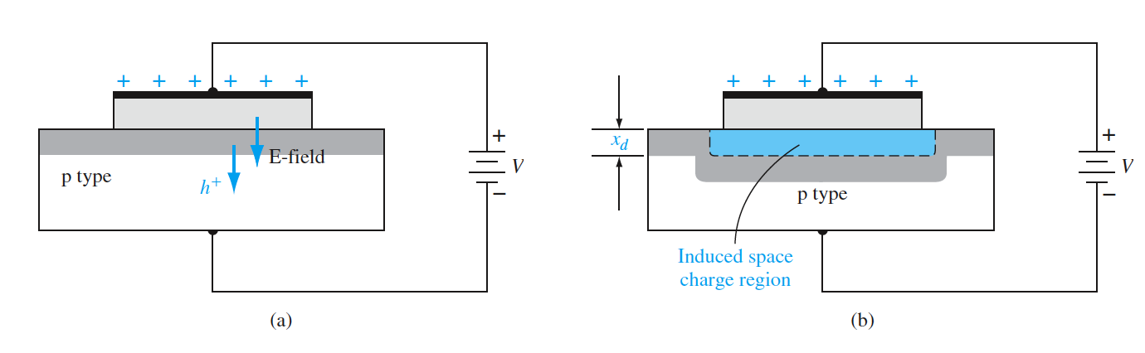
TOPIC 01
MOS Capacitor
1
Evidence 1
The MOS capacitor with a moderate positive gate bias, showing (a) the electric field and charge flow and (b) the induced space charge region.
Semiconductor Device and Process Integration Masterclass · C605
© 2026 Tertiary Infotech Academy Pte Ltd
50
Notes:
[Sources]
- Legacy v5 source slides 58; content and embedded images retained and reflowed without stretching
[/Sources]

Slide 51
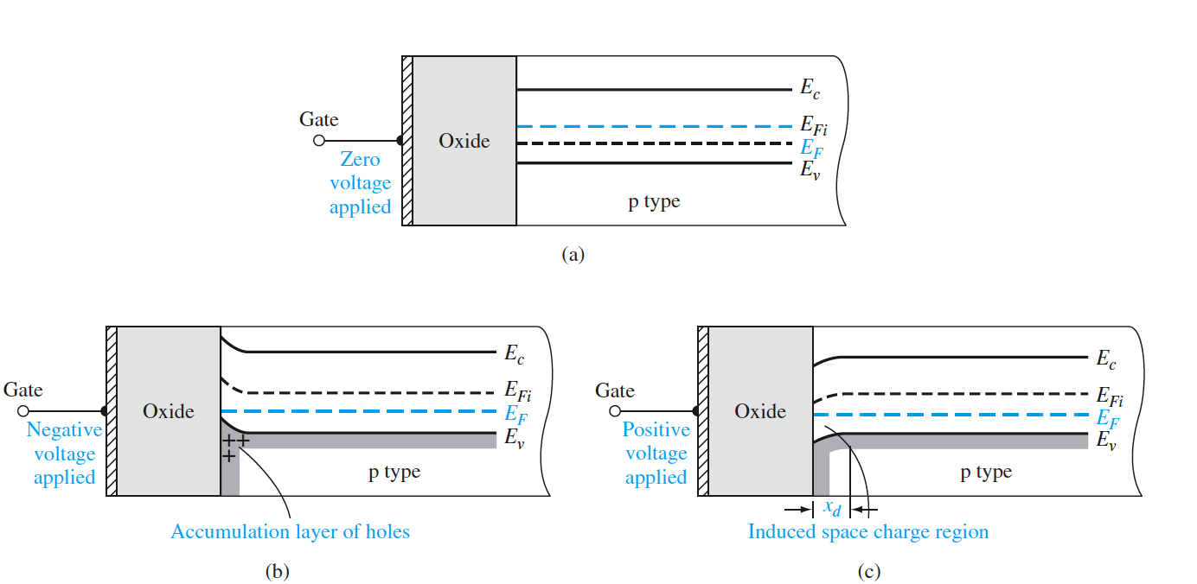
TOPIC 01
Applied Voltage on MOS Capacitor
1
Evidence 1
The energy-band diagram of a MOS capacitor with a p-type substrate for (a) a zero applied gate bias showing the ideal case, (b) a negative gate bias, and (c) a moderate positive gate bias.
Semiconductor Device and Process Integration Masterclass · C605
© 2026 Tertiary Infotech Academy Pte Ltd
51
Notes:
[Sources]
- Legacy v5 source slides 59; content and embedded images retained and reflowed without stretching
[/Sources]

Slide 52
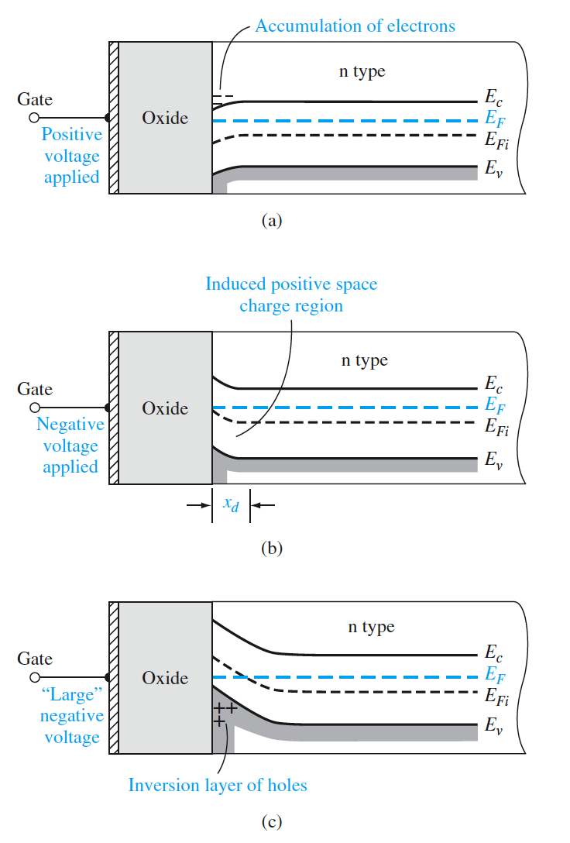
TOPIC 01
Applied Voltage on MOS Capacitor
1
Evidence 1
A larger positive voltage on the MOS capacitor gate increases the electric field and charge
Increased negative charge leads to more band bending and a larger space charge region
Surface inversion occurs: p-type surface becomes n-type due to band bending near the oxide interface
Positive gate voltage creates an electron inversion layer at the oxide–semiconductor interface
For an n-type substrate, a positive gate voltage induces an electron accumulation layer
A negative gate voltage on an n-type substrate induces a positive space charge region
Semiconductor Device and Process Integration Masterclass · C605
© 2026 Tertiary Infotech Academy Pte Ltd
52
Notes:
[Sources]
- Legacy v5 source slides 60; content and embedded images retained and reflowed without stretching
[/Sources]

Slide 53


TOPIC 01
Applied Voltage on MOS Capacitor
1
Vg > Vth -> Inversion
Vg > Vth -> Inversion
Semiconductor Device and Process Integration Masterclass · C605
© 2026 Tertiary Infotech Academy Pte Ltd
53
Notes:
[Sources]
- Legacy v5 source slides 61; content and embedded images retained and reflowed without stretching
[/Sources]

Slide 54


TOPIC 01
Inversion in MOSFET
1
Evidence 1
The surface Fermi level is symmetrically positioned relative to the intrinsic level, like in the bulk semiconductor
Electron concentration at the surface equals hole concentration in the bulk
This condition is called the threshold inversion point, with the applied gate voltage known as the threshold voltage
Beyond this threshold, the conduction band bends closer to the Fermi level, but only slightly changes with further gate voltage increase
Electron concentration at the surface increases exponentially with surface potential, while the space charge region width stabilizes near its maximum
Semiconductor Device and Process Integration Masterclass · C605
© 2026 Tertiary Infotech Academy Pte Ltd
54
Notes:
[Sources]
- Legacy v5 source slides 62; content and embedded images retained and reflowed without stretching
[/Sources]

Slide 55


TOPIC 01
Inversion in MOSFET
Semiconductor Device and Process Integration Masterclass · C605
© 2026 Tertiary Infotech Academy Pte Ltd
55
Notes:
[Sources]
- Legacy v5 source slides 63; content and embedded images retained and reflowed without stretching
[/Sources]

Slide 56


TOPIC 01
Threshold Voltage
1
Evidence 1
Threshold voltage is the gate voltage needed to reach the threshold inversion point
Semiconductor Device and Process Integration Masterclass · C605
© 2026 Tertiary Infotech Academy Pte Ltd
56
Notes:
[Sources]
- Legacy v5 source slides 64; content and embedded images retained and reflowed without stretching
[/Sources]

Slide 57

TOPIC 01
CV Characteristics
1
Evidence 1
Ideal low-frequency capacitance versus gate voltage of a MOS capacitor with a p-type substrate.
Semiconductor Device and Process Integration Masterclass · C605
© 2026 Tertiary Infotech Academy Pte Ltd
57
Notes:
[Sources]
- Legacy v5 source slides 65; content and embedded images retained and reflowed without stretching
[/Sources]

Slide 58

TOPIC 01
What is Field Effect Transistor
1
Evidence 1
Unlike BJT use current to control, Field Effect Transistor (FET) use electric field to control the current.
There are 2 types of FETs
JFET
MOSFET
Semiconductor Device and Process Integration Masterclass · C605
© 2026 Tertiary Infotech Academy Pte Ltd
58
Notes:
[Sources]
- Legacy v5 source slides 66; content and embedded images retained and reflowed without stretching
[/Sources]

Slide 59


TOPIC 01
Who invented FET?
1
Evidence 1
Metal-oxide-semiconductor field-effect transistor (MOSFET) are invented by Dawon Kahng and Martin M. (John) Atalla at Bell Labs in 1959
Semiconductor Device and Process Integration Masterclass · C605
© 2026 Tertiary Infotech Academy Pte Ltd
59
Notes:
[Sources]
- Legacy v5 source slides 67; content and embedded images retained and reflowed without stretching
[/Sources]

Slide 60


TOPIC 01
MOSFET Components
1
Source
Source
2
Drain
Drain
3
Gate
Gate
Semiconductor Device and Process Integration Masterclass · C605
© 2026 Tertiary Infotech Academy Pte Ltd
60
Notes:
[Sources]
- Legacy v5 source slides 68; content and embedded images retained and reflowed without stretching
[/Sources]

Slide 61

TOPIC 01
MOSFET Cross Section Structure
1
A typical n-channel MOSFET structure is shown below
A typical n-channel MOSFET structure is shown below
Semiconductor Device and Process Integration Masterclass · C605
© 2026 Tertiary Infotech Academy Pte Ltd
61
Notes:
[Sources]
- Legacy v5 source slides 69; content and embedded images retained and reflowed without stretching
[/Sources]

Slide 62


TOPIC 01
Types of MOSFET
1
There are four basic MOSFET device types.
There are four basic MOSFET device types.
2
n-channel enhancement mode MOSFET.
n-channel enhancement mode MOSFET.
3
n-channel depletion mode MOSFET.
n-channel depletion mode MOSFET.
Semiconductor Device and Process Integration Masterclass · C605
© 2026 Tertiary Infotech Academy Pte Ltd
62
Notes:
[Sources]
- Legacy v5 source slides 70; content and embedded images retained and reflowed without stretching
[/Sources]

Slide 63


TOPIC 01
Types of MOSFET
1
There are four basic MOSFET device types.
There are four basic MOSFET device types.
2
p-channel enhancement mode MOSFET.
p-channel enhancement mode MOSFET.
3
p-channel depletion mode MOSFET.
p-channel depletion mode MOSFET.
Semiconductor Device and Process Integration Masterclass · C605
© 2026 Tertiary Infotech Academy Pte Ltd
63
Notes:
[Sources]
- Legacy v5 source slides 71; content and embedded images retained and reflowed without stretching
[/Sources]

Slide 64

TOPIC 01
Enhancement Mode MOSFET
1
When VGS > Vth, the channel is turned on
When VGS > Vth, the channel is turned on
When VGS < Vth, the channel is turned off
Semiconductor Device and Process Integration Masterclass · C605
© 2026 Tertiary Infotech Academy Pte Ltd
64
Notes:
[Sources]
- Legacy v5 source slides 72; content and embedded images retained and reflowed without stretching
[/Sources]

Slide 65

TOPIC 01
Enhancement Mode MOSFET
1
When VGS > Vth, the channel is turned on
When VGS > Vth, the channel is turned on
When VGS < Vth, the channel is turned off
Semiconductor Device and Process Integration Masterclass · C605
© 2026 Tertiary Infotech Academy Pte Ltd
65
Notes:
[Sources]
- Legacy v5 source slides 73; content and embedded images retained and reflowed without stretching
[/Sources]

Slide 66


TOPIC 01
Drain Current Equation
1
There are 3 operating region of MOSFET
There are 3 operating region of MOSFET
Off Region (ID = 0)
Linear Region (ID < IDsat)
Saturation Region (ID = IDsat)
Semiconductor Device and Process Integration Masterclass · C605
© 2026 Tertiary Infotech Academy Pte Ltd
66
Notes:
[Sources]
- Legacy v5 source slides 74; content and embedded images retained and reflowed without stretching
[/Sources]

Slide 67

TOPIC 01
IV Characteristics of n-channel MOSFET
Semiconductor Device and Process Integration Masterclass · C605
© 2026 Tertiary Infotech Academy Pte Ltd
67
Notes:
[Sources]
- Legacy v5 source slides 75; content and embedded images retained and reflowed without stretching
[/Sources]

Slide 68

TOPIC 01
Activity: MOSFET
1
Try the MOSFET calculator below
Try the MOSFET calculator below
https://cleanroom.byu.edu/mosfet_calc
Semiconductor Device and Process Integration Masterclass · C605
© 2026 Tertiary Infotech Academy Pte Ltd
68
Notes:
[Sources]
- Legacy v5 source slides 76; content and embedded images retained and reflowed without stretching
[/Sources]

Slide 69

TOPIC 01
Substrate Bias Effects
1
Evidence 1
When a reverse-biased 𝑉𝑆𝐵>0 is applied, the space charge region width under the oxide increases from the original 𝑥𝑑𝑇
More charge accumulates in the space charge region due to the reverse bias
To maintain charge neutrality, the positive charge on the gate must increase to compensate for the increased negative space charge
As a result, the threshold voltage of the n-channel MOSFET increases when 𝑉𝑆𝐵>0
Semiconductor Device and Process Integration Masterclass · C605
© 2026 Tertiary Infotech Academy Pte Ltd
69
Notes:
[Sources]
- Legacy v5 source slides 77; content and embedded images retained and reflowed without stretching
[/Sources]

Slide 70

TOPIC 01
MOSFET Design
1
Evidence 1
To design a MOSFET, you have to consider the following 2 key parameters
Gate oxide thickness Tox
Channel Length Lg
Semiconductor Device and Process Integration Masterclass · C605
© 2026 Tertiary Infotech Academy Pte Ltd
70
Notes:
[Sources]
- Legacy v5 source slides 78; content and embedded images retained and reflowed without stretching
[/Sources]

Slide 71

TOPIC 01
Tox and Lg Scaling
Semiconductor Device and Process Integration Masterclass · C605
© 2026 Tertiary Infotech Academy Pte Ltd
71
Notes:
[Sources]
- Legacy v5 source slides 79; content and embedded images retained and reflowed without stretching
[/Sources]

Slide 72

TOPIC 01
Use MOSFET as a Switch
1
Evidence 1
MOSFET is used widely as a switch by simply control the gate voltage
Semiconductor Device and Process Integration Masterclass · C605
© 2026 Tertiary Infotech Academy Pte Ltd
72
Notes:
[Sources]
- Legacy v5 source slides 80; content and embedded images retained and reflowed without stretching
[/Sources]

Slide 73

TOPIC 01
Use MOSFET as Amplifier
1
Evidence 1
Similar to BJT, MOSFET can also be used as amplifier operating in the linear mode
Semiconductor Device and Process Integration Masterclass · C605
© 2026 Tertiary Infotech Academy Pte Ltd
73
Notes:
[Sources]
- Legacy v5 source slides 81; content and embedded images retained and reflowed without stretching
[/Sources]

Slide 74

TOPIC 01
CMOS
1
Evidence 1
Complementary MOS (CMOS) consists of both NMOSFET and PMOSFET.
Semiconductor Device and Process Integration Masterclass · C605
© 2026 Tertiary Infotech Academy Pte Ltd
74
Notes:
[Sources]
- Legacy v5 source slides 82; content and embedded images retained and reflowed without stretching
[/Sources]

Slide 75

TOPIC 01
Use CMOS as Inverter
1
CMOS is used widely in inverter.
CMOS is used widely in inverter.
input = 1 -> output = 0
input = 0 -> output= 1
Semiconductor Device and Process Integration Masterclass · C605
© 2026 Tertiary Infotech Academy Pte Ltd
75
Notes:
[Sources]
- Legacy v5 source slides 83; content and embedded images retained and reflowed without stretching
[/Sources]

Slide 76

TOPIC 01
Logic Gates
1
Logic gates can be formed by CMOS inverters
Logic gates can be formed by CMOS inverters
All the calculator or computers are using logic gates
Semiconductor Device and Process Integration Masterclass · C605
© 2026 Tertiary Infotech Academy Pte Ltd
76
Notes:
[Sources]
- Legacy v5 source slides 84; content and embedded images retained and reflowed without stretching
[/Sources]

Slide 77
TOPIC 01
Bipolar Junction Transistors
Concepts · mechanisms · process evidence · integration decisions
Semiconductor Device and Process Integration Masterclass · C605
© 2026 Tertiary Infotech Academy Pte Ltd
77
Notes:
[Sources]
- Legacy v5 source slide 85; embedded transition image(s) retained without stretching
[/Sources]

Slide 78

TOPIC 01
Bipolar transistor
1
Evidence 1
Bipolar transistors have three doped regions: emitter, base, and collector
Two pn junctions are present in both npn and pnp transistors
Base width is small relative to the minority carrier diffusion length
Emitter has the highest doping concentration, and the collector has the lowest
Narrow base and doping levels are key to transistor operation
Concepts from pn junction theory apply to bipolar transistors
Semiconductor Device and Process Integration Masterclass · C605
© 2026 Tertiary Infotech Academy Pte Ltd
78
Notes:
[Sources]
- Legacy v5 source slides 86; content and embedded images retained and reflowed without stretching
[/Sources]

Slide 79
TOPIC 01
NPN and PNP BJT
1
There are two types of BJT transistors
2
N-Type
3
P-Type
There are two types of BJT transistors
NPN BJT
PNP BJT
N-Type
P-Type
Semiconductor Device and Process Integration Masterclass · C605
© 2026 Tertiary Infotech Academy Pte Ltd
79
Notes:
[Sources]
- Legacy v5 source slides 87; content and embedded images retained and reflowed without stretching
[/Sources]

Slide 80

TOPIC 01
NPN BJT Symbol
1
Evidence 1
There are 3 terminals to the NPN transistor - Base, Emitter and Collector.
Current flow from collector to emitter.
2
N-Type
N-Type
Emitter
3
P-Type
P-Type
Base
4
Collector
Collector
Semiconductor Device and Process Integration Masterclass · C605
© 2026 Tertiary Infotech Academy Pte Ltd
80
Notes:
[Sources]
- Legacy v5 source slides 88; content and embedded images retained and reflowed without stretching
[/Sources]

Slide 81


TOPIC 01
NPN Transistor Component
Semiconductor Device and Process Integration Masterclass · C605
© 2026 Tertiary Infotech Academy Pte Ltd
81
Notes:
[Sources]
- Legacy v5 source slides 89; content and embedded images retained and reflowed without stretching
[/Sources]

Slide 82

TOPIC 01
Cross Section of Bipolar transistor
1
Evidence 1
Cross section of (a) a conventional integrated circuit npn bipolar transistor and (b) an oxide-isolated npn bipolar transistor.
Semiconductor Device and Process Integration Masterclass · C605
© 2026 Tertiary Infotech Academy Pte Ltd
82
Notes:
[Sources]
- Legacy v5 source slides 90; content and embedded images retained and reflowed without stretching
[/Sources]

Slide 83

TOPIC 01
Basic Principle of Operation
1
Evidence 1
Idealized doping profile of a uniformly doped npn bipolar transistor.
Semiconductor Device and Process Integration Masterclass · C605
© 2026 Tertiary Infotech Academy Pte Ltd
83
Notes:
[Sources]
- Legacy v5 source slides 91; content and embedded images retained and reflowed without stretching
[/Sources]

Slide 84


TOPIC 01
Basic Principle of Operation
1
Evidence 1
(a) Biasing of an npn bipolar transistor in the forward-active mode, (b) minority carrier distribution in an npn bipolar transistor operating in the forward-active mode
Semiconductor Device and Process Integration Masterclass · C605
© 2026 Tertiary Infotech Academy Pte Ltd
84
Notes:
[Sources]
- Legacy v5 source slides 92; content and embedded images retained and reflowed without stretching
[/Sources]

Slide 85

TOPIC 01
Basic Operation of BJT
Semiconductor Device and Process Integration Masterclass · C605
© 2026 Tertiary Infotech Academy Pte Ltd
85
Notes:
[Sources]
- Legacy v5 source slides 93; content and embedded images retained and reflowed without stretching
[/Sources]

Slide 86
TOPIC 01
Basic Operation of BJT
In the forward-active mode, the base-emitter (B–E) junction is forward biased, allowing electrons (for an NPN transistor) or holes (for a PNP transistor) to flow from the emitter into the base. This results in the injection of a large number of majority carriers (electrons in NPN, holes in PNP) from the emitter across the B–E junction into the base.
Once these carriers enter the base, they become minority carriers (electrons in a P-type base, or holes in an N-type base) and create an excess concentration of minority carriers. The base is designed to be thin and lightly doped, allowing most of these carriers to diffuse across the base toward the base-collector (B–C) junction.
The B–C junction is reverse biased, which creates a strong electric field that rapidly sweeps the minority carriers (electrons or holes) from the base into the collector.
Semiconductor Device and Process Integration Masterclass · C605
© 2026 Tertiary Infotech Academy Pte Ltd
86
Notes:
[Sources]
- Legacy v5 source slides 94; content and embedded images retained and reflowed without stretching
[/Sources]

Slide 87

TOPIC 01
Basic Principle of BJT
1
Evidence 1
Energy-band diagram of the npn bipolar transistor under zero bias and under a forward-active mode bias.
Semiconductor Device and Process Integration Masterclass · C605
© 2026 Tertiary Infotech Academy Pte Ltd
87
Notes:
[Sources]
- Legacy v5 source slides 95; content and embedded images retained and reflowed without stretching
[/Sources]

Slide 88

TOPIC 01
Minority carrier distributions for BJT
1
Evidence 1
Minority carrier distributions and basic currents in a
forward-biased npn bipolar transistor.
Semiconductor Device and Process Integration Masterclass · C605
© 2026 Tertiary Infotech Academy Pte Ltd
88
Notes:
[Sources]
- Legacy v5 source slides 96; content and embedded images retained and reflowed without stretching
[/Sources]

Slide 89


TOPIC 01
IV Characteristics of BJT
1
Evidence 1
An npn bipolar transistor in a common-emitter circuit configuration. Bipolar transistor common-emitter current–voltage
characteristics with load line superimposed
Semiconductor Device and Process Integration Masterclass · C605
© 2026 Tertiary Infotech Academy Pte Ltd
89
Notes:
[Sources]
- Legacy v5 source slides 97; content and embedded images retained and reflowed without stretching
[/Sources]

Slide 90


TOPIC 01
Active Mode (Linear Region)
1
Evidence 1
When VBE ~0.7V, BE junction is short circuited, the transistor is in ACTIVE mode
Semiconductor Device and Process Integration Masterclass · C605
© 2026 Tertiary Infotech Academy Pte Ltd
90
Notes:
[Sources]
- Legacy v5 source slides 98; content and embedded images retained and reflowed without stretching
[/Sources]

Slide 91


TOPIC 01
Active Mode (Linear Region)
1
1mA
1mA
2
100mA
100mA
3
99mA
99mA
Semiconductor Device and Process Integration Masterclass · C605
© 2026 Tertiary Infotech Academy Pte Ltd
91
Notes:
[Sources]
- Legacy v5 source slides 99; content and embedded images retained and reflowed without stretching
[/Sources]

Slide 92
TOPIC 01
Saturation Mode
1
Key idea 1
There is a maximum collector current Ic can flow. Once Ic reach the maximum, the transistor is in the saturation mode or short circuit mode.
Current flows freely from collector to emitter like a resistor.
Ideally VCE = 0V. In reality, VCE(Sat) ~ 0.2V
VB > VC>VE
Semiconductor Device and Process Integration Masterclass · C605
© 2026 Tertiary Infotech Academy Pte Ltd
92
Notes:
[Sources]
- Legacy v5 source slides 100; content and embedded images retained and reflowed without stretching
[/Sources]

Slide 93

TOPIC 01
Breakdown Voltage
1
Evidence 1
Energy-band diagram of an npn bipolar transistor (a) in thermal equilibrium, and (b) with a reverse-biased B–C voltage before punch-through, VR1, and after punch-through, VR2.
Semiconductor Device and Process Integration Masterclass · C605
© 2026 Tertiary Infotech Academy Pte Ltd
93
Notes:
[Sources]
- Legacy v5 source slides 101; content and embedded images retained and reflowed without stretching
[/Sources]

Slide 94


TOPIC 01
Breakdown Voltage
1
Evidence 1
Relative breakdown voltages and saturation currents of the open-base and open-emitter configurations.
Semiconductor Device and Process Integration Masterclass · C605
© 2026 Tertiary Infotech Academy Pte Ltd
94
Notes:
[Sources]
- Legacy v5 source slides 102; content and embedded images retained and reflowed without stretching
[/Sources]

Slide 95

TOPIC 01
Use BJT as a Switch
1
BJT is used widely as a switch
BJT is used widely as a switch
ON - Saturation Mode
OFF - Cutoff Mode
Eg: Use BJT to drive a higher voltage needed for a motor to turn
Semiconductor Device and Process Integration Masterclass · C605
© 2026 Tertiary Infotech Academy Pte Ltd
95
Notes:
[Sources]
- Legacy v5 source slides 103; content and embedded images retained and reflowed without stretching
[/Sources]

Slide 96

TOPIC 01
Use BJT as Amplifier
1
Evidence 1
You can use BJT as a amplifier when operating the BJT in the active mode
There are 3 configuration
Common Emitter
Common Collector
Common Base
Semiconductor Device and Process Integration Masterclass · C605
© 2026 Tertiary Infotech Academy Pte Ltd
96
Notes:
[Sources]
- Legacy v5 source slides 104; content and embedded images retained and reflowed without stretching
[/Sources]

Slide 97

TOPIC 01
Common Emitter NPN Amplifier
1
Evidence 1
A typical common emitter NPN amplifier is shown below
Semiconductor Device and Process Integration Masterclass · C605
© 2026 Tertiary Infotech Academy Pte Ltd
97
Notes:
[Sources]
- Legacy v5 source slides 105; content and embedded images retained and reflowed without stretching
[/Sources]

Slide 98

TOPIC 01
Memory Devices and Integrated Circuits
Concepts · mechanisms · process evidence · integration decisions
Semiconductor Device and Process Integration Masterclass · C605
© 2026 Tertiary Infotech Academy Pte Ltd
98
Notes:
[Sources]
- Legacy v5 source slide 106; embedded transition image(s) retained without stretching
[/Sources]

Slide 99

TOPIC 01
Memory in CPU
Semiconductor Device and Process Integration Masterclass · C605
© 2026 Tertiary Infotech Academy Pte Ltd
99
Notes:
[Sources]
- Legacy v5 source slides 107; content and embedded images retained and reflowed without stretching
[/Sources]

Slide 100

TOPIC 01
Dynamic RAM (DRAM)
Semiconductor Device and Process Integration Masterclass · C605
© 2026 Tertiary Infotech Academy Pte Ltd
100
Notes:
[Sources]
- Legacy v5 source slides 108; content and embedded images retained and reflowed without stretching
[/Sources]

Slide 101

TOPIC 01
Basic Concepts of Memory
1
Write '0' and '1' to an element
Write '0' and '1' to an element
Read '0' and '1' from an element
Semiconductor Device and Process Integration Masterclass · C605
© 2026 Tertiary Infotech Academy Pte Ltd
101
Notes:
[Sources]
- Legacy v5 source slides 109; content and embedded images retained and reflowed without stretching
[/Sources]

Slide 102

TOPIC 01
Memory Chip
1
Evidence 1
A typical memory chip consist of memory cell array, row decoder, and column decoder, and sense amplifiers
Semiconductor Device and Process Integration Masterclass · C605
© 2026 Tertiary Infotech Academy Pte Ltd
102
Notes:
[Sources]
- Legacy v5 source slides 110; content and embedded images retained and reflowed without stretching
[/Sources]

Slide 103

TOPIC 01
Memory Cell Array
Semiconductor Device and Process Integration Masterclass · C605
© 2026 Tertiary Infotech Academy Pte Ltd
103
Notes:
[Sources]
- Legacy v5 source slides 111; content and embedded images retained and reflowed without stretching
[/Sources]

Slide 104
TOPIC 01
Type of Memory Devices
1
Memory Devices
2
Read Only Memory (ROM)
3
Random Access Memory (RAM)
4
DRAM
Memory Devices
ROM
EEPROM
Read Only Memory (ROM)
Random Access Memory (RAM)
DRAM
SRAM
NOR Flash
NAND Flash
Semiconductor Device and Process Integration Masterclass · C605
© 2026 Tertiary Infotech Academy Pte Ltd
104
Notes:
[Sources]
- Legacy v5 source slides 112; content and embedded images retained and reflowed without stretching
[/Sources]

Slide 105




TOPIC 01
Memory Components
1
SRAM
SRAM
2
Flash
Flash
3
EEPROM
EEPROM
4
DRAM
DRAM
Semiconductor Device and Process Integration Masterclass · C605
© 2026 Tertiary Infotech Academy Pte Ltd
105
Notes:
[Sources]
- Legacy v5 source slides 113; content and embedded images retained and reflowed without stretching
[/Sources]

Slide 106


TOPIC 01
DRAM vs SRAM
1
DRAM
DRAM
2
SRAM
SRAM
Semiconductor Device and Process Integration Masterclass · C605
© 2026 Tertiary Infotech Academy Pte Ltd
106
Notes:
[Sources]
- Legacy v5 source slides 114; content and embedded images retained and reflowed without stretching
[/Sources]

Slide 107
TOPIC 01
How DRAM Work?
1
When writing, the WL will turn on the M1.
When writing, the WL will turn on the M1.
The BL will write a "0" or "1" to the capacitor
When reading, the sense-amplifier determines the level of charge in the capacitor
Semiconductor Device and Process Integration Masterclass · C605
© 2026 Tertiary Infotech Academy Pte Ltd
107
Notes:
[Sources]
- Legacy v5 source slides 115; content and embedded images retained and reflowed without stretching
[/Sources]

Slide 108
TOPIC 01
How SRAM Work?
1
Evidence 1
When the cell is selected, the value to be written is stored in the cross-coupled flip-flops.
Most SRAM memories select an entire row of cells at a time, and read out the contents of all the cells in the row along the column lines.
Semiconductor Device and Process Integration Masterclass · C605
© 2026 Tertiary Infotech Academy Pte Ltd
108
Notes:
[Sources]
- Legacy v5 source slides 116; content and embedded images retained and reflowed without stretching
[/Sources]

Slide 109

TOPIC 01
Fuse ROM vs EEPROM
1
Fuse ROM
Fuse ROM
2
EEPROM
EEPROM
Semiconductor Device and Process Integration Masterclass · C605
© 2026 Tertiary Infotech Academy Pte Ltd
109
Notes:
[Sources]
- Legacy v5 source slides 117; content and embedded images retained and reflowed without stretching
[/Sources]

Slide 110

TOPIC 01
Floating Gate Transistor
1
Evidence 1
A floating gate transistor can be used for storing charges
EEPROM and Flash use floating gate transistors
Semiconductor Device and Process Integration Masterclass · C605
© 2026 Tertiary Infotech Academy Pte Ltd
110
Notes:
[Sources]
- Legacy v5 source slides 118; content and embedded images retained and reflowed without stretching
[/Sources]

Slide 111

TOPIC 01
NOR vs NAND Flash Architecture
Semiconductor Device and Process Integration Masterclass · C605
© 2026 Tertiary Infotech Academy Pte Ltd
111
Notes:
[Sources]
- Legacy v5 source slides 119; content and embedded images retained and reflowed without stretching
[/Sources]

Slide 112

TOPIC 01
Introduction to process modules
Concepts · mechanisms · process evidence · integration decisions
Semiconductor Device and Process Integration Masterclass · C605
© 2026 Tertiary Infotech Academy Pte Ltd
112
Notes:
[Sources]
- Legacy v5 source slide 120
- OpenAI ImageGen local asset: wafer-fabrication-hero-v2.png
[/Sources]

Slide 113


TOPIC 01
Integrated Circuit
1
Evidence 1
Integrated circuits (ICs) are semiconductor devices that made up of all the active and passive components in a silicon chip.
Semiconductor Device and Process Integration Masterclass · C605
© 2026 Tertiary Infotech Academy Pte Ltd
113
Notes:
[Sources]
- Legacy v5 source slides 121; content and embedded images retained and reflowed without stretching
[/Sources]

Slide 114


TOPIC 01
Moore’s Law
Semiconductor Device and Process Integration Masterclass · C605
© 2026 Tertiary Infotech Academy Pte Ltd
114
Notes:
[Sources]
- Legacy v5 source slides 122, 123; content and embedded images retained and reflowed without stretching
[/Sources]

Slide 115


TOPIC 01
Wafer Fabrication
Chips are built in huge factories called fabs consisting of clean rooms
Semiconductor Device and Process Integration Masterclass · C605
© 2026 Tertiary Infotech Academy Pte Ltd
115
Notes:
[Sources]
- Legacy v5 source slide 124; embedded transition image(s) retained without stretching
[/Sources]

Slide 116


TOPIC 01
Growing Silicon Wafers
1
Evidence 1
Czochralski method used for growing single-crystal materials
Seed crystal contacts liquid phase and is slowly pulled from the melt
Solidification occurs at the solid–liquid interface
Crystal is rotated during pulling for uniform temperature
Impurity atoms (e.g., boron, phosphorus) can be added for intentional doping
Produces a silicon ingot (boule)
Semiconductor Device and Process Integration Masterclass · C605
© 2026 Tertiary Infotech Academy Pte Ltd
116
Notes:
[Sources]
- Legacy v5 source slides 126, 125; content and embedded images retained and reflowed without stretching
[/Sources]

Slide 117
TOPIC 01
Growing Silicon Wafers
1
Key idea 1
Czochralski method used for growing single-crystal materials
Seed crystal contacts liquid phase and is slowly pulled from the melt
Solidification occurs at the solid–liquid interface
Crystal is rotated during pulling for uniform temperature
Impurity atoms (e.g., boron, phosphorus) can be added for intentional doping
Produces a silicon ingot (boule)
Semiconductor Device and Process Integration Masterclass · C605
© 2026 Tertiary Infotech Academy Pte Ltd
117
Notes:
[Sources]
- Legacy v5 source slides 127; content and embedded images retained and reflowed without stretching
[/Sources]

Slide 118
TOPIC 01
Thermal Oxidation
Silicon ICs succeed due to the excellent native oxide (SiO2) formed on silicon
SiO2 used as gate and field insulator in MOSFETs
Metal interconnects placed on top of field oxide
Most semiconductors lack high-quality native oxides for device fabrication
Silicon oxidizes at room temperature, forming a thin oxide (25 Å thick)
Oxidation accelerated at high temperatures for oxygen diffusion to the silicon surface
44% of the final oxide thickness comes from consumed silicon
Semiconductor Device and Process Integration Masterclass · C605
© 2026 Tertiary Infotech Academy Pte Ltd
118
Notes:
[Sources]
- Legacy v5 source slides 128; content and embedded images retained and reflowed without stretching
[/Sources]

Slide 119


TOPIC 01
Thermal Oxidation Process
Semiconductor Device and Process Integration Masterclass · C605
© 2026 Tertiary Infotech Academy Pte Ltd
119
Notes:
[Sources]
- Legacy v5 source slides 129; content and embedded images retained and reflowed without stretching
[/Sources]

Slide 120

TOPIC 01
Vertical Tube Furnaces
1
Evidence 1
Horizontal tube furnaces are preferred for larger-diameter wafers but present challenges, such as maintaining laminar gas flow to ensure uniform reactions.
To address these issues, vertical tube furnaces (VTFs) have become the preferred choice for high-production processes with large wafers. In VTFs, the tube is positioned vertically, with loading from the top or bottom, while using similar materials and heating systems as horizontal furnaces.
Semiconductor Device and Process Integration Masterclass · C605
© 2026 Tertiary Infotech Academy Pte Ltd
120
Notes:
[Sources]
- Legacy v5 source slides 130; content and embedded images retained and reflowed without stretching
[/Sources]

Slide 121


TOPIC 01
Vertical Tube Furnaces
Semiconductor Device and Process Integration Masterclass · C605
© 2026 Tertiary Infotech Academy Pte Ltd
121
Notes:
[Sources]
- Legacy v5 source slides 131; content and embedded images retained and reflowed without stretching
[/Sources]

Slide 122

TOPIC 01
Dry Oxidation
1
Evidence 1
Dry oxidation has a lower growth rate than wet oxidation, yet it has better oxide film quality. Therefore, thin oxides such as screen, pad, and especially gate oxides, use a dry oxidation process.
Semiconductor Device and Process Integration Masterclass · C605
© 2026 Tertiary Infotech Academy Pte Ltd
122
Notes:
[Sources]
- Legacy v5 source slides 132; content and embedded images retained and reflowed without stretching
[/Sources]

Slide 123

TOPIC 01
Wafer Warping
1
Evidence 1
Larger-diameter wafers are prone to warping due to different expansion rates of silicon and silicon dioxide, especially at high temperatures above 1150°C. Two methods help minimize warping:
Ramping: Wafers are inserted at a lower temperature, then gradually heated to the process level and cooled before removal.
Slow loading: Wafers are loaded at 1 inch per minute to reduce warping.
For large wafers, both methods are used, though slow loading extends process time. Vertical tube furnaces mitigate this issue.
Semiconductor Device and Process Integration Masterclass · C605
© 2026 Tertiary Infotech Academy Pte Ltd
123
Notes:
[Sources]
- Legacy v5 source slides 133; content and embedded images retained and reflowed without stretching
[/Sources]

Slide 124

TOPIC 01
Temperature Control System
1
Evidence 1
The temperature control system uses thermocouples connected to proportional band controllers to regulate the power fed to heating coils.
The system adjusts power based on the deviation from the set-point temperature, providing more power when further from the target and less as it approaches.
This allows for rapid temperature recovery without overshoot (when the temperature exceeds the desired level due to excessive power).
Controllers are fine-tuned to maintain the desired temperature in the processing section of the tube.
Semiconductor Device and Process Integration Masterclass · C605
© 2026 Tertiary Infotech Academy Pte Ltd
124
Notes:
[Sources]
- Legacy v5 source slides 134; content and embedded images retained and reflowed without stretching
[/Sources]

Slide 125

TOPIC 01
Rapid Thermal Process (RTP)
1
Evidence 1
Ion implantation requires annealing to repair crystal damage, traditionally done in tube furnaces, but this can lead to unwanted dopant spreading. Rapid Thermal Process (RTP) technology was developed to address this.
RTP uses radiation heating, typically from tungsten halogen lamps, to heat the wafer surface quickly to 800–1050°C at rates of 50–100°C per second.
Unlike tube furnaces, RTP achieves high temperatures in seconds and cools rapidly.
The short heating time limits wafer-wide heating, allowing crystal damage to be repaired without causing dopant diffusion.
Semiconductor Device and Process Integration Masterclass · C605
© 2026 Tertiary Infotech Academy Pte Ltd
125
Notes:
[Sources]
- Legacy v5 source slides 135; content and embedded images retained and reflowed without stretching
[/Sources]

Slide 126


TOPIC 01
Rapid Thermal Process (RTP)
Semiconductor Device and Process Integration Masterclass · C605
© 2026 Tertiary Infotech Academy Pte Ltd
126
Notes:
[Sources]
- Legacy v5 source slides 136; content and embedded images retained and reflowed without stretching
[/Sources]

Slide 127
TOPIC 01
Preoxidation Wafer Cleaning
Surface cleaning before oxidation involves mechanical scrubbing, RCA wet-cleaning, and an HF etch (HF-last process) to remove contaminants and native oxides.
Steam is used for oxides >1200 Å, while pure oxygen is used for thinner oxides (<1200 Å) for better control and density.
Thin MOS gate oxides are grown at 900°C, sometimes in a wet oxygen environment at reduced pressure to reduce process time.
Chlorine improves cleanliness and performance when incorporated into the oxidation process.
Dry nitrogen is used to terminate the oxidation by removing the oxidant.
Semiconductor Device and Process Integration Masterclass · C605
© 2026 Tertiary Infotech Academy Pte Ltd
127
Notes:
[Sources]
- Legacy v5 source slides 137; content and embedded images retained and reflowed without stretching
[/Sources]

Slide 128


TOPIC 01
Rapid Thermal Process (RTP)
1
Evidence 1
RTP (Rapid Thermal Processing) reduces the thermal budget in wafer processing by minimizing the time wafers are exposed to high temperatures, which limits dopant diffusion and crystal dislocations.
Semiconductor Device and Process Integration Masterclass · C605
© 2026 Tertiary Infotech Academy Pte Ltd
128
Notes:
[Sources]
- Legacy v5 source slides 138; content and embedded images retained and reflowed without stretching
[/Sources]

Slide 129

TOPIC 01
Application of RTP in SDE
Semiconductor Device and Process Integration Masterclass · C605
© 2026 Tertiary Infotech Academy Pte Ltd
129
Notes:
[Sources]
- Legacy v5 source slides 139; content and embedded images retained and reflowed without stretching
[/Sources]

Slide 130

TOPIC 01
Advantages of RTP
1
Evidence 1
Reduced dopant spreading: Less time at high temperatures enables denser designs.
Fewer dislocations: Fewer heating/cooling cycles minimize crystal damage.
Single-wafer processing: Enhances uniformity, especially for larger wafers.
RTP for thin oxides: Ideal for MOS gates with shrinking feature sizes and thinner layers.
RTO systems: Offer precise control for ultra-thin oxides (as thin as 10 Å), unlike conventional furnaces, which struggle with slower temperature changes and oxygen control.
Semiconductor Device and Process Integration Masterclass · C605
© 2026 Tertiary Infotech Academy Pte Ltd
130
Notes:
[Sources]
- Legacy v5 source slides 140; content and embedded images retained and reflowed without stretching
[/Sources]

Slide 131

TOPIC 01
Photolithography
Photolithography: Creating circuits using photomasks and UV light.
Photomask: Contains opaque regions blocking UV.
Photoresist: Polymer on semiconductor surface, changes with UV exposure.
Developer: Removes unwanted photoresist, creating patterns.
Semiconductor Device and Process Integration Masterclass · C605
© 2026 Tertiary Infotech Academy Pte Ltd
131
Notes:
[Sources]
- Legacy v5 source slide 141; embedded transition image(s) retained without stretching
[/Sources]

Slide 132

TOPIC 01
Photolithography
Semiconductor Device and Process Integration Masterclass · C605
© 2026 Tertiary Infotech Academy Pte Ltd
132
Notes:
[Sources]
- Legacy v5 source slides 142; content and embedded images retained and reflowed without stretching
[/Sources]

Slide 133

TOPIC 01
Photolithography
1
Evidence 1
Photolithography Outcomes: Holes or islands created on wafer surface.
Alignment (Registration): Precise placement of patterns, crucial for circuit function.
Multiple Steps: IC fabrication can require 40+ masking steps.
Defect Control: Precise dimensions and minimal defects are essential.
Masking as Main Defect Source: Variations in each masking step contribute to defects.
Semiconductor Device and Process Integration Masterclass · C605
© 2026 Tertiary Infotech Academy Pte Ltd
133
Notes:
[Sources]
- Legacy v5 source slides 143; content and embedded images retained and reflowed without stretching
[/Sources]

Slide 134


TOPIC 01
Photolithography
Semiconductor Device and Process Integration Masterclass · C605
© 2026 Tertiary Infotech Academy Pte Ltd
134
Notes:
[Sources]
- Legacy v5 source slides 144; content and embedded images retained and reflowed without stretching
[/Sources]

Slide 135

TOPIC 01
Pattern Transfer Steps
Semiconductor Device and Process Integration Masterclass · C605
© 2026 Tertiary Infotech Academy Pte Ltd
135
Notes:
[Sources]
- Legacy v5 source slides 145; content and embedded images retained and reflowed without stretching
[/Sources]

Slide 136


TOPIC 01
Pattern Transfer Steps
Semiconductor Device and Process Integration Masterclass · C605
© 2026 Tertiary Infotech Academy Pte Ltd
136
Notes:
[Sources]
- Legacy v5 source slides 146, 147; content and embedded images retained and reflowed without stretching
[/Sources]

Slide 137


TOPIC 01
Mask Types
1
Evidence 1
Mask Types: Clear-field masks have opaque patterns, creating holes. Dark-field masks have transparent patterns, creating islands.
Pattern & Outcome: The mask's pattern determines whether material is removed (hole) or left behind (island) on the wafer.
Semiconductor Device and Process Integration Masterclass · C605
© 2026 Tertiary Infotech Academy Pte Ltd
137
Notes:
[Sources]
- Legacy v5 source slides 148; content and embedded images retained and reflowed without stretching
[/Sources]

Slide 138

TOPIC 01
Photoresist
1
Evidence 1
Photoresists are manufactured for both general and specific applications. They are
tuned to respond to specific wavelengths of light and different exposing sources.
They are given specific thermal flow characteristics and formulated to adhere to
specific surfaces.
Semiconductor Device and Process Integration Masterclass · C605
© 2026 Tertiary Infotech Academy Pte Ltd
138
Notes:
[Sources]
- Legacy v5 source slides 149; content and embedded images retained and reflowed without stretching
[/Sources]

Slide 139
TOPIC 01
Photoresist Types
1
Key idea 1
Photoresist Types: Negative-acting resists become less soluble after exposure, positive-acting resists become more soluble.
Photosolubilization: Light changes the chemical structure of positive resists to make them more soluble in developer.
Positive Resist Outcome: Using a light-field mask with a positive resist creates an island of material on the wafer.
Semiconductor Device and Process Integration Masterclass · C605
© 2026 Tertiary Infotech Academy Pte Ltd
139
Notes:
[Sources]
- Legacy v5 source slides 150; content and embedded images retained and reflowed without stretching
[/Sources]

Slide 140

TOPIC 01
Negative Photoresist Chemistry
1
Evidence 1
Exposure causes polymerization, making the resist more resistant to etching.
Yellow Light Protection: Used in negative resist processing to prevent accidental exposure.
.
Semiconductor Device and Process Integration Masterclass · C605
© 2026 Tertiary Infotech Academy Pte Ltd
140
Notes:
[Sources]
- Legacy v5 source slides 151; content and embedded images retained and reflowed without stretching
[/Sources]

Slide 141

TOPIC 01
Positive Photoresist Chemistry
1
Evidence 1
Phenol-formaldehyde novolak resin is the primary polymer used in positive photoresists.
Exposure to light makes the polymer more soluble, allowing developer to remove the exposed areas
.
Semiconductor Device and Process Integration Masterclass · C605
© 2026 Tertiary Infotech Academy Pte Ltd
141
Notes:
[Sources]
- Legacy v5 source slides 152; content and embedded images retained and reflowed without stretching
[/Sources]

Slide 142

TOPIC 01
Comparison of Positive and Negative Resists
1
Evidence 1
Positive Resist Rise: Became dominant in the 1980s due to superior resolution for VLSI circuits.
Mask Polarity Shift: Switching to positive resist required changing from light-field to dark-field masks.
Dimensional Differences: Positive resist and dark-field masks result in wider image dimensions due to diffraction.
Process Transition: Shifting from negative to positive resist requires a complete process redesign.
Semiconductor Device and Process Integration Masterclass · C605
© 2026 Tertiary Infotech Academy Pte Ltd
142
Notes:
[Sources]
- Legacy v5 source slides 153; content and embedded images retained and reflowed without stretching
[/Sources]

Slide 143

TOPIC 01
Comparison of negative and positive resists
Semiconductor Device and Process Integration Masterclass · C605
© 2026 Tertiary Infotech Academy Pte Ltd
143
Notes:
[Sources]
- Legacy v5 source slides 154; content and embedded images retained and reflowed without stretching
[/Sources]

Slide 144

TOPIC 01
Photoresist Sensitivity
1
Evidence 1
Determines how quickly the resist reacts to exposure.
Most resists are sensitive to UV and DUV light.
Semiconductor Device and Process Integration Masterclass · C605
© 2026 Tertiary Infotech Academy Pte Ltd
144
Notes:
[Sources]
- Legacy v5 source slides 155; content and embedded images retained and reflowed without stretching
[/Sources]

Slide 145

TOPIC 01
Photoresist Sensitivity Measurement
1
Evidence 1
Measured in mJ/cm², indicating the energy required to initiate the resist reaction.
The specific wavelengths to which a resist is sensitive.
Regions in the spectral response with higher energy levels correspond to specific wavelengths.
Semiconductor Device and Process Integration Masterclass · C605
© 2026 Tertiary Infotech Academy Pte Ltd
145
Notes:
[Sources]
- Legacy v5 source slides 156; content and embedded images retained and reflowed without stretching
[/Sources]

Slide 146

TOPIC 01
Resolution Capability
1
Evidence 1
Resolution Capability: The smallest feature a resist can produce.
Critical Dimension (CD): The target size for a device or circuit feature.
Aspect Ratio: Ratio of resist thickness to image opening, a measure of resist capability.
Pattern Density & Shape: Influence resist design; specialized resists exist for high-density patterns and small contact holes.
Semiconductor Device and Process Integration Masterclass · C605
© 2026 Tertiary Infotech Academy Pte Ltd
146
Notes:
[Sources]
- Legacy v5 source slides 157; content and embedded images retained and reflowed without stretching
[/Sources]

Slide 147

TOPIC 01
Dehydration Baking
1
Evidence 1
Hydrophobic Surface: Dry surface, promotes good photoresist adhesion.
Hydrophilic Surface: Wet surface, reduces resist adhesion.
Dehydration Bake: Heating to remove surface moisture, improving adhesion.
Low-Temperature Bake: Most common due to ease of implementation and compatibility with spin process.
Semiconductor Device and Process Integration Masterclass · C605
© 2026 Tertiary Infotech Academy Pte Ltd
147
Notes:
[Sources]
- Legacy v5 source slides 158; content and embedded images retained and reflowed without stretching
[/Sources]

Slide 148
TOPIC 01
Soft Bake
Soft Bake: Heating to evaporate solvents in the resist, improving image formation and adhesion.
Soft Bake Goals: Correct image definition and resist adhesion during etching.
Soft Bake Parameters: Time and temperature are critical, determined by the resist manufacturer.
Heat Transfer Methods: Conduction (hot plates), convection (ovens), and radiation (RTP systems).
Semiconductor Device and Process Integration Masterclass · C605
© 2026 Tertiary Infotech Academy Pte Ltd
148
Notes:
[Sources]
- Legacy v5 source slides 159; content and embedded images retained and reflowed without stretching
[/Sources]

Slide 149

TOPIC 01
Photoresist removal
Semiconductor Device and Process Integration Masterclass · C605
© 2026 Tertiary Infotech Academy Pte Ltd
149
Notes:
[Sources]
- Legacy v5 source slides 160; content and embedded images retained and reflowed without stretching
[/Sources]

Slide 150

TOPIC 01
Mask & Resist Combinations
1
Evidence 1
Mask & Resist Combinations: Different combinations of clear/dark-field masks and positive/negative resists produce varying outcomes on the wafer.
Choice Factors: The choice depends on dimensional control and defect protection required for proper circuit function
Semiconductor Device and Process Integration Masterclass · C605
© 2026 Tertiary Infotech Academy Pte Ltd
150
Notes:
[Sources]
- Legacy v5 source slides 161; content and embedded images retained and reflowed without stretching
[/Sources]

Slide 151

TOPIC 01
Image transfer from a light-field mask with a positive photoresist to create an island.
Semiconductor Device and Process Integration Masterclass · C605
© 2026 Tertiary Infotech Academy Pte Ltd
151
Notes:
[Sources]
- Legacy v5 source slides 162; content and embedded images retained and reflowed without stretching
[/Sources]

Slide 152

TOPIC 01
Clear-Field Mask Issue
1
Evidence 1
Prone to glass damage and dirt particles creating unwanted holes.
Semiconductor Device and Process Integration Masterclass · C605
© 2026 Tertiary Infotech Academy Pte Ltd
152
Notes:
[Sources]
- Legacy v5 source slides 163; content and embedded images retained and reflowed without stretching
[/Sources]

Slide 153
TOPIC 01
Pinhole Issue
Pinholes: Small voids in the resist layer that allow etching to reach the wafer surface.
Causes: Particulate contamination, spin process, and resist structure.
Thickness Tradeoff: Thinner resists have more pinholes, thicker resists are harder to resolve small features.
Positive Resist Advantage: Higher aspect ratio allows for thicker films with fewer pinholes.
Semiconductor Device and Process Integration Masterclass · C605
© 2026 Tertiary Infotech Academy Pte Ltd
153
Notes:
[Sources]
- Legacy v5 source slides 164; content and embedded images retained and reflowed without stretching
[/Sources]

Slide 154

TOPIC 01
Pinhole Protection
1
Evidence 1
Dark-field masks with positive resist offer better pinhole protection due to the chrome layer covering most of the surface.
Positive resist is preferred due to better pinhole control.
Semiconductor Device and Process Integration Masterclass · C605
© 2026 Tertiary Infotech Academy Pte Ltd
154
Notes:
[Sources]
- Legacy v5 source slides 165; content and embedded images retained and reflowed without stretching
[/Sources]

Slide 155

TOPIC 01
Spin Priming
1
Evidence 1
Primer Application: Liquid primers, like HMDS, are applied to wafers during the spin process.
Spin Priming Advantages: Takes place in-line with resist spinning, streamlining the process
Semiconductor Device and Process Integration Masterclass · C605
© 2026 Tertiary Infotech Academy Pte Ltd
155
Notes:
[Sources]
- Legacy v5 source slides 166; content and embedded images retained and reflowed without stretching
[/Sources]

Slide 156

TOPIC 01
Spin Process
1
Evidence 1
Resist Application: Resist is deposited onto the wafer in a puddle, allowing it to spread evenly.
Resist Volume Control: Too little resist results in incomplete coverage, too much causes buildup or backside contamination.
Semiconductor Device and Process Integration Masterclass · C605
© 2026 Tertiary Infotech Academy Pte Ltd
156
Notes:
[Sources]
- Legacy v5 source slides 167; content and embedded images retained and reflowed without stretching
[/Sources]

Slide 157

TOPIC 01
Resist Coverage Issue
Semiconductor Device and Process Integration Masterclass · C605
© 2026 Tertiary Infotech Academy Pte Ltd
157
Notes:
[Sources]
- Legacy v5 source slides 168; content and embedded images retained and reflowed without stretching
[/Sources]

Slide 158

TOPIC 01
Dynamic Dispense
1
Evidence 1
Dynamic Spin Dispensing: Technique for applying resist to larger wafers, using low-speed rotation to aid initial spreading.
Benefits: Uses less resist and achieves a more uniform layer
.
Semiconductor Device and Process Integration Masterclass · C605
© 2026 Tertiary Infotech Academy Pte Ltd
158
Notes:
[Sources]
- Legacy v5 source slides 169; content and embedded images retained and reflowed without stretching
[/Sources]

Slide 159

TOPIC 01
Edge Bead Removal
1
Evidence 1
Edge Bead: A buildup of resist around the wafer edge caused by high-speed spinning.
Removal: Solvent spray is used to remove the edge bead.
.
Semiconductor Device and Process Integration Masterclass · C605
© 2026 Tertiary Infotech Academy Pte Ltd
159
Notes:
[Sources]
- Legacy v5 source slides 170; content and embedded images retained and reflowed without stretching
[/Sources]

Slide 160

TOPIC 01
Step and Scan Aligners (Steppers)
1
Evidence 1
Larger die sizes would normally require larger lens systems with larger fields of vision. Increasing the field of vision shortens the time of alignment and exposure. However, larger lenses become expensive. An alternative is a stepper with a smaller
lens and the capability to scan the smaller field over the required area
Semiconductor Device and Process Integration Masterclass · C605
© 2026 Tertiary Infotech Academy Pte Ltd
160
Notes:
[Sources]
- Legacy v5 source slides 171; content and embedded images retained and reflowed without stretching
[/Sources]

Slide 161


TOPIC 01
Next Generation Lithography
1
Evidence 1
There is a basic relationship between the components of an exposure system. The relationship is:
where σ = the minimum feature size
k = constant (sometimes called the Rayleigh constant)
λ = the wavelength of the exposing light
NA = is the numerical aperture of the lens
The term k (or k1 in some formulas) relates
Semiconductor Device and Process Integration Masterclass · C605
© 2026 Tertiary Infotech Academy Pte Ltd
161
Notes:
[Sources]
- Legacy v5 source slides 172; content and embedded images retained and reflowed without stretching
[/Sources]

Slide 162

TOPIC 01
Next Generation Lithography
1
Evidence 1
'k' Factor: Represents the lens' ability to distinguish between adjacent images.
Diffraction Effects: Cause blurring of images, even with perfect lenses.
Smaller Image Size: Achieved by decreasing wavelength or increasing numerical aperture (NA).
Semiconductor Device and Process Integration Masterclass · C605
© 2026 Tertiary Infotech Academy Pte Ltd
162
Notes:
[Sources]
- Legacy v5 source slides 173; content and embedded images retained and reflowed without stretching
[/Sources]

Slide 163

TOPIC 01
Next Generation Lithography
1
Evidence 1
Rayleigh Formula: Shows that smaller wavelengths enable the patterning of smaller features.
Industry Progression: The industry has transitioned to shorter wavelengths to meet the demand for smaller feature sizes.
Semiconductor Device and Process Integration Masterclass · C605
© 2026 Tertiary Infotech Academy Pte Ltd
163
Notes:
[Sources]
- Legacy v5 source slides 174; content and embedded images retained and reflowed without stretching
[/Sources]

Slide 164


TOPIC 01
Numerical Aperture and Resolution Enhancement
1
Evidence 1
Projection Systems: Used for exposing small features, with the mask/reticle and wafer separated.
Resolution & Dimensional Control: Challenges in projection optics to minimize loss of resolution and dimensional control.
Numerical Aperture (NA): Lens' ability to gather light, a key factor in resolution.
Depth of Focus (DoF): Trade-off parameter limiting NA increases, as higher NA results in shallower DoF.
Semiconductor Device and Process Integration Masterclass · C605
© 2026 Tertiary Infotech Academy Pte Ltd
164
Notes:
[Sources]
- Legacy v5 source slides 175, 177; content and embedded images retained and reflowed without stretching
[/Sources]

Slide 165

TOPIC 01
Immersion Exposure System
1
Evidence 1
Light Refraction & Diffraction: Impact image fidelity, with diffraction causing bending of light around edges.
Immersion Lithography: Using purified water between the lens and wafer increases NA and allows for smaller printed features.
Benefits: Reduces image size, enabling smaller feature sizes.
Semiconductor Device and Process Integration Masterclass · C605
© 2026 Tertiary Infotech Academy Pte Ltd
165
Notes:
[Sources]
- Legacy v5 source slides 176; content and embedded images retained and reflowed without stretching
[/Sources]

Slide 166

TOPIC 01
Contrast Effects
1
Evidence 1
Good resolution becomes difficult in regions of the mask where an opaque line is
surrounded by a large clear area. The large amount of radiation coming around the
opaque line tends to shrink the dimension of the line in the resist layer as the exposing rays diffract around the edge of the pattern. This problem is called a
proximity effect.
Semiconductor Device and Process Integration Masterclass · C605
© 2026 Tertiary Infotech Academy Pte Ltd
166
Notes:
[Sources]
- Legacy v5 source slides 178; content and embedded images retained and reflowed without stretching
[/Sources]

Slide 167

TOPIC 01
Phase-Shift Masks
1
Evidence 1
Phase-Shift Masks: Used to improve image fidelity by shifting the phase of exposure rays, preventing diffraction patterns from blending.
Alternating Phase-Shift Mask (AAPSM): Uses a silicon dioxide layer to shift the phase of alternate patterns, enhancing resolution.
Semiconductor Device and Process Integration Masterclass · C605
© 2026 Tertiary Infotech Academy Pte Ltd
167
Notes:
[Sources]
- Legacy v5 source slides 179; content and embedded images retained and reflowed without stretching
[/Sources]

Slide 168

TOPIC 01
Optical Proximity Correction
1
Evidence 1
Optical Proximity Correction (OPC): Uses distorted patterns on the mask to compensate for diffraction effects, improving image fidelity.
OPC Applications: Addressing distorted patterns in dense areas, rounded corners, and contact holes.
Double Masking: Combines a phase mask with a trim mask to achieve the desired pattern.
Semiconductor Device and Process Integration Masterclass · C605
© 2026 Tertiary Infotech Academy Pte Ltd
168
Notes:
[Sources]
- Legacy v5 source slides 180; content and embedded images retained and reflowed without stretching
[/Sources]

Slide 169
TOPIC 01
Mask Making
Chrome layers block energy at wavelengths of 365 nm, 248 nm, and 193 nm
Smaller dimensions require new exposure sources (EUV, X-ray, electrons, ions) and materials
Mask/reticle making varies by exposure method (e.g., pattern generator, laser, e-beam)
Pattern generator uses motor-driven shutters and light source to create patterns on a resist-covered chrome mask
Reticle pattern transferred via step-and-repeat to make a master plate
Master plate used in contact printer to create multiple working mask plates
After exposure, masks go through development, inspection, etch, strip, and final inspection
Inspections are crucial to avoid defects that could result in large-scale wafer scrap
Semiconductor Device and Process Integration Masterclass · C605
© 2026 Tertiary Infotech Academy Pte Ltd
169
Notes:
[Sources]
- Legacy v5 source slides 181; content and embedded images retained and reflowed without stretching
[/Sources]

Slide 170


TOPIC 01
Electron Beam or Direct Writing
1
Evidence 1
A mature technology used for creating high-quality masks/reticles.
Electron source and a "blanker" for turning the beam on and off.
Semiconductor Device and Process Integration Masterclass · C605
© 2026 Tertiary Infotech Academy Pte Ltd
170
Notes:
[Sources]
- Legacy v5 source slides 182; content and embedded images retained and reflowed without stretching
[/Sources]

Slide 171

TOPIC 01
Mask-or reticle-making processing flows.
1
Evidence 1
High-Quality Masks/Reticles: Required for advanced products with small features and tight alignment tolerances.
Laser/E-Beam Direct Write: Methods used to create masks/reticles, with laser systems using a 364 nm wavelength.
Defect-Free Requirements: VLSI/ULSI circuits require virtually defect-free masks/reticles with tight dimensional control.
Repair Technologies: Laser zapping and FIBs are used to repair defects on masks/reticles.
Semiconductor Device and Process Integration Masterclass · C605
© 2026 Tertiary Infotech Academy Pte Ltd
171
Notes:
[Sources]
- Legacy v5 source slides 183; content and embedded images retained and reflowed without stretching
[/Sources]

Slide 172


TOPIC 01
Pellicles
1
Evidence 1
Projection exposure systems (aligners and steppers) increased mask/reticle lifetime
Higher-quality masks/reticles needed due to extended use
Yield loss from dirt/scratches during handling and cleaning
Cleaning introduces contamination, scratches, and breakage ("Catch-22")
Solution: pellicle—a thin, optically neutral polymer on a frame, fitted over the mask
Pellicle protects the mask by holding dirt/dust out of the focal plane, making particles transparent to exposing rays
Semiconductor Device and Process Integration Masterclass · C605
© 2026 Tertiary Infotech Academy Pte Ltd
172
Notes:
[Sources]
- Legacy v5 source slides 184, 185; content and embedded images retained and reflowed without stretching
[/Sources]

Slide 173


TOPIC 01
Subsurface Reflectivity
1
Evidence 1
Ideal exposure: radiation at 90° to wafer surface for clear image in resist
In reality, some waves travel at angles, exposing unwanted resist areas
Reflectivity varies by surface material and smoothness; metals like aluminum have high reflectivity
Goal: smooth, consistent surfaces to control reflections
Reflection issues worsen with varied topography (wafer steps)
Step sidewalls reflect radiation at angles, reducing image resolution
Light interference at steps causes "notching" in the pattern
Semiconductor Device and Process Integration Masterclass · C605
© 2026 Tertiary Infotech Academy Pte Ltd
173
Notes:
[Sources]
- Legacy v5 source slides 186; content and embedded images retained and reflowed without stretching
[/Sources]

Slide 174


TOPIC 01
Antireflective Coatings
1
Evidence 1
Antireflective coatings (ARCs) applied before resist help pattern small images
ARC planarizes the surface, improving resist uniformity
Reduces light scattering, enhancing image definition
Minimizes standing wave effects and improves image contrast
Increases exposure latitude for better patterning quality
Semiconductor Device and Process Integration Masterclass · C605
© 2026 Tertiary Infotech Academy Pte Ltd
174
Notes:
[Sources]
- Legacy v5 source slides 187; content and embedded images retained and reflowed without stretching
[/Sources]

Slide 175
TOPIC 01
Chemical-mechanical polishing (CMP)
Planarization techniques smooth surfaces but don't achieve full global flatness
Small-dimension images still face light scattering and metal-step coverage issues
Chemical-mechanical polishing (CMP) is used for global planarization of wafer surfaces
CMP advantages:
Global planarization across the wafer
Removes all materials
Works on multimaterial surfaces
Enables high-definition damascene process and copper metallization
No hazardous gases
Low-cost process
Challenges differ between wafer polishing (removing microns of silicon) and metallization (removing sub-micron layers)
Semiconductor Device and Process Integration Masterclass · C605
© 2026 Tertiary Infotech Academy Pte Ltd
175
Notes:
[Sources]
- Legacy v5 source slide 188
- OpenAI ImageGen local asset: wafer-fabrication-hero-v2.png
[/Sources]

Slide 176


TOPIC 01
Typical Litho Process Steps
Semiconductor Device and Process Integration Masterclass · C605
© 2026 Tertiary Infotech Academy Pte Ltd
176
Notes:
[Sources]
- Legacy v5 source slides 189; content and embedded images retained and reflowed without stretching
[/Sources]

Slide 177


TOPIC 01
Chemical-mechanical polishing (CMP)
Semiconductor Device and Process Integration Masterclass · C605
© 2026 Tertiary Infotech Academy Pte Ltd
177
Notes:
[Sources]
- Legacy v5 source slides 190; content and embedded images retained and reflowed without stretching
[/Sources]

Slide 178
TOPIC 01
Slurry
Slurry chemistry is crucial in CMP due to its dual mechanical and chemical roles
Mechanical: abrasives (e.g., silica for oxide, alumina for metals) polish the surface
Abrasive sizes: 10-300 nm to polish without causing damage
Chemical: etchants like KOH or NH4OH used for silicon/silicon dioxide; metals like copper oxidized by slurry water
Basic materials reduce the oxidized film, removed by mechanical action
Additives: balance pH to control abrasive charges, reduce surface residues, improve flow (surfactants), and prevent metal redeposition (chelating agents)
Critical factors: slurry pH, wafer-pad interface flow, and etch selectivity for different materials
Semiconductor Device and Process Integration Masterclass · C605
© 2026 Tertiary Infotech Academy Pte Ltd
178
Notes:
[Sources]
- Legacy v5 source slides 191; content and embedded images retained and reflowed without stretching
[/Sources]

Slide 179
TOPIC 01
Polishing Rates
Polishing rate is a key production measure in CMP
Influencing factors:
Pad material, slurry type, and abrasive size
Chemicals used for surface corrosion
Pad pressure, rotation rates, slurry flow rate, and viscosity
Temperature and humidity in the polishing chamber
Wafer diameter, pattern sizes, and surface materials
Balancing these factors is essential for optimizing polish speed while maintaining process control
Semiconductor Device and Process Integration Masterclass · C605
© 2026 Tertiary Infotech Academy Pte Ltd
179
Notes:
[Sources]
- Legacy v5 source slides 192; content and embedded images retained and reflowed without stretching
[/Sources]

Slide 180

TOPIC 01
Planarity
1
Evidence 1
Global planarity is the goal of CMP, but multimetal schemes, especially copper, pose challenges
Copper deposition in damascene trenches leads to lower density in the center, causing faster polishing and a "dish" shape
Copper density variations result in uneven polishing across the pattern
Semiconductor Device and Process Integration Masterclass · C605
© 2026 Tertiary Infotech Academy Pte Ltd
180
Notes:
[Sources]
- Legacy v5 source slides 193; content and embedded images retained and reflowed without stretching
[/Sources]

Slide 181

TOPIC 01
CMP Application in Tungsten plugs
1
Evidence 1
Tungsten plugs also present issues, often recessed below surrounding oxide after initial CMP
An oxide buff is needed to fully planarize the surface after tungsten CMP
Semiconductor Device and Process Integration Masterclass · C605
© 2026 Tertiary Infotech Academy Pte Ltd
181
Notes:
[Sources]
- Legacy v5 source slides 194; content and embedded images retained and reflowed without stretching
[/Sources]

Slide 182

TOPIC 01
CMP Application in BEOL
Semiconductor Device and Process Integration Masterclass · C605
© 2026 Tertiary Infotech Academy Pte Ltd
182
Notes:
[Sources]
- Legacy v5 source slides 195; content and embedded images retained and reflowed without stretching
[/Sources]

Slide 183
TOPIC 01
Post-CMP Clean
Clean wafer surfaces are crucial after CMP, with unique challenges from abrasive particles
Particles typically removed via mechanical brush cleaners or high-pressure water jets
Chemical cleaning uses standard FEOL methods
Slurry surfactants and pH adjustments create electrical repulsion, reducing particle contamination
Copper contamination is a key concern; it can degrade circuit performance if it enters the silicon
Copper residue levels should be reduced to 4 × 10¹³ atoms/cm²
Semiconductor Device and Process Integration Masterclass · C605
© 2026 Tertiary Infotech Academy Pte Ltd
183
Notes:
[Sources]
- Legacy v5 source slides 196; content and embedded images retained and reflowed without stretching
[/Sources]

Slide 184


TOPIC 01
CMP Tools
1
Evidence 1
Successful CMP requires a sophisticated integrated system beyond basic polishing units
Production tools include:
Automatic wafer-handling robots
On-board metrology and cleanliness detectors
End-point detection systems to signal layer removal or target depth
Post-CMP cleaning units may be integrated or connected via robots in a cluster design
Goal: achieve a "dry-in, dry-out" process for efficiency and cleanliness
Semiconductor Device and Process Integration Masterclass · C605
© 2026 Tertiary Infotech Academy Pte Ltd
184
Notes:
[Sources]
- Legacy v5 source slides 197, 198; content and embedded images retained and reflowed without stretching
[/Sources]

Slide 185
TOPIC 01
Etching
Photoresist pattern used as a mask for etching
Plasma etching is the standard process in IC fabrication
Etch gas (e.g., chlorofluorocarbons) injected into a low-pressure chamber
Plasma created by applying RF voltage between cathode and anode
Wafer placed on cathode, ions bombard wafer surface
Etching occurs anisotropically in selected regions
Silicon dioxide can also be etched similarly when covered by photoresist
Semiconductor Device and Process Integration Masterclass · C605
© 2026 Tertiary Infotech Academy Pte Ltd
185
Notes:
[Sources]
- Legacy v5 source slide 199
- OpenAI ImageGen local asset: wafer-fabrication-hero-v2.png
[/Sources]

Slide 186

TOPIC 01
Wet Etching
1
Evidence 1
Wet Etching: Immersion in chemical etchants, used for features larger than 3 µm.
Process Control: Heaters and agitation improve etch uniformity.
Etchant Selection: Based on selectivity (removing top layer without attacking underlying material).
Etch Time Variability: Influenced by temperature and resist adhesion.
Semiconductor Device and Process Integration Masterclass · C605
© 2026 Tertiary Infotech Academy Pte Ltd
186
Notes:
[Sources]
- Legacy v5 source slides 200, 201; content and embedded images retained and reflowed without stretching
[/Sources]

Slide 187

TOPIC 01
Incomplete Etch
1
Incomplete etch: portion of surface layer remains
Incomplete etch: portion of surface layer remains
Causes: short etch time, surface layer slowing etch, uneven surface
Wet etching: low temperature or weak solution
Dry etching: wrong gas mixture or improper system operation
Semiconductor Device and Process Integration Masterclass · C605
© 2026 Tertiary Infotech Academy Pte Ltd
187
Notes:
[Sources]
- Legacy v5 source slides 202; content and embedded images retained and reflowed without stretching
[/Sources]

Slide 188

TOPIC 01
Overetch and Undercutting
1
Ideal etch: vertical sidewalls (anisotropic etching)
Ideal etch: vertical sidewalls (anisotropic etching)
Isotropic etching: material removed in all directions, causing sloped sides
Undercutting: surface layer eroded below resist edge
Semiconductor Device and Process Integration Masterclass · C605
© 2026 Tertiary Infotech Academy Pte Ltd
188
Notes:
[Sources]
- Legacy v5 source slides 203; content and embedded images retained and reflowed without stretching
[/Sources]

Slide 189

TOPIC 01
Degrees of undercutting
1
Evidence 1
Severe undercutting: caused by excessive etch time, high temperature, or strong etch mixture
Weak photoresist adhesion also leads to undercutting
Dehydration, prime, soft-bake, and hard-bake steps prevent bond failure
Poor resist bond can cause severe or catastrophic undercutting
Semiconductor Device and Process Integration Masterclass · C605
© 2026 Tertiary Infotech Academy Pte Ltd
189
Notes:
[Sources]
- Legacy v5 source slides 204; content and embedded images retained and reflowed without stretching
[/Sources]

Slide 190
TOPIC 01
Selectivity
1
Goal: preserve underlying surface during etching
Goal: preserve underlying surface during etching
Selectivity: ratio of etch rate of layer to underlying surface
High selectivity: minimal attack on underlying surface
Selectivity varies by material and method (e.g., oxide/silicon)
Critical for small contacts with high aspect ratios
Also applies to photoresist removal, especially in dry etching
Semiconductor Device and Process Integration Masterclass · C605
© 2026 Tertiary Infotech Academy Pte Ltd
190
Notes:
[Sources]
- Legacy v5 source slides 205; content and embedded images retained and reflowed without stretching
[/Sources]

Slide 191

TOPIC 01
Etch Profile Control
1
Evidence 1
Anisotropic etching produces vertical or near-vertical sidewalls
Challenge arises with multilayer stacks of different materials
Poor selectivity can lead to varying widths in the etched stack
Profile control in multilayer etching requires balancing etchant chemistry, power levels, system pressure, and design
Semiconductor Device and Process Integration Masterclass · C605
© 2026 Tertiary Infotech Academy Pte Ltd
191
Notes:
[Sources]
- Legacy v5 source slides 206; content and embedded images retained and reflowed without stretching
[/Sources]

Slide 192

TOPIC 01
Summary of wet-etching process.
Semiconductor Device and Process Integration Masterclass · C605
© 2026 Tertiary Infotech Academy Pte Ltd
192
Notes:
[Sources]
- Legacy v5 source slides 207; content and embedded images retained and reflowed without stretching
[/Sources]

Slide 193
TOPIC 01
Limitations of Wet Etch
1
Wet etching limits: pattern sizes ≥ 2 μm
Wet etching limits: pattern sizes ≥ 2 μm
Isotropic etching: sloped sidewalls
Requires rinse and dry steps
Hazardous/toxic chemicals
Contamination risk
Resist-wafer bond failure causes undercutting
Semiconductor Device and Process Integration Masterclass · C605
© 2026 Tertiary Infotech Academy Pte Ltd
193
Notes:
[Sources]
- Legacy v5 source slides 208; content and embedded images retained and reflowed without stretching
[/Sources]

Slide 194

TOPIC 01
Dry Etching
1
Dry etching: uses gases as the etch medium
Dry etching: uses gases as the etch medium
No wet chemicals or rinsing, wafers remain dry
Three techniques: plasma, ion beam milling, reactive ion etch (RIE)
Semiconductor Device and Process Integration Masterclass · C605
© 2026 Tertiary Infotech Academy Pte Ltd
194
Notes:
[Sources]
- Legacy v5 source slides 209; content and embedded images retained and reflowed without stretching
[/Sources]

Slide 195

TOPIC 01
Plasma Etching
1
Evidence 1
Plasma etching: chemical process using gases and plasma energy
Similar to wet etching but uses gases, not liquids
Requires: etchant gas (e.g., CF4 with oxygen) and energy source (RF field)
Process: vacuum chamber, gas supply, power source, end-point detector
Energized fluorine in plasma reacts with silicon dioxide, forming volatile byproducts
Byproducts removed by vacuum system
Semiconductor Device and Process Integration Masterclass · C605
© 2026 Tertiary Infotech Academy Pte Ltd
195
Notes:
[Sources]
- Legacy v5 source slides 210; content and embedded images retained and reflowed without stretching
[/Sources]

Slide 196


TOPIC 01
Plasma planar system
1
Plasma planar systems: used for more precise etching
Plasma planar systems: used for more precise etching
Wafers placed on grounded pallet under RF electrode
Etching occurs directly in the plasma field
More directional ions result in anisotropic etch (near-vertical sidewalls)
Wafer pallet rotation improves etching uniformity
Semiconductor Device and Process Integration Masterclass · C605
© 2026 Tertiary Infotech Academy Pte Ltd
196
Notes:
[Sources]
- Legacy v5 source slides 211; content and embedded images retained and reflowed without stretching
[/Sources]

Slide 197
TOPIC 01
Plasma Etch Selectivity
Selectivity crucial in plasma etching, balanced with overetch
Overetch needed due to layer variations, uniformity issues, and microloading
Microloading: local etch rate varies with area size being etched
Overetch can reach 50-80% for metals, up to 200% for oxides/polysilicon
Critical factors: photoresist and underlying layer (e.g., silicon)
High resist-removal rates in dry etching, affecting small geometries
High-aspect-ratio patterns (up to 4:1) can slow etching at the bottom
Methods to control selectivity: gas formula, etch rate, gas dilution, end-point detectors (e.g., laser interferometer)
Semiconductor Device and Process Integration Masterclass · C605
© 2026 Tertiary Infotech Academy Pte Ltd
197
Notes:
[Sources]
- Legacy v5 source slides 212; content and embedded images retained and reflowed without stretching
[/Sources]

Slide 198

TOPIC 01
Plasma etch chemicals.
Semiconductor Device and Process Integration Masterclass · C605
© 2026 Tertiary Infotech Academy Pte Ltd
198
Notes:
[Sources]
- Legacy v5 source slides 213; content and embedded images retained and reflowed without stretching
[/Sources]

Slide 199

TOPIC 01
Plasma Etch in IC Fabrication
Semiconductor Device and Process Integration Masterclass · C605
© 2026 Tertiary Infotech Academy Pte Ltd
199
Notes:
[Sources]
- Legacy v5 source slides 214; content and embedded images retained and reflowed without stretching
[/Sources]

Slide 200
TOPIC 01
Resist Stripping
After etching, resist layer is removed (stripped)
Wet chemical stripping preferred in FEOL to protect sensitive MOS gates
Plasma O2 stripping used more in BEOL, where sensitive parts are covered
Chemical choice for stripping depends on wafer surface, resist polarity, and resist condition
Resist removal needed after processes like wet etch, dry etch, and ion implantation
Challenges: high-temp hard bakes, plasma etch residues, sidewall polymers, and ion implantation crusting
Semiconductor Device and Process Integration Masterclass · C605
© 2026 Tertiary Infotech Academy Pte Ltd
200
Notes:
[Sources]
- Legacy v5 source slides 215; content and embedded images retained and reflowed without stretching
[/Sources]

Slide 201
TOPIC 01
Sulfuric Acid and Oxidant Solutions
Sulfuric acid and hydrogen peroxide (SPM) are common wet strippers for nonmetallic surfaces (silicon dioxide, silicon nitride, polysilicon)
Effective for both negative and positive resists
Nitric acid sometimes added as an oxidant (typical 10:1 ratio with sulfuric acid)
Drawback: nitric acid turns the bath orange, masking carbon buildup
Resist removal through oxidation mechanism
Semiconductor Device and Process Integration Masterclass · C605
© 2026 Tertiary Infotech Academy Pte Ltd
201
Notes:
[Sources]
- Legacy v5 source slides 216; content and embedded images retained and reflowed without stretching
[/Sources]

Slide 202
TOPIC 01
Dry Stripping
Dry-plasma resist stripping uses oxygen plasma to oxidize resist components into gases
Ashing: plasma process for removing organic residues
Plasma stripping: removes both organic and inorganic residues
Plasma generated by microwave, RF, or UV-ozone sources
Advantages: no wet chemicals, reduced handling
Disadvantages: ineffective at removing metallic ions, risk of radiation damage
Downstream strippers reduce radiation damage by generating plasma away from wafers
Wet stripping remains mainstream due to plasma limitations (metal ion removal, radiation concerns)
Semiconductor Device and Process Integration Masterclass · C605
© 2026 Tertiary Infotech Academy Pte Ltd
202
Notes:
[Sources]
- Legacy v5 source slides 217; content and embedded images retained and reflowed without stretching
[/Sources]

Slide 203
TOPIC 01
Diffusion
Diffusion used for doping silicon in IC fabrication
Impurity atoms (boron, phosphorus) change conductivity type
Forms pn junctions in semiconductor devices
Wafers oxidized, windows opened with photolithography and etching
High-temperature furnace (~1100°C) used for dopant diffusion
Dopants diffuse into silicon due to a density gradient
Process stops as wafer cools, fixing dopants in place
Semiconductor Device and Process Integration Masterclass · C605
© 2026 Tertiary Infotech Academy Pte Ltd
203
Notes:
[Sources]
- Legacy v5 source slide 218
- OpenAI ImageGen local asset: wafer-fabrication-hero-v2.png
[/Sources]

Slide 204

TOPIC 01
Lateral Diffusion
1
Evidence 1
Dopant atoms in diffusion doping move in all directions, not just vertically
Lateral diffusion occurs under the oxide barrier, forming junctions
Lateral diffusion is about 85% of the vertical junction depth
Happens with both diffusion and ion implantation methods
Side diffusion impacts circuit density, discussed further in ion implantation
Semiconductor Device and Process Integration Masterclass · C605
© 2026 Tertiary Infotech Academy Pte Ltd
204
Notes:
[Sources]
- Legacy v5 source slides 219; content and embedded images retained and reflowed without stretching
[/Sources]

Slide 205

TOPIC 01
Drive-in Oxidation
1
Evidence 1
Drive-in-oxidation step (also called drive-in, diffusion, reoxidation, or reox) serves two purposes:
Redistributes dopant deeper into the wafer
Grows new oxide on the exposed silicon surface
Dopant redistribution occurs through heat, without additional dopant source
Dopant atoms spread deeper and wider into the wafer while total dopant quantity remains constant
Surface concentration decreases, forming a Gaussian distribution
Semiconductor Device and Process Integration Masterclass · C605
© 2026 Tertiary Infotech Academy Pte Ltd
205
Notes:
[Sources]
- Legacy v5 source slides 220; content and embedded images retained and reflowed without stretching
[/Sources]

Slide 206

TOPIC 01
Ion Implantation
Diffusion is a chemical process. Ion implantation is a physical process,
Dopant ions accelerated and directed into the semiconductor surface
Ions lose energy through collisions, resting at various depths
Advantages: low-temperature process, precise doping layers
Photoresist or oxide layers block doping in selected regions
Disadvantage: silicon crystal damage from ion collisions
Damage repaired by thermal annealing at lower temperatures than diffusion
Semiconductor Device and Process Integration Masterclass · C605
© 2026 Tertiary Infotech Academy Pte Ltd
206
Notes:
[Sources]
- Legacy v5 source slide 221; embedded transition image(s) retained without stretching
[/Sources]

Slide 207

TOPIC 01
Well Ion Implantation
Semiconductor Device and Process Integration Masterclass · C605
© 2026 Tertiary Infotech Academy Pte Ltd
207
Notes:
[Sources]
- Legacy v5 source slides 222; content and embedded images retained and reflowed without stretching
[/Sources]

Slide 208

TOPIC 01
Vt Adjustment Ion Implantation
Semiconductor Device and Process Integration Masterclass · C605
© 2026 Tertiary Infotech Academy Pte Ltd
208
Notes:
[Sources]
- Legacy v5 source slides 223; content and embedded images retained and reflowed without stretching
[/Sources]

Slide 209

TOPIC 01
Poly Ion Implantation
Semiconductor Device and Process Integration Masterclass · C605
© 2026 Tertiary Infotech Academy Pte Ltd
209
Notes:
[Sources]
- Legacy v5 source slides 224; content and embedded images retained and reflowed without stretching
[/Sources]

Slide 210

TOPIC 01
SDE Ion Implantation
Semiconductor Device and Process Integration Masterclass · C605
© 2026 Tertiary Infotech Academy Pte Ltd
210
Notes:
[Sources]
- Legacy v5 source slides 225; content and embedded images retained and reflowed without stretching
[/Sources]

Slide 211


TOPIC 01
S/D Ion Implantation
Semiconductor Device and Process Integration Masterclass · C605
© 2026 Tertiary Infotech Academy Pte Ltd
211
Notes:
[Sources]
- Legacy v5 source slides 226, 227; content and embedded images retained and reflowed without stretching
[/Sources]

Slide 212

TOPIC 01
Ionization Chamber
1
Evidence 1
Ions are atoms or molecules with a positive or negative charge
Ion implantation uses ionized atoms of the dopants
Ionization occurs in a vacuum chamber (~10⁻³ torr) fed by dopant source vapors
A heated filament generates electrons, which are attracted to a charged anode
As electrons travel to the anode, they collide with dopant source molecules, creating positively charged ions
Semiconductor Device and Process Integration Masterclass · C605
© 2026 Tertiary Infotech Academy Pte Ltd
212
Notes:
[Sources]
- Legacy v5 source slides 228; content and embedded images retained and reflowed without stretching
[/Sources]

Slide 213

TOPIC 01
Wafer Charging
1
Evidence 1
High-current implants can cause wafer charging, where excess positive charge builds on the wafer surface
Wafer charging attracts neutralizing electrons, potentially damaging dielectric layers, especially thin MOS gate dielectrics
Methods to reduce or neutralize charge:
Flood guns supplying electrons
Plasma bridge for low-energy electrons
Magnetic fields to control electron paths
High-energy implanters accelerate ions from 10 keV to 3.0 MeV with beam currents up to 1.0 mA
Oxygen-implant machines are used in SOI applications for high-current oxygen implantation
Semiconductor Device and Process Integration Masterclass · C605
© 2026 Tertiary Infotech Academy Pte Ltd
213
Notes:
[Sources]
- Legacy v5 source slides 229; content and embedded images retained and reflowed without stretching
[/Sources]

Slide 214
TOPIC 01
Beam Focus
Upon exiting the acceleration tube, the ion beam separates due to charge repulsion, leading to uneven ion density and nonuniform wafer layers
Beam focusing is essential for successful implantation
Electrostatic or magnetic lenses are used to focus the ions into a small beam or parallel beams
Parallel beams are crucial for transistor-gate applications, as deviations can cause uneven dopant doses, impacting transistor performance
Semiconductor Device and Process Integration Masterclass · C605
© 2026 Tertiary Infotech Academy Pte Ltd
214
Notes:
[Sources]
- Legacy v5 source slides 230; content and embedded images retained and reflowed without stretching
[/Sources]

Slide 215

TOPIC 01
Beam Scanning
1
Evidence 1
Ion beams are smaller than the wafer (~1 cm), requiring scanning for uniform doping
Three methods for scanning: beam scanning, mechanical scanning, and shuttering (used alone or combined)
In beam scanning, the beam passes between electrostatic plates with controllable charges
By adjusting the positive and negative charges, the beam is swept across the wafer in a raster scan pattern to ensure uniform coverage
Semiconductor Device and Process Integration Masterclass · C605
© 2026 Tertiary Infotech Academy Pte Ltd
215
Notes:
[Sources]
- Legacy v5 source slides 231; content and embedded images retained and reflowed without stretching
[/Sources]

Slide 216

TOPIC 01
Dopant concentration profile after an ion implant.
1
Evidence 1
Ion distribution in ion implantation differs from diffusion-based doping
In ion implantation, dopant dose depends on beam current density and implant time
Ion location in the wafer is influenced by:
Ion energy and mass (heavier ions and higher energy penetrate deeper)
Wafer orientation (crystal planes with varying atom densities affect ion stopping)
Ions are slowed and stopped by:
Electronic interactions with wafer electrons
Physical collisions with wafer atom nuclei
Semiconductor Device and Process Integration Masterclass · C605
© 2026 Tertiary Infotech Academy Pte Ltd
216
Notes:
[Sources]
- Legacy v5 source slides 232; content and embedded images retained and reflowed without stretching
[/Sources]

Slide 217

TOPIC 01
Crystal Damage
1
Evidence 1
Lattice damage: ions collide with host atoms, displacing them from their lattice sites
Damage clusters: displaced atoms further displace other substrate atoms, creating a cluster of displaced atoms
Vacancy-interstitial: the most common defect, where an incoming ion knocks a substrate atom from its lattice site, and the displaced atom settles in a non-lattice position
Semiconductor Device and Process Integration Masterclass · C605
© 2026 Tertiary Infotech Academy Pte Ltd
217
Notes:
[Sources]
- Legacy v5 source slides 233; content and embedded images retained and reflowed without stretching
[/Sources]

Slide 218

TOPIC 01
Annealing and Dopant Activation
1
Evidence 1
Crystal damage repair and electrical activation of dopants achieved through thermal annealing
Annealing temperature is kept below the dopant diffusion threshold to prevent lateral diffusion
Typical tube furnace annealing: 600–1000°C in a hydrogen atmosphere, lasting 15–30 minutes
RTP (Rapid Thermal Processing) is also used:
Semiconductor Device and Process Integration Masterclass · C605
© 2026 Tertiary Infotech Academy Pte Ltd
218
Notes:
[Sources]
- Legacy v5 source slides 234; content and embedded images retained and reflowed without stretching
[/Sources]

Slide 219

TOPIC 01
Channeling
1
Evidence 1
The crystalline structure of the wafer can cause channeling during ion implantation
Channeling occurs when the crystal's major axis aligns with the ion beam, allowing ions to penetrate much deeper than expected, up to 10 times the calculated depth
Ion concentration profiles in channeled areas show excessive dopant penetration
Semiconductor Device and Process Integration Masterclass · C605
© 2026 Tertiary Infotech Academy Pte Ltd
219
Notes:
[Sources]
- Legacy v5 source slides 235; content and embedded images retained and reflowed without stretching
[/Sources]

Slide 220



TOPIC 01
Techniques to minimize channeling
1
Apply a blocking amorphous surface layer
Apply a blocking amorphous surface layer
Slightly misorient the wafer relative to the ion beam
Create a damage layer on the wafer surface
Semiconductor Device and Process Integration Masterclass · C605
© 2026 Tertiary Infotech Academy Pte Ltd
220
Notes:
[Sources]
- Legacy v5 source slides 236; content and embedded images retained and reflowed without stretching
[/Sources]

Slide 221

TOPIC 01
Shadowing Effect
Semiconductor Device and Process Integration Masterclass · C605
© 2026 Tertiary Infotech Academy Pte Ltd
221
Notes:
[Sources]
- Legacy v5 source slides 237; content and embedded images retained and reflowed without stretching
[/Sources]

Slide 222

TOPIC 01
Chemical Vapor Deposition
Deposition: process of physically depositing material on the wafer surface
CVD (Chemical Vapor Deposition): primary technique for depositing films in semiconductor processing
CVD process:
Chemicals (C) containing desired atoms are mixed and reacted in a chamber to form a vapor (V)
Atoms/molecules from the vapor deposit (D) on the wafer surface, building up to form a film
Semiconductor Device and Process Integration Masterclass · C605
© 2026 Tertiary Infotech Academy Pte Ltd
222
Notes:
[Sources]
- Legacy v5 source slide 238; embedded transition image(s) retained without stretching
[/Sources]

Slide 223

TOPIC 01
Examples of CVD reactions.
Semiconductor Device and Process Integration Masterclass · C605
© 2026 Tertiary Infotech Academy Pte Ltd
223
Notes:
[Sources]
- Legacy v5 source slides 239; content and embedded images retained and reflowed without stretching
[/Sources]

Slide 224

TOPIC 01
Plasma-Enhanced CVD (PECVD)
1
Evidence 1
Plasma-Enhanced CVD (PECVD): Developed to replace silicon dioxide with silicon nitride, allowing for lower deposition temperatures.
Benefits: Enables deposition over aluminum layers without alloying.
PECVD Reactor: Physically similar to plasma etch systems, with a parallel-plate chamber and plasma source.
In Situ Cleaning: PECVD reactors can use plasma for etching and cleaning prior to deposition, reducing contamination.
Semiconductor Device and Process Integration Masterclass · C605
© 2026 Tertiary Infotech Academy Pte Ltd
224
Notes:
[Sources]
- Legacy v5 source slides 240; content and embedded images retained and reflowed without stretching
[/Sources]

Slide 225

TOPIC 01
Multi-chamber PECVD Tool
Semiconductor Device and Process Integration Masterclass · C605
© 2026 Tertiary Infotech Academy Pte Ltd
225
Notes:
[Sources]
- Legacy v5 source slides 241; content and embedded images retained and reflowed without stretching
[/Sources]

Slide 226

TOPIC 01
Epitaxial Process
1
Evidence 1
Epitaxial Process: Involves rigorous wafer cleaning, deposition, and cooldown steps.
Process Steps: Gas-phase cleaning, deposition, and cooldown, all requiring precise control of temperature and gas flow.
Semiconductor Device and Process Integration Masterclass · C605
© 2026 Tertiary Infotech Academy Pte Ltd
226
Notes:
[Sources]
- Legacy v5 source slides 242; content and embedded images retained and reflowed without stretching
[/Sources]

Slide 227

TOPIC 01
Epitaxial silicon deposition
1
Evidence 1
Epitaxial silicon is a single-crystal silicon layer deposited on a single-crystal silicon wafer surface in a high-temperature process. An epitaxial silicon layer is needed for bipolar transistors, BiCMOS IC chips, and high-speed, advanced CMOS IC chips.
Semiconductor Device and Process Integration Masterclass · C605
© 2026 Tertiary Infotech Academy Pte Ltd
227
Notes:
[Sources]
- Legacy v5 source slides 243; content and embedded images retained and reflowed without stretching
[/Sources]

Slide 228

TOPIC 01
Epitaxial growth process
1
Evidence 1
The process begins with precursors like DCS and AsH₃ entering the reactor. The steps include:
Precursor molecules diffuse to the wafer surface and adsorb.
They dissociate and react on the surface.
Adatoms (solid byproducts) migrate and bond with surface atoms, aligning with the substrate’s crystal structure.
Volatile byproducts desorb from the hot surface and diffuse out of the reactor
Semiconductor Device and Process Integration Masterclass · C605
© 2026 Tertiary Infotech Academy Pte Ltd
228
Notes:
[Sources]
- Legacy v5 source slides 244; content and embedded images retained and reflowed without stretching
[/Sources]

Slide 229

TOPIC 01
Selective Epitaxial Growth (SEG)
1
Evidence 1
Selective Epitaxial Growth: Deposits epitaxial films through holes in dielectric layers, isolating devices.
Advantages: Creates isolated devices, simplifying fabrication processes
Semiconductor Device and Process Integration Masterclass · C605
© 2026 Tertiary Infotech Academy Pte Ltd
229
Notes:
[Sources]
- Legacy v5 source slides 245; content and embedded images retained and reflowed without stretching
[/Sources]

Slide 230

TOPIC 01
SEG Application
Semiconductor Device and Process Integration Masterclass · C605
© 2026 Tertiary Infotech Academy Pte Ltd
230
Notes:
[Sources]
- Legacy v5 source slides 246; content and embedded images retained and reflowed without stretching
[/Sources]

Slide 231

TOPIC 01
Polysilicon Deposition
1
Evidence 1
Polysilicon Importance: Became crucial with the development of silicon-gate MOS devices.
Polysilicon Applications: MOS gates, load resistors, trench fills, multilayer poly, contact barrier layers, and bipolar emitters.
Semiconductor Device and Process Integration Masterclass · C605
© 2026 Tertiary Infotech Academy Pte Ltd
231
Notes:
[Sources]
- Legacy v5 source slides 247; content and embedded images retained and reflowed without stretching
[/Sources]

Slide 232

TOPIC 01
Multilevel Metal Schemes
Multilevel Metallization: Used to increase wiring density on chips by stacking multiple metal layers.
Key Components: Barrier layer, intermetallic dielectric layer (IDL), vias, and conducting plugs.
Challenges: Increased cost, lower yield, and planarization requirements.
Semiconductor Device and Process Integration Masterclass · C605
© 2026 Tertiary Infotech Academy Pte Ltd
232
Notes:
[Sources]
- Legacy v5 source slide 248; embedded transition image(s) retained without stretching
[/Sources]

Slide 233

TOPIC 01
Two-metal structure.
Semiconductor Device and Process Integration Masterclass · C605
© 2026 Tertiary Infotech Academy Pte Ltd
233
Notes:
[Sources]
- Legacy v5 source slides 249; content and embedded images retained and reflowed without stretching
[/Sources]

Slide 234
TOPIC 01
Barrier Metals
1
Key idea 1
Barrier Layers: Used to prevent alloying between silicon and aluminum or copper metallization.
Barrier Materials: TiW, TiN, Ta, and TaN are common barrier materials.
Applications: TiW used for aluminum metallization, TiN for both aluminum and copper
Semiconductor Device and Process Integration Masterclass · C605
© 2026 Tertiary Infotech Academy Pte Ltd
234
Notes:
[Sources]
- Legacy v5 source slides 250; content and embedded images retained and reflowed without stretching
[/Sources]

Slide 235

TOPIC 01
Sputtering Deposition
1
Evidence 1
Sputtering: A physical vapor deposition (PVD) process where ions bombard a target material, causing atoms to be ejected and deposited on a substrate.
Process Overview: Argon ions are accelerated towards a grounded target, knocking off atoms and depositing them on the wafer.
Semiconductor Device and Process Integration Masterclass · C605
© 2026 Tertiary Infotech Academy Pte Ltd
235
Notes:
[Sources]
- Legacy v5 source slides 251; content and embedded images retained and reflowed without stretching
[/Sources]

Slide 236

TOPIC 01
Resputtering
1
Evidence 1
Ionized Physical Vapor Deposition (I-PVD): Enhances sputter deposition by introducing ions into the plasma, improving uniformity in deep holes.
Mechanism: Metal ions are attracted to the wafer, depositing directly into holes.
Resputtering: Ions can also sputter material at the bottom of the holes, depositing it on the sidewalls for better coverage.
Semiconductor Device and Process Integration Masterclass · C605
© 2026 Tertiary Infotech Academy Pte Ltd
236
Notes:
[Sources]
- Legacy v5 source slides 252; content and embedded images retained and reflowed without stretching
[/Sources]

Slide 237

TOPIC 01
Dual-Damascene Copper Process
1
Evidence 1
Copper Metallization Challenges: Etching difficulty, high resistance to silicon, diffusion through silicon dioxide, and poor adhesion.
Damascene Process: Developed to overcome copper challenges, involving trench formation, copper plating, and chemical-mechanical polishing (CMP).
Advantages: Superior dimensional control and eliminates width variations from etching.
Semiconductor Device and Process Integration Masterclass · C605
© 2026 Tertiary Infotech Academy Pte Ltd
237
Notes:
[Sources]
- Legacy v5 source slides 253; content and embedded images retained and reflowed without stretching
[/Sources]

Slide 238

TOPIC 01
Dual-Damascene Copper Process
Semiconductor Device and Process Integration Masterclass · C605
© 2026 Tertiary Infotech Academy Pte Ltd
238
Notes:
[Sources]
- Legacy v5 source slides 254; content and embedded images retained and reflowed without stretching
[/Sources]

Slide 239

TOPIC 01
Barrier or Liner Deposition
1
Evidence 1
Copper Diffusion Prevention: A "liner" layer of tantalum (Ta) is deposited in via holes to prevent copper diffusion into silicon.
Liner Deposition: Sputtering or CVD techniques are used, with the liner layer deposited on the bottom and sides of vias.
Semiconductor Device and Process Integration Masterclass · C605
© 2026 Tertiary Infotech Academy Pte Ltd
239
Notes:
[Sources]
- Legacy v5 source slides 255; content and embedded images retained and reflowed without stretching
[/Sources]

Slide 240
TOPIC 01
Seed Deposition
1
Key idea 1
Copper Deposition: Electrochemical plating (ECP) is the preferred method for depositing copper.
Copper Seed Layer: A thin copper layer is deposited using PVD techniques to initiate ECP in via holes.
Uniformity Challenge: Achieving uniform seed layer deposition in high-aspect vias is crucial for successful ECP.
Semiconductor Device and Process Integration Masterclass · C605
© 2026 Tertiary Infotech Academy Pte Ltd
240
Notes:
[Sources]
- Legacy v5 source slides 256; content and embedded images retained and reflowed without stretching
[/Sources]

Slide 241


TOPIC 01
Multiple Chamber Tool
Semiconductor Device and Process Integration Masterclass · C605
© 2026 Tertiary Infotech Academy Pte Ltd
241
Notes:
[Sources]
- Legacy v5 source slides 257, 258; content and embedded images retained and reflowed without stretching
[/Sources]

Slide 242
TOPIC 01
Basic manufacturing process flows
Concepts · mechanisms · process evidence · integration decisions
Semiconductor Device and Process Integration Masterclass · C605
© 2026 Tertiary Infotech Academy Pte Ltd
242
Notes:
[Sources]
- Legacy v5 source slide 259
- OpenAI ImageGen local asset: wafer-fabrication-hero-v2.png
[/Sources]

Slide 243
TOPIC 01
CMOS Process in the 1980s
In the 1980s, CMOS technology rapidly developed to meet the needs of digital devices like personal computers and LCDs:
Minimum feature size reduced from 3 μm to 0.8 μm, while wafer sizes grew from 100 mm to 150 mm.
LOCOS isolation with ion implantation was used to electrically isolate transistors.
PSG (Phosphosilicate Glass) served as the ILD0 and was reflowed at high temperatures (~1100°C).
Al-Si alloy was used for metal interconnections on tapered contacts, deposited by thermal or e-beam evaporation.
Horizontal furnaces were standard for processes like oxidation, LPCVD, and post-implantation annealing, with plasma etchers gradually replacing wet etching for smaller patterns.
Positive photoresist replaced negative photoresist to improve resolution, and projection alignment systems were used in photolithography
Semiconductor Device and Process Integration Masterclass · C605
© 2026 Tertiary Infotech Academy Pte Ltd
243
Notes:
[Sources]
- Legacy v5 source slides 260; content and embedded images retained and reflowed without stretching
[/Sources]

Slide 244

TOPIC 01
Isolation and Well Formation
Semiconductor Device and Process Integration Masterclass · C605
© 2026 Tertiary Infotech Academy Pte Ltd
244
Notes:
[Sources]
- Legacy v5 source slides 261; content and embedded images retained and reflowed without stretching
[/Sources]

Slide 245
TOPIC 01
Isolation and Well Formation
Semiconductor Device and Process Integration Masterclass · C605
© 2026 Tertiary Infotech Academy Pte Ltd
245
Notes:
[Sources]
- Legacy v5 source slides 262; content and embedded images retained and reflowed without stretching
[/Sources]

Slide 246

TOPIC 01
Transistor Formation
Semiconductor Device and Process Integration Masterclass · C605
© 2026 Tertiary Infotech Academy Pte Ltd
246
Notes:
[Sources]
- Legacy v5 source slides 263; content and embedded images retained and reflowed without stretching
[/Sources]

Slide 247

TOPIC 01
Transistor Formation
Semiconductor Device and Process Integration Masterclass · C605
© 2026 Tertiary Infotech Academy Pte Ltd
247
Notes:
[Sources]
- Legacy v5 source slides 264; content and embedded images retained and reflowed without stretching
[/Sources]

Slide 248

TOPIC 01
Interconnect Formation
Semiconductor Device and Process Integration Masterclass · C605
© 2026 Tertiary Infotech Academy Pte Ltd
248
Notes:
[Sources]
- Legacy v5 source slides 265; content and embedded images retained and reflowed without stretching
[/Sources]

Slide 249

TOPIC 01
Interconnect Formation
Semiconductor Device and Process Integration Masterclass · C605
© 2026 Tertiary Infotech Academy Pte Ltd
249
Notes:
[Sources]
- Legacy v5 source slides 266; content and embedded images retained and reflowed without stretching
[/Sources]

Slide 250
TOPIC 01
CMOS Process in the 1990s
In the 1990s, CMOS IC processing advanced rapidly to meet the growing demands of digital electronics.
Key developments included:
Feature size shrank from 0.8 to 0.18 μm.
Wafer size increased from 150 mm to 300 mm.
Mid-1990s CMOS process flow featured a minimum feature size of 0.25 μm.
The process included steps like epitaxial-layer growth (performed by wafer manufacturers), STI, well and transistor formation, global interconnections, and passivation.
After wafer processing, the wafer is ready for testing, die sawing, sorting, packaging, and final testing.
Semiconductor Device and Process Integration Masterclass · C605
© 2026 Tertiary Infotech Academy Pte Ltd
250
Notes:
[Sources]
- Legacy v5 source slides 267; content and embedded images retained and reflowed without stretching
[/Sources]

Slide 251
TOPIC 01
CMOS Process in the 1990s
In the 1990s, CMOS IC processing saw key advancements:
Photolithography shifted from UV to deep ultraviolet (DUV) at 248 nm using positive photoresists.
Steppers replaced older alignment systems, and integrated track-stepper systems became common for photoresist coating, baking, exposure, and development in one sequence.
Plasma etching became the standard for patterned etches, while wet etching was still used for blanket film stripping and quality control.
Vertical furnaces dominated for smaller footprints and better contamination control, and RTP gained popularity for post-implant annealing and silicide formation.
Semiconductor Device and Process Integration Masterclass · C605
© 2026 Tertiary Infotech Academy Pte Ltd
251
Notes:
[Sources]
- Legacy v5 source slides 268; content and embedded images retained and reflowed without stretching
[/Sources]

Slide 252
TOPIC 01
CMOS Process in the 1990s
Sputtering replaced evaporation for metal deposition, with dc magnetron sputtering widely used in IC fabs.
Multilayer metal interconnections were developed to handle the increase in transistors.
CVD tungsten plugs were used for connecting layers, with titanium and titanium nitride as popular barrier and adhesion layers.
Titanium nitride also served as an anti-reflective coating (ARC) for better photolithography patterning of metal wires.
Semiconductor Device and Process Integration Masterclass · C605
© 2026 Tertiary Infotech Academy Pte Ltd
252
Notes:
[Sources]
- Legacy v5 source slides 269; content and embedded images retained and reflowed without stretching
[/Sources]

Slide 253
TOPIC 01
Key Steps of CMOS Process
Wafer Preparation: Silicon wafer is prepared from an ingot.
Oxidation: Grow a silicon dioxide (SiO₂) layer on the wafer.
Photolithography: Apply photoresist, align mask, expose to UV light, and develop.
Etching: Remove material from exposed areas.
Doping (Ion Implantation): Introduce impurities to create n-type or p-type regions.
Gate Oxide Formation: Grow a thin oxide layer for the transistor gate.
Polysilicon Deposition: Deposit and pattern polysilicon for the gate structure.
Silicidation: Form silicide on source, drain, and gate for better conductivity.
Interlayer Dielectric Deposition: Add insulating layers between metal interconnects.
Metallization: Deposit and pattern metal for interconnections.
Passivation Layer: Apply a protective layer over the circuit.
Testing and Dicing: Test the wafer and dice it into individual chips.
Packaging: Bond the chip into a package and wire connections.
Final Testing: Perform final tests before shipment
Semiconductor Device and Process Integration Masterclass · C605
© 2026 Tertiary Infotech Academy Pte Ltd
253
Notes:
[Sources]
- Legacy v5 source slides 270; content and embedded images retained and reflowed without stretching
[/Sources]

Slide 254

TOPIC 01
Shallow Trench Isolation
Semiconductor Device and Process Integration Masterclass · C605
© 2026 Tertiary Infotech Academy Pte Ltd
254
Notes:
[Sources]
- Legacy v5 source slides 271; content and embedded images retained and reflowed without stretching
[/Sources]

Slide 255

TOPIC 01
Shallow Trench Isolation
Semiconductor Device and Process Integration Masterclass · C605
© 2026 Tertiary Infotech Academy Pte Ltd
255
Notes:
[Sources]
- Legacy v5 source slides 272; content and embedded images retained and reflowed without stretching
[/Sources]

Slide 256

TOPIC 01
Well Formation
Semiconductor Device and Process Integration Masterclass · C605
© 2026 Tertiary Infotech Academy Pte Ltd
256
Notes:
[Sources]
- Legacy v5 source slides 273; content and embedded images retained and reflowed without stretching
[/Sources]

Slide 257

TOPIC 01
Well Formation
Semiconductor Device and Process Integration Masterclass · C605
© 2026 Tertiary Infotech Academy Pte Ltd
257
Notes:
[Sources]
- Legacy v5 source slides 274; content and embedded images retained and reflowed without stretching
[/Sources]

Slide 258

TOPIC 01
Well Formation
Semiconductor Device and Process Integration Masterclass · C605
© 2026 Tertiary Infotech Academy Pte Ltd
258
Notes:
[Sources]
- Legacy v5 source slides 275; content and embedded images retained and reflowed without stretching
[/Sources]

Slide 259

TOPIC 01
Well Formation
Semiconductor Device and Process Integration Masterclass · C605
© 2026 Tertiary Infotech Academy Pte Ltd
259
Notes:
[Sources]
- Legacy v5 source slides 276; content and embedded images retained and reflowed without stretching
[/Sources]

Slide 260

TOPIC 01
Transistor Formation
Semiconductor Device and Process Integration Masterclass · C605
© 2026 Tertiary Infotech Academy Pte Ltd
260
Notes:
[Sources]
- Legacy v5 source slides 277; content and embedded images retained and reflowed without stretching
[/Sources]

Slide 261

TOPIC 01
Transistor Formation
Semiconductor Device and Process Integration Masterclass · C605
© 2026 Tertiary Infotech Academy Pte Ltd
261
Notes:
[Sources]
- Legacy v5 source slides 278; content and embedded images retained and reflowed without stretching
[/Sources]

Slide 262
TOPIC 01
Transistor Formation
Semiconductor Device and Process Integration Masterclass · C605
© 2026 Tertiary Infotech Academy Pte Ltd
262
Notes:
[Sources]
- Legacy v5 source slides 279; content and embedded images retained and reflowed without stretching
[/Sources]

Slide 263
TOPIC 01
Transistor Formation
Semiconductor Device and Process Integration Masterclass · C605
© 2026 Tertiary Infotech Academy Pte Ltd
263
Notes:
[Sources]
- Legacy v5 source slides 280; content and embedded images retained and reflowed without stretching
[/Sources]

Slide 264
TOPIC 01
Transistor Formation
Semiconductor Device and Process Integration Masterclass · C605
© 2026 Tertiary Infotech Academy Pte Ltd
264
Notes:
[Sources]
- Legacy v5 source slides 281; content and embedded images retained and reflowed without stretching
[/Sources]

Slide 265
TOPIC 01
Backend Processes
Semiconductor Device and Process Integration Masterclass · C605
© 2026 Tertiary Infotech Academy Pte Ltd
265
Notes:
[Sources]
- Legacy v5 source slides 282; content and embedded images retained and reflowed without stretching
[/Sources]

Slide 266
TOPIC 01
Backend Processes
Semiconductor Device and Process Integration Masterclass · C605
© 2026 Tertiary Infotech Academy Pte Ltd
266
Notes:
[Sources]
- Legacy v5 source slides 283; content and embedded images retained and reflowed without stretching
[/Sources]

Slide 267
TOPIC 01
Backend Processes
Semiconductor Device and Process Integration Masterclass · C605
© 2026 Tertiary Infotech Academy Pte Ltd
267
Notes:
[Sources]
- Legacy v5 source slides 284; content and embedded images retained and reflowed without stretching
[/Sources]

Slide 268
TOPIC 01
Backend Processes
Semiconductor Device and Process Integration Masterclass · C605
© 2026 Tertiary Infotech Academy Pte Ltd
268
Notes:
[Sources]
- Legacy v5 source slides 285; content and embedded images retained and reflowed without stretching
[/Sources]

Slide 269
TOPIC 01
Backend Processes
Semiconductor Device and Process Integration Masterclass · C605
© 2026 Tertiary Infotech Academy Pte Ltd
269
Notes:
[Sources]
- Legacy v5 source slides 286; content and embedded images retained and reflowed without stretching
[/Sources]

Slide 270
TOPIC 01
Backend Processes
Semiconductor Device and Process Integration Masterclass · C605
© 2026 Tertiary Infotech Academy Pte Ltd
270
Notes:
[Sources]
- Legacy v5 source slides 287; content and embedded images retained and reflowed without stretching
[/Sources]

Slide 271
TOPIC 01
Backend Processes
Semiconductor Device and Process Integration Masterclass · C605
© 2026 Tertiary Infotech Academy Pte Ltd
271
Notes:
[Sources]
- Legacy v5 source slides 288; content and embedded images retained and reflowed without stretching
[/Sources]

Slide 272
TOPIC 01
Backend Processes
Semiconductor Device and Process Integration Masterclass · C605
© 2026 Tertiary Infotech Academy Pte Ltd
272
Notes:
[Sources]
- Legacy v5 source slides 289; content and embedded images retained and reflowed without stretching
[/Sources]

Slide 273
TOPIC 01
Backend Processes
Semiconductor Device and Process Integration Masterclass · C605
© 2026 Tertiary Infotech Academy Pte Ltd
273
Notes:
[Sources]
- Legacy v5 source slides 290; content and embedded images retained and reflowed without stretching
[/Sources]

Slide 274
TOPIC 01
Backend Processes
Semiconductor Device and Process Integration Masterclass · C605
© 2026 Tertiary Infotech Academy Pte Ltd
274
Notes:
[Sources]
- Legacy v5 source slides 291; content and embedded images retained and reflowed without stretching
[/Sources]

Slide 275

TOPIC 01
Backend Processes
Semiconductor Device and Process Integration Masterclass · C605
© 2026 Tertiary Infotech Academy Pte Ltd
275
Notes:
[Sources]
- Legacy v5 source slides 292, 294; content and embedded images retained and reflowed without stretching
[/Sources]

Slide 276

TOPIC 01
Cross Sections
1
FEOL
FEOL
2
BEOL
BEOL
Semiconductor Device and Process Integration Masterclass · C605
© 2026 Tertiary Infotech Academy Pte Ltd
276
Notes:
[Sources]
- Legacy v5 source slides 293; content and embedded images retained and reflowed without stretching
[/Sources]

Slide 277
TOPIC 01
Layout and Design Rules
Chips are specified with set of masks
The masks are generated from layout
The layout obeys the design rule
Semiconductor Device and Process Integration Masterclass · C605
© 2026 Tertiary Infotech Academy Pte Ltd
277
Notes:
[Sources]
- Legacy v5 source slide 295; embedded transition image(s) retained without stretching
[/Sources]

Slide 278
TOPIC 01
Design Rules Check
1
Evidence 1
Design Rules are conservative rules for layout to ensure yield and reliability
Semiconductor Device and Process Integration Masterclass · C605
© 2026 Tertiary Infotech Academy Pte Ltd
278
Notes:
[Sources]
- Legacy v5 source slides 296; content and embedded images retained and reflowed without stretching
[/Sources]

Slide 279
TOPIC 01
Design to Fabout Flow
Semiconductor Device and Process Integration Masterclass · C605
© 2026 Tertiary Infotech Academy Pte Ltd
279
Notes:
[Sources]
- Legacy v5 source slides 297; content and embedded images retained and reflowed without stretching
[/Sources]

Slide 280
TOPIC 01
Singapore Semiconductor Landscape
Semiconductor Device and Process Integration Masterclass · C605
© 2026 Tertiary Infotech Academy Pte Ltd
280
Notes:
[Sources]
- Legacy v5 source slides 298; content and embedded images retained and reflowed without stretching
[/Sources]

Slide 281
02
TOPIC 02
Process Integration Issues
Concepts · mechanisms · process evidence · integration decisions
Semiconductor Device and Process Integration Masterclass · C605
© 2026 Tertiary Infotech Academy Pte Ltd
281
Notes:
[Sources]
- Legacy v5 source slide 299
- OpenAI ImageGen local asset: process-integration-hero-v2.png
[/Sources]

Slide 282
TOPIC 02
Topics
1
Process integration and yield issues
Process integration and yield issues
Device performance issues
Device reliability issues
Packaging
Follow Up Actions
What's Next
Semiconductor Device and Process Integration Masterclass · C605
© 2026 Tertiary Infotech Academy Pte Ltd
282
Notes:
[Sources]
- Legacy v5 source slides 300; content and embedded images retained and reflowed without stretching
[/Sources]

Slide 283
TOPIC 02
Process integration and yield issues
Concepts · mechanisms · process evidence · integration decisions
Semiconductor Device and Process Integration Masterclass · C605
© 2026 Tertiary Infotech Academy Pte Ltd
283
Notes:
[Sources]
- Legacy v5 source slide 301
- OpenAI ImageGen local asset: process-integration-hero-v2.png
[/Sources]

Slide 284
TOPIC 02
Isolations
1
Key idea 1
Local oxidation of silicon (LOCOS), and STI are the two isolation techniques that can be used in IC fabrication. p-type doped junctions also have been used to electronically isolate neighboring transistors.
Semiconductor Device and Process Integration Masterclass · C605
© 2026 Tertiary Infotech Academy Pte Ltd
284
Notes:
[Sources]
- Legacy v5 source slides 302; content and embedded images retained and reflowed without stretching
[/Sources]

Slide 285
TOPIC 02
Local Oxidation of Silicon
Blanket field oxides used until 1970 had drawbacks:
High oxide step with sharp edges, difficult to cover during metal deposition.
Channel stop doping occurred before oxidation, complicating feature size reduction.
LOCOS (Local Oxidation of Silicon), introduced in the 1970s, improved the process:
Self-aligned field oxide with isolation doping after channel stop implantation.
Lower step height and sloped sidewalls, easing metal/polysilicon deposition.
LOCOS oxide thickness: 5,000–10,000 Å.
Semiconductor Device and Process Integration Masterclass · C605
© 2026 Tertiary Infotech Academy Pte Ltd
285
Notes:
[Sources]
- Legacy v5 source slides 303; content and embedded images retained and reflowed without stretching
[/Sources]

Slide 286
TOPIC 02
Local Oxidation of Silicon
Semiconductor Device and Process Integration Masterclass · C605
© 2026 Tertiary Infotech Academy Pte Ltd
286
Notes:
[Sources]
- Legacy v5 source slides 304; content and embedded images retained and reflowed without stretching
[/Sources]

Slide 287
TOPIC 02
Local Oxidation of Silicon
LPCVD silicon nitride used as an oxidation mask for designated thick oxide growth, with pad oxide to relieve stress.
Plasma etch for nitride patterning and hot phosphoric acid for stripping after LOCOS formation.
A key disadvantage of LOCOS is the bird's beak:
Lateral oxide encroachment under the nitride due to isotropic diffusion of oxygen during thermal oxidation.
Bird's beak reduces transistor packing density, taking up about 0.5 μm on both sides.
Poly-buffered LOCOS (PBL) reduces bird's beak (by 0.1–0.2 μm) using a polysilicon buffer layer to consume lateral oxygen diffusion.
Semiconductor Device and Process Integration Masterclass · C605
© 2026 Tertiary Infotech Academy Pte Ltd
287
Notes:
[Sources]
- Legacy v5 source slides 305; content and embedded images retained and reflowed without stretching
[/Sources]

Slide 288
TOPIC 02
Local Oxidation of Silicon
Semiconductor Device and Process Integration Masterclass · C605
© 2026 Tertiary Infotech Academy Pte Ltd
288
Notes:
[Sources]
- Legacy v5 source slides 306; content and embedded images retained and reflowed without stretching
[/Sources]

Slide 289
TOPIC 02
Local Oxidation of Silicon
1
Evidence 1
Poly-buffered LOCOS (PBL) reduces bird's beak (by 0.1–0.2 μm) using a polysilicon buffer layer to consume lateral oxygen diffusion.
Semiconductor Device and Process Integration Masterclass · C605
© 2026 Tertiary Infotech Academy Pte Ltd
289
Notes:
[Sources]
- Legacy v5 source slides 307; content and embedded images retained and reflowed without stretching
[/Sources]

Slide 290
TOPIC 02
Shallow trench isolation
1
Evidence 1
Shallow Trench Isolation (STI) was developed to replace LOCOS, using CVD oxide trench fill instead of thermal oxidation, reducing oxide encroachment.
Early STI process:
LPCVD nitride used as a mask for silicon etching and as an oxide stop layer.
Trench is filled with CVD oxide, and channel stop implantation is applied.
Photoresist etchback planarizes the surface, stopping at the nitride layer.
Nitride is stripped with hot phosphoric acid, leaving oxide to isolate devices.
STI advantages:
Fewer oxide encroachment issues and better for smaller geometries (below 0.35 μm).
Replaced LOCOS when smaller feature sizes and highly planarized surfaces were required for photolithography resolution.
Semiconductor Device and Process Integration Masterclass · C605
© 2026 Tertiary Infotech Academy Pte Ltd
290
Notes:
[Sources]
- Legacy v5 source slides 308; content and embedded images retained and reflowed without stretching
[/Sources]

Slide 291
TOPIC 02
Shallow trench isolation
1
STI process steps:
STI process steps:
Oxidation, nitride deposition, etching, CVD oxide fill, CMP, annealing, and nitride stripping.
O3-TEOS chemistry used for trench fill, eliminating the need for thermal annealing due to dense oxide formation.
Challenges in STI: Single-crystal silicon etching, oxide CVD, and CMP become more difficult as feature sizes shrink.
Recent innovation: STI oxide is used to induce stress and strain in the silicon, improving device speed.
Semiconductor Device and Process Integration Masterclass · C605
© 2026 Tertiary Infotech Academy Pte Ltd
291
Notes:
[Sources]
- Legacy v5 source slides 309; content and embedded images retained and reflowed without stretching
[/Sources]

Slide 292
TOPIC 02
Single well
1
Evidence 1
Early CMOS IC processing used a single well (n- or p-well), depending on the wafer type.
Well formation involved high-energy, low-current ion implantation and thermal anneal/drive-in.
Photolithography steps for well formation:
Photoresist coating, alignment, exposure, development, and pattern inspection.
p-well formation on an n-type wafer is similar to n-well formation on a p-type wafer.
Semiconductor Device and Process Integration Masterclass · C605
© 2026 Tertiary Infotech Academy Pte Ltd
292
Notes:
[Sources]
- Legacy v5 source slides 310; content and embedded images retained and reflowed without stretching
[/Sources]

Slide 293
TOPIC 02
Twin wells
1
Evidence 1
Self-aligned twin-well processing results in p- and n-wells at different levels, affecting photolithography resolution due to depth of field (DOF) issues.
Double-photomask twin wells are often used in advanced CMOS manufacturing to address this problem.
Both well implantation processes use high-energy, low-current implanters.
Furnaces are used for annealing and dopant drive-in processes in well formation.
Semiconductor Device and Process Integration Masterclass · C605
© 2026 Tertiary Infotech Academy Pte Ltd
293
Notes:
[Sources]
- Legacy v5 source slides 311; content and embedded images retained and reflowed without stretching
[/Sources]

Slide 294
TOPIC 02
Self-aligned twin wells
Uses LPCVD silicon nitride to block oxygen and prevent ion penetration during well formation.
Reduces cost by eliminating a photolithography masking step.
Pad oxide is needed to relieve stress from the nitride layer.
Nitride is removed with hot phosphoric acid, selective to oxide
Advantages:
Eliminates a masking step, lowering production costs and improving chip yield.
Disadvantages:
Creates a non-flat surface, with n-well lower than the p-well due to oxide growth into the substrate.
In twin-well formation, n-well is implanted first because phosphorus diffuses slower than boron, preventing uncontrolled boron diffusion during annealing.
Semiconductor Device and Process Integration Masterclass · C605
© 2026 Tertiary Infotech Academy Pte Ltd
294
Notes:
[Sources]
- Legacy v5 source slides 312; content and embedded images retained and reflowed without stretching
[/Sources]

Slide 295
TOPIC 02
Self-aligned source/drain process
1
Evidence 1
Ion implantation introduced self-aligned source/drain (S/D) processes in MOSFET manufacturing.
Polysilicon replaced aluminum as the gate material due to aluminum's inability to withstand high post-implantation annealing temperatures.
Process steps:
Activation mask defines transistor areas on the field oxide.
Gate oxide growth and polysilicon deposition occur, followed by gate definition using a gate mask.
S/D ion implantation and thermal annealing complete the MOSFET formation.
Semiconductor Device and Process Integration Masterclass · C605
© 2026 Tertiary Infotech Academy Pte Ltd
295
Notes:
[Sources]
- Legacy v5 source slides 313; content and embedded images retained and reflowed without stretching
[/Sources]

Slide 296
TOPIC 02
Lightly doped drain
1
Evidence 1
Hot electron effect occurs in gates <2 μm, causing gate leakage and reliability issues.
Solution: Lightly Doped Drain (LDD) or Source-Drain Extension (SDE).
Shallow, low-dopant junctions extend under the gate.
Sidewall spacers separate heavily doped S/D regions from the gate.
Reduces hot electron impact.
Semiconductor Device and Process Integration Masterclass · C605
© 2026 Tertiary Infotech Academy Pte Ltd
296
Notes:
[Sources]
- Legacy v5 source slides 314; content and embedded images retained and reflowed without stretching
[/Sources]

Slide 297
TOPIC 02
Self Aligned Cobalt Silicide Process
Semiconductor Device and Process Integration Masterclass · C605
© 2026 Tertiary Infotech Academy Pte Ltd
297
Notes:
[Sources]
- Legacy v5 source slides 315; content and embedded images retained and reflowed without stretching
[/Sources]

Slide 298
TOPIC 02
Wafer Sort and Process Evidence
Wafer sort (also called die sort or electrical sort) tests chip performance after fabrication
Each chip is electrically tested for functionality and performance
The wafer is mounted on a vacuum chuck, with electrical probes contacting bonding pads
Probes are connected to power supplies that test circuits and record results
Testing is directed by a computer program
Wafer probers are automated, requiring minimal operator assistance after initial alignment
Semiconductor Device and Process Integration Masterclass · C605
© 2026 Tertiary Infotech Academy Pte Ltd
298
Notes:
[Sources]
- Legacy v5 source slide 316
- OpenAI ImageGen local asset: process-integration-hero-v2.png
[/Sources]

Slide 299
TOPIC 02
Wafer Sort
Wafer sort (also called die sort or electrical sort) tests chip performance after fabrication
Each chip is electrically tested for functionality and performance
Wafer sort is a key step in yield calculation during chip production
The wafer is mounted on a vacuum chuck, with electrical probes contacting bonding pads
Testing is directed by a computer program
Wafer probers are automated, requiring minimal operator assistance after initial alignment
Semiconductor Device and Process Integration Masterclass · C605
© 2026 Tertiary Infotech Academy Pte Ltd
299
Notes:
[Sources]
- Legacy v5 source slides 317; content and embedded images retained and reflowed without stretching
[/Sources]

Slide 300
TOPIC 02
Wafer Sort
Semiconductor Device and Process Integration Masterclass · C605
© 2026 Tertiary Infotech Academy Pte Ltd
300
Notes:
[Sources]
- Legacy v5 source slides 318; content and embedded images retained and reflowed without stretching
[/Sources]

Slide 301
TOPIC 02
Particles
1
Evidence 1
Dense integrated circuits are highly sensitive to contamination due to their small feature sizes and thin layers
Feature sizes are in the submicron to nanometer range (e.g., a human hair is ~100 μm)
Devices are vulnerable to airborne particulate contamination from workers, equipment, and chemicals
As feature sizes and films shrink, stricter control over particle size is required to prevent contamination
Semiconductor Device and Process Integration Masterclass · C605
© 2026 Tertiary Infotech Academy Pte Ltd
301
Notes:
[Sources]
- Legacy v5 source slides 319; content and embedded images retained and reflowed without stretching
[/Sources]

Slide 302
TOPIC 02
Mobile ionic contaminants
Semiconductor devices require controlled resistivity, precise N-P junctions, and accurate doping
Small amounts of dopants achieve desired electrical properties
Mobile ionic contaminants (MICs), primarily metal ions, can disrupt device performance and reliability
MICs are electrically charged and highly mobile within semiconductor materials
These contaminants can cause device failure even after testing and shipping
Sodium is the most common mobile ionic contaminant in untreated chemicals and the most mobile in silicon
Controlling sodium is a critical objective in silicon processing
MIC contamination is particularly problematic in metal oxide silicon (MOS) devices
Specialty chemical suppliers have developed low-sodium-grade chemicals for MOS applications
Ultrapure water manufacturing also focuses on reducing MIC contamination
Semiconductor Device and Process Integration Masterclass · C605
© 2026 Tertiary Infotech Academy Pte Ltd
302
Notes:
[Sources]
- Legacy v5 source slides 320; content and embedded images retained and reflowed without stretching
[/Sources]

Slide 303
TOPIC 02
Airborne Molecular Contaminants
Airborne molecular contaminants (AMCs) are fugitive molecules from process tools, chemical systems, or carried in by personnel
AMCs include gases, dopants, and chemicals like oxygen, moisture, organics, acids, and bases
They cause issues in delicate processes like photoresist exposure, shifting etch rates, and unwanted dopants affecting device parameters
AMCs can change the wetting characteristics of etchants, leading to incomplete etching
Detecting and controlling AMCs is crucial with increasing automation
FOUPs (wafer containers) are a source of AMC outgassing, as identified in the 2011 ITRS Yield Enhancement chapter
Semiconductor Device and Process Integration Masterclass · C605
© 2026 Tertiary Infotech Academy Pte Ltd
303
Notes:
[Sources]
- Legacy v5 source slides 321; content and embedded images retained and reflowed without stretching
[/Sources]

Slide 304
TOPIC 02
Contamination-Caused Problems
1
Key idea 1
Contaminants affect the processing and devices in three specific performance areas include:
Device processing yield
Device performance
Device reliability
Semiconductor Device and Process Integration Masterclass · C605
© 2026 Tertiary Infotech Academy Pte Ltd
304
Notes:
[Sources]
- Legacy v5 source slides 322; content and embedded images retained and reflowed without stretching
[/Sources]

Slide 305
TOPIC 02
Contamination-Caused Problems
1
The major contamination sources are:
The major contamination sources are:
Air
The production facility
Cleanroom personnel
Process water
Process chemicals
Process gases
Static charge
Process equipment
Semiconductor Device and Process Integration Masterclass · C605
© 2026 Tertiary Infotech Academy Pte Ltd
305
Notes:
[Sources]
- Legacy v5 source slides 323; content and embedded images retained and reflowed without stretching
[/Sources]

Slide 306
TOPIC 02
Air cleanliness class standards
Semiconductor Device and Process Integration Masterclass · C605
© 2026 Tertiary Infotech Academy Pte Ltd
306
Notes:
[Sources]
- Legacy v5 source slides 324; content and embedded images retained and reflowed without stretching
[/Sources]

Slide 307
TOPIC 02
Typical class numbers for various environments
Semiconductor Device and Process Integration Masterclass · C605
© 2026 Tertiary Infotech Academy Pte Ltd
307
Notes:
[Sources]
- Legacy v5 source slides 325; content and embedded images retained and reflowed without stretching
[/Sources]

Slide 308
TOPIC 02
HEPA filter
1
Evidence 1
Air is drawn through a prefilter by a fan and forced through a HEPA filter
The air exits the filter in a laminar flow pattern
A shield directs the laminar airflow over the wafers before exiting the hood
The setup is called a vertical laminar flow (VLF) station due to the laminar airflow
Semiconductor Device and Process Integration Masterclass · C605
© 2026 Tertiary Infotech Academy Pte Ltd
308
Notes:
[Sources]
- Legacy v5 source slides 326; content and embedded images retained and reflowed without stretching
[/Sources]

Slide 309
TOPIC 02
Micro-and Mini-Environments
1
Evidence 1
Mid-1980s projections showed rising cleanroom costs with diminishing effectiveness
Focus shifted to isolating wafers in smaller environments for better control
Steppers and other process tools already employed clean microenvironments for wafer loading and unloading
This isolation approach became the new standard for improving contamination control
Mini-environments prevent wafer exposure to room air
SMIF (Standard Mechanical Interface) developed by HP in the 1980s isolates wafers in pressurized pods
Semiconductor Device and Process Integration Masterclass · C605
© 2026 Tertiary Infotech Academy Pte Ltd
309
Notes:
[Sources]
- Legacy v5 source slides 327; content and embedded images retained and reflowed without stretching
[/Sources]

Slide 310
TOPIC 02
Micro-and Mini-Environments
1
Evidence 1
WIT (Wafer Isolation Technology) includes wafer pods (e.g., FOUPs) for transport, isolated tool environments, and wafer loading mechanisms
FOUPs connect to tools but may be contaminated by outgassed chemicals
Mini-environments improve temperature, humidity, and cleanliness control, reducing contamination and yield loss
WIT lowers costs by reducing cleanroom standards and operator constraints
Larger wafer pods require robotic handling, increasing complexity
Layouts include storage (stockers) for wafers awaiting processing and zone off process areas to avoid cross-contamination
Semiconductor Device and Process Integration Masterclass · C605
© 2026 Tertiary Infotech Academy Pte Ltd
310
Notes:
[Sources]
- Legacy v5 source slides 328; content and embedded images retained and reflowed without stretching
[/Sources]

Slide 311
TOPIC 02
Cleanroom Elements
1
Controlled airflow
Controlled airflow
Air filtration systems (e.g., HEPA filters)
Positive air pressure
Airlocks or vestibules
Cleanroom attire for personnel
Restricted access
Cleaning protocols
Equipment enclosures
Surface cleanliness maintenance
Semiconductor Device and Process Integration Masterclass · C605
© 2026 Tertiary Infotech Academy Pte Ltd
311
Notes:
[Sources]
- Legacy v5 source slides 329; content and embedded images retained and reflowed without stretching
[/Sources]

Slide 312
TOPIC 02
Static Control
1
Evidence 1
Higher-density circuits with submicron features are highly vulnerable to static-attracted contamination
Static charges (up to 50,000V) build up on wafers, storage boxes, surfaces, and equipment, attracting particles from the air and garments
Statically held particles are difficult to remove with standard cleaning methods
Most static charge is caused by triboelectric charging, where materials in contact become charged when separated
One material becomes positively charged (losing electrons), the other negatively charged (gaining electrons)
Semiconductor Device and Process Integration Masterclass · C605
© 2026 Tertiary Infotech Academy Pte Ltd
312
Notes:
[Sources]
- Legacy v5 source slides 330; content and embedded images retained and reflowed without stretching
[/Sources]

Slide 313
TOPIC 02
Process Water
1
Evidence 1
Wafers undergo multiple etching and cleaning steps, each followed by a water rinse
Fabrication facilities use millions of gallons of water daily, requiring strict cleanliness standards
City water contains contaminants like dissolved minerals, particulates, bacteria, organics, dissolved oxygen, and silica
Reverse osmosis (RO) and ion-exchange systems remove contaminants
Deionized (DI) water has a resistivity of 18 MΩ-cm; ultrapure water (UPW) reaches 18.2 MΩ-cm at 25°C
Semiconductor Device and Process Integration Masterclass · C605
© 2026 Tertiary Infotech Academy Pte Ltd
313
Notes:
[Sources]
- Legacy v5 source slides 331; content and embedded images retained and reflowed without stretching
[/Sources]

Slide 314
TOPIC 02
Deionized water system.
Semiconductor Device and Process Integration Masterclass · C605
© 2026 Tertiary Infotech Academy Pte Ltd
314
Notes:
[Sources]
- Legacy v5 source slides 332; content and embedded images retained and reflowed without stretching
[/Sources]

Slide 315
TOPIC 02
RCA Clean
RCA cleans remain the standard for prefurnace cleaning, with chemical purity improvements over time
SC-1 and SC-2 steps can be reversed depending on the application
For oxide-free surfaces, an HF step is used before, between, or after RCA cleans
Adaptations include adding chelating agents (e.g., EDTA) to bind metallic ions and prevent redeposition
Diluted RCA solutions (e.g., SC-1: 1:1:50, SC-2: 1:1:60) are as effective as concentrated versions, reduce microroughness, and are cost-effective
Semiconductor Device and Process Integration Masterclass · C605
© 2026 Tertiary Infotech Academy Pte Ltd
315
Notes:
[Sources]
- Legacy v5 source slides 333; content and embedded images retained and reflowed without stretching
[/Sources]

Slide 316
TOPIC 02
Isopropyl Alcohol (IPA) Vapor Drying
1
Evidence 1
Alcohol drying uses IPA vapor to replace water on wafer surfaces
Chilled coils condense water vapor, leaving wafers dry
Direct displacement dryer moves wafers from a DI water bath directly into the IPA vapor zone for water displacement
Semiconductor Device and Process Integration Masterclass · C605
© 2026 Tertiary Infotech Academy Pte Ltd
316
Notes:
[Sources]
- Legacy v5 source slides 334; content and embedded images retained and reflowed without stretching
[/Sources]

Slide 317
TOPIC 02
Yield and Process Variation
High yields are critical in semiconductor manufacturing, with typical yields ranging from 20% to 80% due to process complexity
Nonrepairable errors mean defective chips/wafers often can't be recovered
High capital costs and competition push for high-volume, high-yield processes
Yield is tracked at key points: after wafer fabrication, wafer sort, and final testing
Semiconductor Device and Process Integration Masterclass · C605
© 2026 Tertiary Infotech Academy Pte Ltd
317
Notes:
[Sources]
- Legacy v5 source slide 335; embedded transition image(s) retained without stretching
[/Sources]

Slide 318
TOPIC 02
Accumulative Wafer-Fabrication Yield
Semiconductor Device and Process Integration Masterclass · C605
© 2026 Tertiary Infotech Academy Pte Ltd
318
Notes:
[Sources]
- Legacy v5 source slides 336; content and embedded images retained and reflowed without stretching
[/Sources]

Slide 319
TOPIC 02
Wafer-Fabrication Yield Limiters
1
Key idea 1
Wafer-fabrication yield is influenced by five key factors:
Number of process steps
Wafer breakage and warping
Process variation
Process defects
Mask defects
Semiconductor Device and Process Integration Masterclass · C605
© 2026 Tertiary Infotech Academy Pte Ltd
319
Notes:
[Sources]
- Legacy v5 source slides 337; content and embedded images retained and reflowed without stretching
[/Sources]

Slide 320
TOPIC 02
Wafer Breakage and Warping
Wafer breakage and warping are significant yield-limiting factors in fabrication:
Wafers are fragile, typically 300 mm in diameter and 800 μm thick, and require careful handling
Frequent handling and heat treatments increase the risk of breakage by inducing strain
Automatic handlers only process full wafers, so any breakage leads to rejection
Silicon wafers are easier to handle with automation, but gallium arsenide wafers are more prone to breakage, limiting yield
Warping from rapid heating/cooling distorts the surface, causing image projection errors during patterning
Semiconductor Device and Process Integration Masterclass · C605
© 2026 Tertiary Infotech Academy Pte Ltd
320
Notes:
[Sources]
- Legacy v5 source slides 338; content and embedded images retained and reflowed without stretching
[/Sources]

Slide 321
TOPIC 02
Process Variation
During wafer fabrication, doping, layering, and patterning processes must meet strict physical and cleanliness standards, but variations still occur across wafers, batches, and days.
Process control aims to keep operations within specifications and maintain consistent process parameters (e.g., time, temperature, pressure)
Statistical process control techniques monitor these parameters
Inspections, tests, and equipment calibration help detect unwanted variations
Despite best efforts, some variation is inevitable, requiring process engineering and circuit design to accommodate these differences while ensuring functionality
Semiconductor Device and Process Integration Masterclass · C605
© 2026 Tertiary Infotech Academy Pte Ltd
321
Notes:
[Sources]
- Legacy v5 source slides 339; content and embedded images retained and reflowed without stretching
[/Sources]

Slide 322
TOPIC 02
Process Defects
Process defects are isolated regions of contamination or irregularities on the wafer surface, often called spot defects or point defects.
Killer defects render circuits inoperable, while smaller defects may go undetected until wafer sort
Sources of defects include liquids, gases, air, personnel, machines, and water used in fabrication
Many defects occur during the patterning process, where particulates damage the fragile photoresist layer, causing pinholes in the wafer surface
Wafers are inspected frequently, and those exceeding contamination limits are rejected
The SIA ITRS sets a maximum defect density of 0.68 defects per cm² for 300-mm wafers
Semiconductor Device and Process Integration Masterclass · C605
© 2026 Tertiary Infotech Academy Pte Ltd
322
Notes:
[Sources]
- Legacy v5 source slides 340; content and embedded images retained and reflowed without stretching
[/Sources]

Slide 323
TOPIC 02
Mask Defects
1
Evidence 1
Photomask or reticle defects can transfer directly to the wafer, causing issues during the patterning process. Three common defects include:
Contamination: Dirt or stains block light, printing as opaque areas on the wafer
Cracks: Cracks in the quartz plate block or scatter light, creating unwanted or distorted images
Pattern distortions: Defects like pinholes, chrome spots, pattern breaks, or bridges between patterns
These defects are more critical for circuits with smaller feature sizes, higher densities, and larger die sizes.
Semiconductor Device and Process Integration Masterclass · C605
© 2026 Tertiary Infotech Academy Pte Ltd
323
Notes:
[Sources]
- Legacy v5 source slides 341; content and embedded images retained and reflowed without stretching
[/Sources]

Slide 324
TOPIC 02
Defect Detection
1
Evidence 1
Laser beams and e-beams are used for detecting smaller particles on wafer surfaces
Advantages:
Increased sensitivity to smaller particle sizes due to high-intensity reflected light
Helium and neon lasers are commonly used for detection
E-beams offer even smaller spot sizes, ideal for nano-sized patterns
E-beams are especially effective for copper and low-k dielectric metallization systems
Semiconductor Device and Process Integration Masterclass · C605
© 2026 Tertiary Infotech Academy Pte Ltd
324
Notes:
[Sources]
- Legacy v5 source slides 342; content and embedded images retained and reflowed without stretching
[/Sources]

Slide 325
TOPIC 02
Secondary Ion Mass Spectrometry (SIMS)
1
Evidence 1
Secondary Ion Mass Spectrometry (SIMS) bombards the wafer surface with high-energy ions (ion-sputtering)
Collisions produce secondary ions that identify the surface materials
SIMS detects dopants in the junction region
The junction is located where the dopant type disappears from the stream of secondary ions
Semiconductor Device and Process Integration Masterclass · C605
© 2026 Tertiary Infotech Academy Pte Ltd
325
Notes:
[Sources]
- Legacy v5 source slides 343; content and embedded images retained and reflowed without stretching
[/Sources]

Slide 326
TOPIC 02
Auger Electron Spectroscopy
1
Evidence 1
SEM releases a spectrum of secondary electrons when the electron beam hits the surface
Auger electrons are a subset released from the top nanometers, with energies specific to the emitting element
Different elements (e.g., sodium, chlorine) release distinct Auger electrons
Auger electron analysis allows for material identification, including surface contamination
The e-beam scans the wafer, and Auger electrons are analyzed for energy (wavelength)
Results are displayed on an x-y plot where energy peaks indicate the presence of specific elements
Semiconductor Device and Process Integration Masterclass · C605
© 2026 Tertiary Infotech Academy Pte Ltd
326
Notes:
[Sources]
- Legacy v5 source slides 344; content and embedded images retained and reflowed without stretching
[/Sources]

Slide 327
TOPIC 02
Wafer-Sort Yield Factors
After fabrication, wafers undergo wafer sort testing to check each chip's electrical functionality and device specifications. Despite passing in-process checks, undetected defects and process variations can result in nonfunctional chips.
Factors influencing yield during wafer sort include:
Wafer diameter
Die size (area)
Number of processing steps
Circuit density
Defect density
Crystal defect density
Process cycle time
Semiconductor Device and Process Integration Masterclass · C605
© 2026 Tertiary Infotech Academy Pte Ltd
327
Notes:
[Sources]
- Legacy v5 source slides 345; content and embedded images retained and reflowed without stretching
[/Sources]

Slide 328
TOPIC 02
Wafer-Sort Yield Factors
1
Evidence 1
The shift to larger-diameter wafers in the semiconductor industry has been driven by production efficiency and increasing die sizes.
Initial wafers were less than 1 inch in diameter
Standard wafer sizes evolved to 150 mm (6 in) in the 1980s, 200 mm in the 1990s, and 300 mm by 2012
Larger wafers increase production efficiency, as the incremental cost of processing larger wafers is outweighed by the significant increase in available chips per wafer
Semiconductor Device and Process Integration Masterclass · C605
© 2026 Tertiary Infotech Academy Pte Ltd
328
Notes:
[Sources]
- Legacy v5 source slides 346; content and embedded images retained and reflowed without stretching
[/Sources]

Slide 329
TOPIC 02
Wafer Diameter and Die Size
1
Evidence 1
Another reason for moving to larger-diameter wafers is the trend toward larger die sizes.
As die size increases without increasing wafer diameter, the percentage of whole die on the wafer decreases
To maintain good wafer-sort yields with larger die sizes, larger wafer diameters are needed
Larger wafers are more cost-effective, fitting more chips and improving production efficiency
Semiconductor Device and Process Integration Masterclass · C605
© 2026 Tertiary Infotech Academy Pte Ltd
329
Notes:
[Sources]
- Legacy v5 source slides 347; content and embedded images retained and reflowed without stretching
[/Sources]

Slide 330
TOPIC 02
Crystal Defects
1
Evidence 1
Crystal dislocations are point defects caused by discontinuities in the wafer's crystal structure, affecting wafer-sort yield alongside contamination and process defects.
Dislocations can form during fabrication, often nucleating from chips or abrasions on the wafer edge due to poor handling or equipment
These dislocations propagate toward the center during heat treatments (e.g., oxidations and diffusions), with their length depending on the wafer's thermal history
Wafers with more process steps or heat treatments develop more dislocation lines, impacting more chips
Larger-diameter wafers help mitigate this issue by leaving more unaffected die in the center
Semiconductor Device and Process Integration Masterclass · C605
© 2026 Tertiary Infotech Academy Pte Ltd
330
Notes:
[Sources]
- Legacy v5 source slides 348; content and embedded images retained and reflowed without stretching
[/Sources]

Slide 331
TOPIC 02
Process Variations
1
Evidence 1
Process variations affect wafer-sort yield, with issues often concentrated around the wafer edges. Key factors include:
Sampling limitations: Not all defects are detected during in-process inspections, leading to undetected problems that show up as failed devices at wafer sort
Temperature nonuniformity: In tube furnaces, edges heat and cool faster, causing variations at the wafer's outer edges
Contamination and handling: Physical contact and contamination are more frequent at wafer edges
Patterning uniformity: Full mask projection processes are less uniform at the edges, while steppers reduce image variations by exposing smaller areas
Semiconductor Device and Process Integration Masterclass · C605
© 2026 Tertiary Infotech Academy Pte Ltd
331
Notes:
[Sources]
- Legacy v5 source slides 349; content and embedded images retained and reflowed without stretching
[/Sources]

Slide 332
TOPIC 02
Die Area and Defect Density
1
Evidence 1
Die size impacts wafer-sort yield in relation to defect density:
Background defect density: Defects on the wafer surface are present regardless of die size, device type, or process controls
Effect on yield: Larger die sizes result in lower yields at the same defect density, as more defects are likely to fall within each die area
Semiconductor Device and Process Integration Masterclass · C605
© 2026 Tertiary Infotech Academy Pte Ltd
332
Notes:
[Sources]
- Legacy v5 source slides 350; content and embedded images retained and reflowed without stretching
[/Sources]

Slide 333
TOPIC 02
Circuit Density and Defect Density
1
Evidence 1
Wafer surface defects cause die failures by disrupting critical circuit areas. While some defects may not impact nonsensitive parts, increasing circuit integration—due to smaller feature sizes and higher component density—raises the likelihood of defects occurring in active areas, thus reducing wafer-sort yield.
Semiconductor Device and Process Integration Masterclass · C605
© 2026 Tertiary Infotech Academy Pte Ltd
333
Notes:
[Sources]
- Legacy v5 source slides 351; content and embedded images retained and reflowed without stretching
[/Sources]

Slide 334
TOPIC 02
Wafer-Sort Yield Formulas
Semiconductor Device and Process Integration Masterclass · C605
© 2026 Tertiary Infotech Academy Pte Ltd
334
Notes:
[Sources]
- Legacy v5 source slides 352; content and embedded images retained and reflowed without stretching
[/Sources]

Slide 335
TOPIC 02
Comparison of Yield Models
1
Evidence 1
The defect density in yield models differs from that found through optical inspection. Yield models focus on "killer defects", which include contaminants, surface, and crystal defects that destroy die.
Non-critical defects and cases where multiple defects fall in the same sensitive area are excluded from these models.
Semiconductor Device and Process Integration Masterclass · C605
© 2026 Tertiary Infotech Academy Pte Ltd
335
Notes:
[Sources]
- Legacy v5 source slides 353; content and embedded images retained and reflowed without stretching
[/Sources]

Slide 336
TOPIC 02
Yield Predictions
1
Evidence 1
Yield predictions from formulas assume a controlled process. However, in practice, wafer-sort yield varies from wafer to wafer due to normal process variations during fabrication.
Semiconductor Device and Process Integration Masterclass · C605
© 2026 Tertiary Infotech Academy Pte Ltd
336
Notes:
[Sources]
- Legacy v5 source slides 354; content and embedded images retained and reflowed without stretching
[/Sources]

Slide 337
TOPIC 02
Overall Process Yields
1
Evidence 1
The overall process yield is the product of three major yield points. This percentage represents the ratio of shipped die to the total number of whole die on the starting wafer, providing a comprehensive measure of process success
Semiconductor Device and Process Integration Masterclass · C605
© 2026 Tertiary Infotech Academy Pte Ltd
337
Notes:
[Sources]
- Legacy v5 source slides 355; content and embedded images retained and reflowed without stretching
[/Sources]

Slide 338
TOPIC 02
Overall Process Yields
1
Evidence 1
Process yields typically follow an S-curve pattern over a product's manufacturing lifetime. Initially, yields rise slowly as early issues are resolved, followed by rapid improvement.
Eventually, yields level off due to process limits such as die size, integration level, circuit density, and defect density.
Overall yields can vary widely, from very low for new or poorly designed products to around 90% for simpler, mature products.
Yield performance is proprietary, as it directly impacts profit and production control.
Semiconductor Device and Process Integration Masterclass · C605
© 2026 Tertiary Infotech Academy Pte Ltd
338
Notes:
[Sources]
- Legacy v5 source slides 356; content and embedded images retained and reflowed without stretching
[/Sources]

Slide 339
TOPIC 02
SPC (Statistical Process Control)
SPC (Statistical Process Control) ensures process control and yield improvement using statistical tools.
Monitoring and adjustments are needed to keep processes in control.
SPC uses averages and ranges to analyze data.
Semiconductor Device and Process Integration Masterclass · C605
© 2026 Tertiary Infotech Academy Pte Ltd
339
Notes:
[Sources]
- Legacy v5 source slide 357; embedded transition image(s) retained without stretching
[/Sources]

Slide 340
TOPIC 02
Ellipsometry
1
Evidence 1
Ellipsometry: A film-thickness measurement technique using polarized light and measuring beam rotation to determine thickness and refractive index.
Applications: Measuring thin oxides and multilayer thin-film stacks.
Advantages: High accuracy, especially for thin oxide
Semiconductor Device and Process Integration Masterclass · C605
© 2026 Tertiary Infotech Academy Pte Ltd
340
Notes:
[Sources]
- Legacy v5 source slides 358; content and embedded images retained and reflowed without stretching
[/Sources]

Slide 341
TOPIC 02
Stylus
1
Evidence 1
Mechanical Stylus Measurement: Used to measure film thickness of materials not suitable for optical techniques.
Method: A step is created in the film, and a stylus measures the height difference.
Data Acquisition: The stylus position is measured and recorded, providing film thickness information.
Semiconductor Device and Process Integration Masterclass · C605
© 2026 Tertiary Infotech Academy Pte Ltd
341
Notes:
[Sources]
- Legacy v5 source slides 359; content and embedded images retained and reflowed without stretching
[/Sources]

Slide 342
TOPIC 02
Scanning Electron Microscope (SEM)
1
Evidence 1
SEM (Scanning Electron Microscope) is used to measure junction depths and film thickness
Wafer is cleaved, exposing the junction
Depth is measured from the SEM photograph using the scale factor
SEM and groove and stain methods offer a visual view of junctions and lateral diffusion not available with other techniques
Semiconductor Device and Process Integration Masterclass · C605
© 2026 Tertiary Infotech Academy Pte Ltd
342
Notes:
[Sources]
- Legacy v5 source slides 360; content and embedded images retained and reflowed without stretching
[/Sources]

Slide 343
TOPIC 02
Scanning Electron Microscope (SEM)
1
Evidence 1
Uses an electron beam to create high-resolution images of surfaces in a vacuum.
Advantages: Submicrometer resolution, large depth of field, and high magnification.
Tilting Wafer Holder: Enables viewing of surfaces at different angles, enhancing three-dimensional perspective.]
Semiconductor Device and Process Integration Masterclass · C605
© 2026 Tertiary Infotech Academy Pte Ltd
343
Notes:
[Sources]
- Legacy v5 source slides 361; content and embedded images retained and reflowed without stretching
[/Sources]

Slide 344
TOPIC 02
Transmission Electron Microscopy
1
Evidence 1
Transmission Electron Microscopy (TEM): Provides higher resolution than SEM by transmitting electrons through a thin sample, allowing for sub-angstrom resolution.
X-ray Spectroscopy (SEM-EDS): By analyzing X-rays emitted from the sample during SEM analysis, it provides information about the elemental composition of the surface.
Semiconductor Device and Process Integration Masterclass · C605
© 2026 Tertiary Infotech Academy Pte Ltd
344
Notes:
[Sources]
- Legacy v5 source slides 362; content and embedded images retained and reflowed without stretching
[/Sources]

Slide 345
TOPIC 02
Critical Dimensions and Line-Width Measurements
1
Evidence 1
Critical dimensions are controlled by various processes:
Vertical dimensions: determined by doping and layering
Horizontal dimensions: defined by lithography
Critical dimensions measured during develop inspection and final inspection
Measurement techniques include:
Microscope image shearing (low-tech)
SEM (Scanning Electron Microscope)
Scatterometry
Atomic Force Microscope (AFM)
Device electrical measurements
Semiconductor Device and Process Integration Masterclass · C605
© 2026 Tertiary Infotech Academy Pte Ltd
345
Notes:
[Sources]
- Legacy v5 source slides 363; content and embedded images retained and reflowed without stretching
[/Sources]

Slide 346
TOPIC 02
Atomic Force Microscopy (AFM)
1
Evidence 1
Atomic Force Microscopy (AFM) is a surface profiling technique
AFM uses a delicately counterbalanced probe to scan the surface
The probe and surface separation is extremely small (~2 Å), allowing atomic forces to influence the probe
Sophisticated electronics track the probe's position as it moves across the surface
The result is a three-dimensional map of the surface
Semiconductor Device and Process Integration Masterclass · C605
© 2026 Tertiary Infotech Academy Pte Ltd
346
Notes:
[Sources]
- Legacy v5 source slides 364; content and embedded images retained and reflowed without stretching
[/Sources]

Slide 347
TOPIC 02
Device performance issues
Concepts · mechanisms · process evidence · integration decisions
Semiconductor Device and Process Integration Masterclass · C605
© 2026 Tertiary Infotech Academy Pte Ltd
347
Notes:
[Sources]
- Legacy v5 source slide 365
- OpenAI ImageGen local asset: process-integration-hero-v2.png
[/Sources]

Slide 348

TOPIC 02
Four-Point Probe Measurement
1
Evidence 1
Used to measure resistivity of wafers, crystals, and thin layers of dopants.
Sheet Resistance (Rs): Electrical quantity measured on thin layers, expressed in ohms per square.
Ohms Per Square Concept: Sheet resistance is constant for any square of the same thin material, regardless of its size.
2
For thin films, the formula is:
For thin films, the formula is:
where T = layer thickness
ρs = resistivity
Rs = sheet resistance
Semiconductor Device and Process Integration Masterclass · C605
© 2026 Tertiary Infotech Academy Pte Ltd
348
Notes:
[Sources]
- Legacy v5 source slides 366; content and embedded images retained and reflowed without stretching
[/Sources]

Slide 349
TOPIC 02
Sheet Resistance Wafer Map
Semiconductor Device and Process Integration Masterclass · C605
© 2026 Tertiary Infotech Academy Pte Ltd
349
Notes:
[Sources]
- Legacy v5 source slides 367; content and embedded images retained and reflowed without stretching
[/Sources]

Slide 350
TOPIC 02
Gate Oxide Electrical Measurement
Gate oxide integrity (GOI) refers to film uniformity and contamination
Measured using a destructive electrical test called oxide rupture voltage (BVox)
Test structure is the same as for capacitance-voltage (C/V) analysis
In the test, voltage is increased until the oxide breaks down, allowing current to flow from the gate electrode to the silicon
Maximum voltage before breakdown depends on oxide thickness, structural quality, and purity
Semiconductor Device and Process Integration Masterclass · C605
© 2026 Tertiary Infotech Academy Pte Ltd
350
Notes:
[Sources]
- Legacy v5 source slides 368; content and embedded images retained and reflowed without stretching
[/Sources]

Slide 351
TOPIC 02
Gate Oxide Characterization
Semiconductor Device and Process Integration Masterclass · C605
© 2026 Tertiary Infotech Academy Pte Ltd
351
Notes:
[Sources]
- Legacy v5 source slides 369; content and embedded images retained and reflowed without stretching
[/Sources]

Slide 352
TOPIC 02
Device electrical testing
Device electrical testing requires three main components:
Probe machine: positions needlelike probes on the devices
Switch box: applies correct voltage, current, and polarities to the device
Display method: shows the test results
For testing many devices, probe cards (like in wafer-sort) are used to position probes
Display options:
Curve tracer: an oscilloscope that displays voltage on the horizontal scale and current on the vertical scale, showing characteristic voltage/current traces
Digital voltmeter: for more specific measurements
High-production tests are performed digitally, with results stored, correlated, and displayed on a read-out
Semiconductor Device and Process Integration Masterclass · C605
© 2026 Tertiary Infotech Academy Pte Ltd
352
Notes:
[Sources]
- Legacy v5 source slides 370; content and embedded images retained and reflowed without stretching
[/Sources]

Slide 353
TOPIC 02
Device electrical testing
Semiconductor Device and Process Integration Masterclass · C605
© 2026 Tertiary Infotech Academy Pte Ltd
353
Notes:
[Sources]
- Legacy v5 source slides 371; content and embedded images retained and reflowed without stretching
[/Sources]

Slide 354
TOPIC 02
Device Performance Characterization
Semiconductor Device and Process Integration Masterclass · C605
© 2026 Tertiary Infotech Academy Pte Ltd
354
Notes:
[Sources]
- Legacy v5 source slides 372; content and embedded images retained and reflowed without stretching
[/Sources]

Slide 355
TOPIC 02
Device Engineering
Semiconductor Device and Process Integration Masterclass · C605
© 2026 Tertiary Infotech Academy Pte Ltd
355
Notes:
[Sources]
- Legacy v5 source slides 373; content and embedded images retained and reflowed without stretching
[/Sources]

Slide 356
TOPIC 02
Device reliability issues
Concepts · mechanisms · process evidence · integration decisions
Semiconductor Device and Process Integration Masterclass · C605
© 2026 Tertiary Infotech Academy Pte Ltd
356
Notes:
[Sources]
- Legacy v5 source slide 374
- OpenAI ImageGen local asset: reliability-analysis-hero-v2.png
[/Sources]

Slide 357
TOPIC 02
Device Reliability
1
Hot Carrier Injection
Hot Carrier Injection
Time Dependent Dielectric Breakdown
Electromigration
Semiconductor Device and Process Integration Masterclass · C605
© 2026 Tertiary Infotech Academy Pte Ltd
357
Notes:
[Sources]
- Legacy v5 source slides 375; content and embedded images retained and reflowed without stretching
[/Sources]

Slide 358
TOPIC 02
Hot Carrier Effects
1
Evidence 1
Energetic electrons crossing the Si–SiO₂ interface can generate additional interface states
Interface states are likely caused by breaking silicon-hydrogen bonds, creating dangling silicon bonds
These interface states trap charge, leading to:
Threshold voltage shift
Increased surface scattering
Reduced carrier mobility
Hot-electron effects degrade the device over time, limiting its useful life
Semiconductor Device and Process Integration Masterclass · C605
© 2026 Tertiary Infotech Academy Pte Ltd
358
Notes:
[Sources]
- Legacy v5 source slides 376; content and embedded images retained and reflowed without stretching
[/Sources]

Slide 359
TOPIC 02
Hot Carrier Degradation
Semiconductor Device and Process Integration Masterclass · C605
© 2026 Tertiary Infotech Academy Pte Ltd
359
Notes:
[Sources]
- Legacy v5 source slides 377; content and embedded images retained and reflowed without stretching
[/Sources]

Slide 360
TOPIC 02
Hot Carrier Reliability Tests
Semiconductor Device and Process Integration Masterclass · C605
© 2026 Tertiary Infotech Academy Pte Ltd
360
Notes:
[Sources]
- Legacy v5 source slides 378; content and embedded images retained and reflowed without stretching
[/Sources]

Slide 361
TOPIC 02
Time Dependent Dielectric Breakdown
Semiconductor Device and Process Integration Masterclass · C605
© 2026 Tertiary Infotech Academy Pte Ltd
361
Notes:
[Sources]
- Legacy v5 source slides 379; content and embedded images retained and reflowed without stretching
[/Sources]

Slide 362
TOPIC 02
Time Dependent Dielectric Breakdown
Semiconductor Device and Process Integration Masterclass · C605
© 2026 Tertiary Infotech Academy Pte Ltd
362
Notes:
[Sources]
- Legacy v5 source slides 380; content and embedded images retained and reflowed without stretching
[/Sources]

Slide 363
TOPIC 02
TDDB Reliability Test
Semiconductor Device and Process Integration Masterclass · C605
© 2026 Tertiary Infotech Academy Pte Ltd
363
Notes:
[Sources]
- Legacy v5 source slides 381; content and embedded images retained and reflowed without stretching
[/Sources]

Slide 364
TOPIC 02
Electromigration
Semiconductor Device and Process Integration Masterclass · C605
© 2026 Tertiary Infotech Academy Pte Ltd
364
Notes:
[Sources]
- Legacy v5 source slides 382; content and embedded images retained and reflowed without stretching
[/Sources]

Slide 365
TOPIC 02
Electromigration Failures
Semiconductor Device and Process Integration Masterclass · C605
© 2026 Tertiary Infotech Academy Pte Ltd
365
Notes:
[Sources]
- Legacy v5 source slides 383, 384; content and embedded images retained and reflowed without stretching
[/Sources]

Slide 366
TOPIC 02
Electromigration Test
Semiconductor Device and Process Integration Masterclass · C605
© 2026 Tertiary Infotech Academy Pte Ltd
366
Notes:
[Sources]
- Legacy v5 source slides 385; content and embedded images retained and reflowed without stretching
[/Sources]

Slide 367
TOPIC 02
Assembly, Packaging and Final Test
Concepts · mechanisms · process evidence · integration decisions
Semiconductor Device and Process Integration Masterclass · C605
© 2026 Tertiary Infotech Academy Pte Ltd
367
Notes:
[Sources]
- Legacy v5 source slide 386
- OpenAI ImageGen local asset: advanced-packaging-hero-v2.png
[/Sources]

Slide 368
TOPIC 02
Basic Bonding Processes
1
Evidence 1
Packaging is a once-through process, unlike repeated wafer fabrication steps.
Three bonding methods for chip-to-package:
Wire bonding: most common for single chips.
TAB: connects leads to a circuit board via a lead frame.
Bump/flip-chip: uses solder balls, wafer is flipped and heat-processed.
3D packaging uses variations of these bonding methods.
Semiconductor Device and Process Integration Masterclass · C605
© 2026 Tertiary Infotech Academy Pte Ltd
368
Notes:
[Sources]
- Legacy v5 source slides 387; content and embedded images retained and reflowed without stretching
[/Sources]

Slide 369
TOPIC 02
Prebonding Wafer Preparation
1
Key idea 1
After the final passivation layer and an alloy step in wafer fabrication, the circuits are complete. However, one or two additional processes may be performed on the wafer before transfer to packaging. These steps (wafer thinning and backside gold)
are optional, depending on the wafer thickness and the particular circuit design.
Semiconductor Device and Process Integration Masterclass · C605
© 2026 Tertiary Infotech Academy Pte Ltd
369
Notes:
[Sources]
- Legacy v5 source slides 388; content and embedded images retained and reflowed without stretching
[/Sources]

Slide 370
TOPIC 02
Wafer Thinning
Bump/ball bonding adds solder balls post-fabrication for wafer scale processes.
Thick wafers complicate die separation and packaging, solved by wafer thinning.
Thinning also removes unwanted electrical junctions and improves conduction.
Thinning (via grinding/CMP) reduces wafers to ~100 µm, crucial for 3D packaging.
Concerns: wafer scratching, breakage, and warping, which affect die separation and packaging.
Semiconductor Device and Process Integration Masterclass · C605
© 2026 Tertiary Infotech Academy Pte Ltd
370
Notes:
[Sources]
- Legacy v5 source slides 389; content and embedded images retained and reflowed without stretching
[/Sources]

Slide 371
TOPIC 02
Backside Gold
1
Key idea 1
Another optional wafer process is adding a layer of backside gold. A layer of gold is required on wafers that are going to be attached to the package by eutectic techniques (see the “Die Attach” section).
The gold is usually applied in the fabrication area (after back grinding) by sputtering.
Semiconductor Device and Process Integration Masterclass · C605
© 2026 Tertiary Infotech Academy Pte Ltd
371
Notes:
[Sources]
- Legacy v5 source slides 390; content and embedded images retained and reflowed without stretching
[/Sources]

Slide 372
TOPIC 02
Die Separation
1
Evidence 1
The traditional chip-packaging process starts with the separation of the wafer into individual dies. The two methods of die separation are scribing and sawing.
For bump or ball processes, the die separation occurs after the bump or ball system is established on the wafer.
Semiconductor Device and Process Integration Masterclass · C605
© 2026 Tertiary Infotech Academy Pte Ltd
372
Notes:
[Sources]
- Legacy v5 source slides 391; content and embedded images retained and reflowed without stretching
[/Sources]

Slide 373
TOPIC 02
Sawing
1
Evidence 1
The traditional chip-packaging process starts with the separation of the wafer into individual dies. The two methods of die separation are scribing and sawing.
For bump or ball processes, the die separation occurs after the bump or ball system is established on the wafer.
Semiconductor Device and Process Integration Masterclass · C605
© 2026 Tertiary Infotech Academy Pte Ltd
373
Notes:
[Sources]
- Legacy v5 source slides 392; content and embedded images retained and reflowed without stretching
[/Sources]

Slide 374
TOPIC 02
Sawing
1
Evidence 1
Sawing is the preferred die separation method for thicker wafers. Two techniques:
Partial cut followed by stress and roller separation.
Complete saw-through, often with wafers mounted on plastic film for stability.
Sawing provides cleaner edges and fewer cracks.
Semiconductor Device and Process Integration Masterclass · C605
© 2026 Tertiary Infotech Academy Pte Ltd
374
Notes:
[Sources]
- Legacy v5 source slides 393; content and embedded images retained and reflowed without stretching
[/Sources]

Slide 375
TOPIC 02
Scribing
1
Key idea 1
Scribing, or diamond scribing, was the first production die-separation technique developed in the industry. It requires dragging a diamond-tipped scribe through the center of the scribe lines and separating the die by flexing the wafer.
Scribing becomes unreliable in wafers over 10 mils thick.
Semiconductor Device and Process Integration Masterclass · C605
© 2026 Tertiary Infotech Academy Pte Ltd
375
Notes:
[Sources]
- Legacy v5 source slides 394; content and embedded images retained and reflowed without stretching
[/Sources]

Slide 376
TOPIC 02
Die Pick and Place
1
Evidence 1
After sawing, the separated die are transferred to a station to select (pick) the functioning die.
In operation, a memory tape or disk that has recorded the locations of the good die (from wafer sort) and is loaded into an automatic “pick” tool
A vacuum wand picks up the good die and automatically places them in a sectioned plate for transfer to the next operation.
Semiconductor Device and Process Integration Masterclass · C605
© 2026 Tertiary Infotech Academy Pte Ltd
376
Notes:
[Sources]
- Legacy v5 source slides 395; content and embedded images retained and reflowed without stretching
[/Sources]

Slide 377
TOPIC 02
Die Inspection
Before being committed to the rest of the process, the die are given an optical inspection.
Of primary interest is the quality of the die edge, which should be free of chips and cracks.
This inspection also sorts out surface irregularities, such as scratches and contamination.
The identification of damaged die saves the expense and time of packaging a failed die.
Semiconductor Device and Process Integration Masterclass · C605
© 2026 Tertiary Infotech Academy Pte Ltd
377
Notes:
[Sources]
- Legacy v5 source slides 396; content and embedded images retained and reflowed without stretching
[/Sources]

Slide 378
TOPIC 02
Die Attach
Before being committed to the rest of the process, the die are given an optical inspection.
Of primary interest is the quality of the die edge, which should be free of chips and cracks.
This inspection also sorts out surface irregularities, such as scratches and contamination.
The identification of damaged die saves the expense and time of packaging a failed die.
Semiconductor Device and Process Integration Masterclass · C605
© 2026 Tertiary Infotech Academy Pte Ltd
378
Notes:
[Sources]
- Legacy v5 source slides 397; content and embedded images retained and reflowed without stretching
[/Sources]

Slide 379
TOPIC 02
Die Attach
1
Key idea 1
A crucial step in packaging, creating a strong bond between the chip and package.
Goals: Physical bond, electrical connection, and heat transfer.
Requirements: Durable, contaminant-free, and cost-effective.
Semiconductor Device and Process Integration Masterclass · C605
© 2026 Tertiary Infotech Academy Pte Ltd
379
Notes:
[Sources]
- Legacy v5 source slides 398; content and embedded images retained and reflowed without stretching
[/Sources]

Slide 380
TOPIC 02
Eutectic Die Attach
1
Die Attach Methods: Eutectic and epoxy adhesives.
Die Attach Methods: Eutectic and epoxy adhesives.
Eutectic Method: Utilizes the eutectic alloy of gold and silicon, which melts at a lower temperature than either material alone.
Process: Gold is plated onto the die attach area and alloys with silicon when heated
Semiconductor Device and Process Integration Masterclass · C605
© 2026 Tertiary Infotech Academy Pte Ltd
380
Notes:
[Sources]
- Legacy v5 source slides 399; content and embedded images retained and reflowed without stretching
[/Sources]

Slide 381
TOPIC 02
Epoxy Die Attach
Epoxy Die Attach: Uses thick liquid epoxy adhesives, offering flexibility in electrical and thermal conductivity.
Process: Epoxy is dispensed, the die is positioned, and the bond is cured in an oven.
Advantages: Cost-effective, easy to automate, and requires no stage heating.
Disadvantages: Potential decomposition at high temperatures and lower bonding strength compared to eutectics.
Successful Die Attach Indicators: Proper alignment, solid and uniform contact, and a void-free die attach area.
Semiconductor Device and Process Integration Masterclass · C605
© 2026 Tertiary Infotech Academy Pte Ltd
381
Notes:
[Sources]
- Legacy v5 source slides 400; content and embedded images retained and reflowed without stretching
[/Sources]

Slide 382
TOPIC 02
Wire Bonding
1
Evidence 1
Wire Bonding: Critical process connecting chip bonding pads to package inner leads.
Process: A thin wire is bonded to the chip, spanned to the lead, and then bonded again.
Requirements: Precise wire placement, good electrical contact at both ends, and proper loop formation.
Pitch: Distance between adjacent wires.
Semiconductor Device and Process Integration Masterclass · C605
© 2026 Tertiary Infotech Academy Pte Ltd
382
Notes:
[Sources]
- Legacy v5 source slides 401; content and embedded images retained and reflowed without stretching
[/Sources]

Slide 383
TOPIC 02
Gold Wire Bonding
1
Evidence 1
Gold Wire Bonding: Preferred for its conductivity, heat transfer, and resistance to oxidation.
Methods: Thermocompression (TC) and thermosonic bonding.
Thermocompression Bonding: Uses heat and pressure to create a ball bond between the wire and bonding pad.
Process: A ball of melted gold wire is forced onto the pad, creating a strong bond.
Semiconductor Device and Process Integration Masterclass · C605
© 2026 Tertiary Infotech Academy Pte Ltd
383
Notes:
[Sources]
- Legacy v5 source slides 402; content and embedded images retained and reflowed without stretching
[/Sources]

Slide 384
TOPIC 02
Aluminum Wire Bonding
1
Evidence 1
Aluminum Wire Bonding: Cost-effective alternative to gold, offering advantages for compatibility with epoxy die attach.
Method: Ultrasonic or wedge bonding, where a wedge forces the wire onto the pad with ultrasonic energy.
Process: No ball is formed, the wire is bonded to the pad and lead using ultrasonic energy.
Semiconductor Device and Process Integration Masterclass · C605
© 2026 Tertiary Infotech Academy Pte Ltd
384
Notes:
[Sources]
- Legacy v5 source slides 403; content and embedded images retained and reflowed without stretching
[/Sources]

Slide 385
TOPIC 02
Tape Automated Bonding Process
1
Evidence 1
Tape Automated Bonding (TAB): Used for connecting chips directly to PCBs, especially for thin devices.
Process: Leads are formed on a flexible tape, and the tape is positioned over the chip for bonding.
Applications: Thin devices, such as credit card-sized radios.
Semiconductor Device and Process Integration Masterclass · C605
© 2026 Tertiary Infotech Academy Pte Ltd
385
Notes:
[Sources]
- Legacy v5 source slides 404; content and embedded images retained and reflowed without stretching
[/Sources]

Slide 386
TOPIC 02
Bump or Ball FlipChip Bonding
1
Evidence 1
Limitations of Wire Bonding: Electrical resistance, height limitations, potential for shorting, and limited space for connections.
Bump (Ball) Bonding: Addresses wire bonding limitations by replacing wires with metal bumps.
Advantages: Allows for bonding pads on both the edge and interior of the chip, increasing signal speed.
Process: Bumps are soldered to corresponding leads on the package or PCB after the chip is flipped over.
Semiconductor Device and Process Integration Masterclass · C605
© 2026 Tertiary Infotech Academy Pte Ltd
386
Notes:
[Sources]
- Legacy v5 source slides 405; content and embedded images retained and reflowed without stretching
[/Sources]

Slide 387
TOPIC 02
Bump or Ball FlipChip Bonding
1
Evidence 1
Flip Chip Connection Technology: Involves depositing solder bumps on the chip during fabrication, flipping the chip, and bonding to package leads.
Advantages: Improved signal speed, higher density, and reduced height.
Underfill: Epoxy used to fill the gap between the chip and package, providing additional stress tolerance.
Wafer Preparation: Wafers are thinned and solder bumps are formed on the bonding pads
Semiconductor Device and Process Integration Masterclass · C605
© 2026 Tertiary Infotech Academy Pte Ltd
387
Notes:
[Sources]
- Legacy v5 source slides 406; content and embedded images retained and reflowed without stretching
[/Sources]

Slide 388
TOPIC 02
Bump or Ball Process
Semiconductor Device and Process Integration Masterclass · C605
© 2026 Tertiary Infotech Academy Pte Ltd
388
Notes:
[Sources]
- Legacy v5 source slides 407; content and embedded images retained and reflowed without stretching
[/Sources]

Slide 389
TOPIC 02
Copper Metallization (Damascene) Bump Bonding
Semiconductor Device and Process Integration Masterclass · C605
© 2026 Tertiary Infotech Academy Pte Ltd
389
Notes:
[Sources]
- Legacy v5 source slides 408; content and embedded images retained and reflowed without stretching
[/Sources]

Slide 390
TOPIC 02
Reflow
1
Key idea 1
A heating of the wafer in the 350°C range in hydrogen enhances the electrical contact to the intermetal stack.
Also, surface tension pulls the solder deposit into a spherical shape, much like surface tension causes spherical soap bubbles.
Semiconductor Device and Process Integration Masterclass · C605
© 2026 Tertiary Infotech Academy Pte Ltd
390
Notes:
[Sources]
- Legacy v5 source slides 409; content and embedded images retained and reflowed without stretching
[/Sources]

Slide 391
TOPIC 02
Die Separation and Die Pick and Place
1
Key idea 1
These two steps are the same as in the wire-bonding process.
Typically, the die are affixed to a flexible tape on a reel that allows automatic handling in the subsequent
processes.
Semiconductor Device and Process Integration Masterclass · C605
© 2026 Tertiary Infotech Academy Pte Ltd
391
Notes:
[Sources]
- Legacy v5 source slides 410; content and embedded images retained and reflowed without stretching
[/Sources]

Slide 392
TOPIC 02
Alignment of Die to Package
Packages used in flipchip systems are usually ceramic or organic.
Organic is the term used for packages based on the same materials used for circuit boards.
Sometimes they are referred to as “plastic” packages. The first step is flipping the die upside down and aligning it to the package such that the bumps on the die are positioned over the corresponding leads on the package.
Semiconductor Device and Process Integration Masterclass · C605
© 2026 Tertiary Infotech Academy Pte Ltd
392
Notes:
[Sources]
- Legacy v5 source slides 411; content and embedded images retained and reflowed without stretching
[/Sources]

Slide 393
TOPIC 02
Postbonding and Preseal Inspection
Preseal/Precap Inspection: Performed after bonding to ensure package quality and identify potential reliability issues.
Inspection Categories: Commercial and high-reliability (Mil-Standard 883).
Inspection Criteria: Die attach quality, bond placement, bond shape, and chip surface condition.
High-Reliability Standards: More stringent requirements for chips used in space and military applications.
Semiconductor Device and Process Integration Masterclass · C605
© 2026 Tertiary Infotech Academy Pte Ltd
393
Notes:
[Sources]
- Legacy v5 source slides 412; content and embedded images retained and reflowed without stretching
[/Sources]

Slide 394
TOPIC 02
Sealing Techniques
1
Evidence 1
Packaging Sealing: Protects the chip from environmental factors, using various methods based on hermeticity and package type.
Methods: Welded seals, soldered seals, glass-sealed lids, CERDIP package construction, molded epoxy enclosures, and sealing layers.
Semiconductor Device and Process Integration Masterclass · C605
© 2026 Tertiary Infotech Academy Pte Ltd
394
Notes:
[Sources]
- Legacy v5 source slides 413; content and embedded images retained and reflowed without stretching
[/Sources]

Slide 395
TOPIC 02
Molded Epoxy Enclosures
1
Evidence 1
Epoxy Molding: Used to create traditional plastic packages, providing non-hermetic protection.
Advantages: Lightweight, cost-effective, and efficient to manufacture.
Limitations: Non-hermetic seal, but research is ongoing to improve epoxy materials
Semiconductor Device and Process Integration Masterclass · C605
© 2026 Tertiary Infotech Academy Pte Ltd
395
Notes:
[Sources]
- Legacy v5 source slides 414; content and embedded images retained and reflowed without stretching
[/Sources]

Slide 396
TOPIC 02
Lead Plating
1
Evidence 1
Package Lead Finishes: Typically lead-tin solder, tin plate, or gold plate.
Functions: Improved solderability, protection from oxidation and corrosion during storage, and protection from corrosive agents during processing and use.
Semiconductor Device and Process Integration Masterclass · C605
© 2026 Tertiary Infotech Academy Pte Ltd
396
Notes:
[Sources]
- Legacy v5 source slides 415; content and embedded images retained and reflowed without stretching
[/Sources]

Slide 397
TOPIC 02
Final Testing
1
Evidence 1
At the conclusion of the packaging process, the completed package is put through a series of environmental, electrical, and reliability tests.
These tests vary in type and specifications, depending on the customer and use of the packaged devices. The tests may be performed on all of the packages in a lot or on selected samples.
Semiconductor Device and Process Integration Masterclass · C605
© 2026 Tertiary Infotech Academy Pte Ltd
397
Notes:
[Sources]
- Legacy v5 source slides 416; content and embedded images retained and reflowed without stretching
[/Sources]

Slide 398
TOPIC 02
Burn-In Tests
1
Key idea 1
Burn-In Test: Optional test used to identify potential failures in high-reliability devices.
Process: Packages are temperature-cycled under electrical bias.
Goal: Stress the electrical connections and drive contaminants into active circuitry, causing early failure.
Benefits: Increases reliability by identifying and removing devices prone to early failures.
Semiconductor Device and Process Integration Masterclass · C605
© 2026 Tertiary Infotech Academy Pte Ltd
398
Notes:
[Sources]
- Legacy v5 source slides 417; content and embedded images retained and reflowed without stretching
[/Sources]

Slide 399
TOPIC 02
Chip-Scale Packages
1
Evidence 1
Ideal Package: No package, as it adds electrical resistance, weight, and cost.
Chip-Scale Packages: Minimize package size, reducing cost and increasing density.
Challenges: Providing adequate mechanical and environmental protection and easy connection to PCBs.
Semiconductor Device and Process Integration Masterclass · C605
© 2026 Tertiary Infotech Academy Pte Ltd
399
Notes:
[Sources]
- Legacy v5 source slides 418, 419; content and embedded images retained and reflowed without stretching
[/Sources]

Slide 400
TOPIC 02
Follow up actions
Concepts · mechanisms · process evidence · integration decisions
Semiconductor Device and Process Integration Masterclass · C605
© 2026 Tertiary Infotech Academy Pte Ltd
400
Notes:
[Sources]
- Legacy v5 source slide 420
- OpenAI ImageGen local asset: process-integration-hero-v2.png
[/Sources]

Slide 401
TOPIC 02
Process Integration Optimization
Process Monitoring and Control
Inline Testing: Continuously monitor key process parameters such as layer thickness, etching depth, and doping concentration during fabrication.
Statistical Process Control (SPC): Use SPC tools to track variations in the manufacturing process and ensure they remain within acceptable limits.
CMP (Chemical Mechanical Polishing) Optimization
Surface Planarity: Ensure that CMP leaves a smooth and planar surface for subsequent layers, particularly in multilayer interconnect systems.
Erosion and Dishing Control: Fine-tune CMP to minimize erosion and dishing effects that can lead to defective interconnect structures.
Stress and Strain Management
Stress Testing: Evaluate the stress and strain in thin films (e.g., silicon, oxides, metals) to prevent cracking, warping, or reliability issues over time.
Strain Engineering: Use techniques like strained silicon to enhance carrier mobility and improve device performance
Semiconductor Device and Process Integration Masterclass · C605
© 2026 Tertiary Infotech Academy Pte Ltd
401
Notes:
[Sources]
- Legacy v5 source slides 421; content and embedded images retained and reflowed without stretching
[/Sources]

Slide 402
TOPIC 02
Process Integration Optimization
Material Compatibility:
Ensure compatibility between different layers (e.g., polysilicon, metal, dielectric) to avoid issues like delamination, stress, or oxidation problems.
Thermal Budget Management:
Optimize thermal cycles (e.g., during oxidation and annealing) to prevent damage to previously deposited layers or structures.
Interconnect Reliability:
Focus on preventing electromigration and stress migration in metal interconnects to improve long-term reliability.
Etch Stop Layer Optimization
Etch Stop Layer Integration: Ensure etch stop layers are properly implemented to avoid over-etching or damage to underlying structures.
Process Window Control: Keep the etching process within a narrow window to maintain uniformity and precision, especially with advanced nodes.
Semiconductor Device and Process Integration Masterclass · C605
© 2026 Tertiary Infotech Academy Pte Ltd
402
Notes:
[Sources]
- Legacy v5 source slides 422; content and embedded images retained and reflowed without stretching
[/Sources]

Slide 403
TOPIC 02
Yield Improvement
Process Integration Debugging
Failure Analysis: For any chips that fail testing, perform failure analysis to identify the root cause of the defect (e.g., contamination, misalignment, or material defects).
Redesign or Adjustments: Based on failure analysis, adjust process steps or redesign aspects of the circuit to mitigate future issues.
Electrical Testing
Parametric Testing: Test individual components like transistors, resistors, and capacitors for electrical performance parameters (e.g., threshold voltage, leakage current, capacitance).
Yield Analysis: Analyze wafer yields and look for defects caused by process variations. Adjust processes to improve overall yields.
Semiconductor Device and Process Integration Masterclass · C605
© 2026 Tertiary Infotech Academy Pte Ltd
403
Notes:
[Sources]
- Legacy v5 source slides 423; content and embedded images retained and reflowed without stretching
[/Sources]

Slide 404
TOPIC 02
Continuous Improvement
Defect Inspection and Reduction
Defect Inspection: Perform optical or scanning electron microscopy (SEM) inspections to detect physical defects such as particles, scratches, and pattern deviations.
Defect Classification: Classify defects based on their severity and location. This helps prioritize which defects require process improvements.
Continuous Improvement
Feedback Loop: Use the data collected from testing and inspection to feed back into the design and manufacturing process for continuous improvements.
Process Updates: As technologies evolve, update the CMOS process to integrate new materials, methods, or scaling approaches (e.g., FinFETs or gate-all-around structures).
Semiconductor Device and Process Integration Masterclass · C605
© 2026 Tertiary Infotech Academy Pte Ltd
404
Notes:
[Sources]
- Legacy v5 source slides 424; content and embedded images retained and reflowed without stretching
[/Sources]

Slide 405
TOPIC 02
The Future
Concepts · mechanisms · process evidence · integration decisions
Semiconductor Device and Process Integration Masterclass · C605
© 2026 Tertiary Infotech Academy Pte Ltd
405
Notes:
[Sources]
- Legacy v5 source slide 425; embedded transition image(s) retained without stretching
[/Sources]

Slide 406
TOPIC 02
Packaging
The future of Integrated Circuit (IC) packaging is driven by the need for higher performance, lower power consumption, smaller form factors, and increased functionality.
As the semiconductor industry continues to follow Moore's Law (though slowing down), the focus has shifted from traditional scaling of transistors to advanced packaging techniques to meet these needs. Here are some key trends and technologies shaping the future of IC packaging:
Semiconductor Device and Process Integration Masterclass · C605
© 2026 Tertiary Infotech Academy Pte Ltd
406
Notes:
[Sources]
- Legacy v5 source slides 426; content and embedded images retained and reflowed without stretching
[/Sources]

Slide 407
TOPIC 02
Heterogeneous Integration
Heterogeneous integration involves packaging multiple types of chips (e.g., logic, memory, analog, RF) and components into a single package, improving performance, power efficiency, and reducing size. This enables combining different technologies and materials that would be hard to integrate on a single monolithic chip.
System-in-Package (SiP): Multiple ICs are integrated into a single package, forming a miniaturized system with specific functionalities, such as combining sensors, logic, and memory.
3D Heterogeneous Integration: This involves stacking different types of chips (such as DRAM on top of logic) in a 3D arrangement, connected using through-silicon vias (TSVs) or hybrid bonding. This increases bandwidth while reducing latency and power consumption.
Semiconductor Device and Process Integration Masterclass · C605
© 2026 Tertiary Infotech Academy Pte Ltd
407
Notes:
[Sources]
- Legacy v5 source slides 427; content and embedded images retained and reflowed without stretching
[/Sources]

Slide 408
TOPIC 02
3D IC Packaging
1
Evidence 1
In traditional ICs, components are placed side by side, leading to limitations in size and speed. 3D IC packaging, where dies are stacked on top of each other, allows for greater density and reduced interconnect lengths. It is highly beneficial for applications requiring high bandwidth and low latency, such as AI, machine learning, and high-performance computing.
Chiplet-based architectures: In this approach, multiple small functional blocks (chiplets) are connected through high-density interconnects within a single package. It allows for better yield, reduced cost, and flexibility by using different process nodes for different chiplets.
Die stacking and TSVs: Through-silicon vias enable vertical connections between stacked dies, offering significant performance improvements in data transfer rates between layers.
Semiconductor Device and Process Integration Masterclass · C605
© 2026 Tertiary Infotech Academy Pte Ltd
408
Notes:
[Sources]
- Legacy v5 source slides 428, 429, 430; content and embedded images retained and reflowed without stretching
[/Sources]

Slide 409
TOPIC 02
Transistors
The future of transistors in IC (Integrated Circuit) manufacturing is driven by the demand for higher performance, lower power consumption, and smaller sizes, as well as new emerging applications such as artificial intelligence (AI), quantum computing, and 5G/6G communication.
As traditional CMOS (Complementary Metal-Oxide-Semiconductor) scaling slows down, the semiconductor industry is exploring new materials, architectures, and technologies to continue improving transistor performance. Here are some key trends and technologies expected to define the future of transistors in IC manufacturing:
Semiconductor Device and Process Integration Masterclass · C605
© 2026 Tertiary Infotech Academy Pte Ltd
409
Notes:
[Sources]
- Legacy v5 source slides 431; content and embedded images retained and reflowed without stretching
[/Sources]

Slide 410
TOPIC 02
Gate-All-Around (GAA) transistors
Gate-All-Around (GAA) transistors are a key step forward from FinFETs (Fin Field-Effect Transistors), which are currently used in advanced nodes. In GAA transistors, the gate completely surrounds the channel, providing better control over the current and reducing leakage. This allows for smaller sizes and higher performance than FinFETs.
Nanowire and Nanosheet GAA FETs: GAA transistors will initially be implemented using nanowires or nanosheets. Samsung is already working on this technology with their 3nm GAA process, and other manufacturers like TSMC are expected to follow. Nanosheet transistors, in particular, allow designers to adjust the width of the nanosheets to balance performance and power efficiency.
Advantages of GAA FETs: Better electrostatic control of the channel, improved performance at smaller sizes, reduced leakage, and better power efficiency compared to FinFETs.
Semiconductor Device and Process Integration Masterclass · C605
© 2026 Tertiary Infotech Academy Pte Ltd
410
Notes:
[Sources]
- Legacy v5 source slides 432; content and embedded images retained and reflowed without stretching
[/Sources]

Slide 411
TOPIC 02
FinFET
1
FinFET: vertical transistor with a 3D fin structure.
FinFET: vertical transistor with a 3D fin structure.
Raised fin covered with a high-k metal gate stack, increasing gate area by utilizing both sides and the top.
The "fin" is created by etching into the base material,
Multiple gates can also be added to the transistor for further innovation.
Semiconductor Device and Process Integration Masterclass · C605
© 2026 Tertiary Infotech Academy Pte Ltd
411
Notes:
[Sources]
- Legacy v5 source slides 433; content and embedded images retained and reflowed without stretching
[/Sources]

Slide 412
TOPIC 02
GAAFET
1
Evidence 1
GAAFET, also known as a surrounding-gate transistor (SGT), is similar in concept to a FinFET except that the gate material surrounds the channel region on all sides.
Depending on design, gate-all-around FETs can have two or four effective gates.
Semiconductor Device and Process Integration Masterclass · C605
© 2026 Tertiary Infotech Academy Pte Ltd
412
Notes:
[Sources]
- Legacy v5 source slides 434, 435; content and embedded images retained and reflowed without stretching
[/Sources]

Slide 413
TOPIC 02
Vertical Transistors
1
Evidence 1
Vertical transistors represent a potential future direction for transistor design. By stacking transistors vertically, it is possible to significantly increase transistor density without increasing the overall footprint. This can help extend Moore's Law beyond traditional scaling limits.
Vertical Nanowire FETs: These are transistors where the current flows vertically, reducing the chip’s area while maintaining or even improving performance. Vertical transistors can potentially overcome some of the limitations of traditional planar and even GAA designs.
Vertical Transport Field Effect Transistors (VTFETs): IBM and Samsung have introduced the concept of VTFETs, where transistors are built vertically rather than in a horizontal plane. This allows for greater density and potentially better power efficiency.
Semiconductor Device and Process Integration Masterclass · C605
© 2026 Tertiary Infotech Academy Pte Ltd
413
Notes:
[Sources]
- Legacy v5 source slides 437, 436; content and embedded images retained and reflowed without stretching
[/Sources]

Slide 414
TOPIC 02
2D Materials (beyond Silicon)
As the physical limits of silicon approach, new materials are being explored for transistors. Two-dimensional (2D) materials such as graphene, transition metal dichalcogenides (TMDs) (e.g., molybdenum disulfide), and black phosphorus offer promising electrical properties that could enable transistors to be scaled down further.
Graphene: A single layer of carbon atoms, graphene has excellent electrical properties, such as high electron mobility, making it a strong candidate for future transistor materials.
Molybdenum Disulfide (MoS2): A semiconductor from the TMD family, MoS2 is another promising 2D material because of its bandgap properties, which are more suitable for transistors than graphene.
Advantages of 2D materials: High electron mobility, potential for extreme miniaturization (down to atomic thickness), and better thermal management.
Semiconductor Device and Process Integration Masterclass · C605
© 2026 Tertiary Infotech Academy Pte Ltd
414
Notes:
[Sources]
- Legacy v5 source slides 438; content and embedded images retained and reflowed without stretching
[/Sources]

Slide 415
TOPIC 02
Quantum Computing Transistors
1
Evidence 1
As quantum computing evolves, new types of transistors may be developed to support qubit-based architectures. These transistors would need to handle quantum states like superposition and entanglement, operating at cryogenic temperatures and with very low error rates.
Quantum Dots: Quantum dots can confine electrons or holes in a small space and could serve as the basis for transistors in quantum computing applications.
Superconducting Transistors: Used in quantum computing, these transistors operate at extremely low temperatures and use superconducting materials to enable qubit manipulation.
Semiconductor Device and Process Integration Masterclass · C605
© 2026 Tertiary Infotech Academy Pte Ltd
415
Notes:
[Sources]
- Legacy v5 source slides 440; content and embedded images retained and reflowed without stretching
- OpenAI ImageGen local asset: device-physics-hero-v2.png
[/Sources]

Slide 416
HANDS-ON ACTIVITY 1 · 35 MIN
Device Physics Evidence Map
A new process engineer must explain why doping, junction bias and oxide thickness matter before reviewing a CMOS traveller.
1
Frame
▶
2
Map
▶
3
Analyse
▶
4
Verify
▶
5
Decide
YOU'LL PRODUCE
Completed device-physics evidence map with at least six mechanism-control-consequence links.
Evidence: activities/01-device-physics-evidence-map · Detailed procedure: Learner Guide and activity folder
Semiconductor Device and Process Integration Masterclass · C605
© 2026 Tertiary Infotech Academy Pte Ltd
416
Notes:
[Sources]
- Activity procedure and evidence pack: activities/01-device-physics-evidence-map
- OpenAI ImageGen thematic asset: device-physics-hero-v2.png
[/Sources]

Slide 417
HANDS-ON ACTIVITY 2 · 40 MIN
Process Module Architecture
A fab is onboarding a mixed-experience team and needs a common architecture view that separates FEOL, MOL, BEOL and packaging loops.
1
Frame
▶
2
Map
▶
3
Analyse
▶
4
Verify
▶
5
Decide
YOU'LL PRODUCE
Process architecture map with module boundaries, control gates and two feedback loops.
Evidence: activities/02-process-module-architecture · Detailed procedure: Learner Guide and activity folder
Semiconductor Device and Process Integration Masterclass · C605
© 2026 Tertiary Infotech Academy Pte Ltd
417
Notes:
[Sources]
- Activity procedure and evidence pack: activities/02-process-module-architecture
- OpenAI ImageGen thematic asset: device-physics-hero-v2.png
[/Sources]

Slide 418
HANDS-ON ACTIVITY 3 · 50 MIN
CMOS Manufacturing Flow and Control Gates
A product transfer team must turn a high-level CMOS description into a controlled manufacturing flow for a pilot lot.
1
Frame
▶
2
Map
▶
3
Analyse
▶
4
Verify
▶
5
Decide
YOU'LL PRODUCE
One-page CMOS process flow with control gates and three device-physics sequence rationales.
Evidence: activities/03-cmos-manufacturing-flow · Detailed procedure: Learner Guide and activity folder
Semiconductor Device and Process Integration Masterclass · C605
© 2026 Tertiary Infotech Academy Pte Ltd
418
Notes:
[Sources]
- Activity procedure and evidence pack: activities/03-cmos-manufacturing-flow
- OpenAI ImageGen thematic asset: wafer-fabrication-hero-v2.png
[/Sources]

Slide 419
HANDS-ON ACTIVITY 4 · 45 MIN
Lithography-Etch Interaction Case
Contact resistance rises after a lithography focus excursion and a longer-than-normal plasma over-etch.
1
Frame
▶
2
Map
▶
3
Analyse
▶
4
Verify
▶
5
Decide
YOU'LL PRODUCE
Interaction matrix, causal chain and discriminating verification plan.
Evidence: activities/04-lithography-etch-interaction · Detailed procedure: Learner Guide and activity folder
Semiconductor Device and Process Integration Masterclass · C605
© 2026 Tertiary Infotech Academy Pte Ltd
419
Notes:
[Sources]
- Activity procedure and evidence pack: activities/04-lithography-etch-interaction
- OpenAI ImageGen thematic asset: wafer-fabrication-hero-v2.png
[/Sources]

Slide 420
HANDS-ON ACTIVITY 5 · 45 MIN
Doping and Thermal-Budget Interaction
Threshold voltage drifts low after a revised rapid thermal anneal recipe is introduced to improve activation.
1
Frame
▶
2
Map
▶
3
Analyse
▶
4
Verify
▶
5
Decide
YOU'LL PRODUCE
Thermal-budget comparison, evidence map and split-lot experiment design.
Evidence: activities/05-doping-thermal-budget · Detailed procedure: Learner Guide and activity folder
Semiconductor Device and Process Integration Masterclass · C605
© 2026 Tertiary Infotech Academy Pte Ltd
420
Notes:
[Sources]
- Activity procedure and evidence pack: activities/05-doping-thermal-budget
- OpenAI ImageGen thematic asset: process-integration-hero-v2.png
[/Sources]

Slide 421
HANDS-ON ACTIVITY 6 · 55 MIN
Yield and Performance Metric Verification
A wafer-sort yield decline is concentrated near the edge while centre-die parametric results remain within specification.
1
Frame
▶
2
Map
▶
3
Analyse
▶
4
Verify
▶
5
Decide
YOU'LL PRODUCE
Metric dashboard worksheet with calculations, spatial interpretation and verification conclusion.
Evidence: activities/06-yield-performance-verification · Detailed procedure: Learner Guide and activity folder
Semiconductor Device and Process Integration Masterclass · C605
© 2026 Tertiary Infotech Academy Pte Ltd
421
Notes:
[Sources]
- Activity procedure and evidence pack: activities/06-yield-performance-verification
- OpenAI ImageGen thematic asset: process-integration-hero-v2.png
[/Sources]

Slide 422
HANDS-ON ACTIVITY 7 · 45 MIN
Reliability Failure Analysis
Qualification finds early-life gate failures and resistance drift in upper-metal interconnects after accelerated stress.
1
Frame
▶
2
Map
▶
3
Analyse
▶
4
Verify
▶
5
Decide
YOU'LL PRODUCE
Failure-mechanism comparison and reliability verification statement.
Evidence: activities/07-reliability-failure-analysis · Detailed procedure: Learner Guide and activity folder
Semiconductor Device and Process Integration Masterclass · C605
© 2026 Tertiary Infotech Academy Pte Ltd
422
Notes:
[Sources]
- Activity procedure and evidence pack: activities/07-reliability-failure-analysis
- OpenAI ImageGen thematic asset: reliability-analysis-hero-v2.png
[/Sources]

Slide 423
HANDS-ON ACTIVITY 8 · 60 MIN
Follow-Up Action and Integration Review
The integration review board must disposition a yield loss involving etch overrun, dielectric stress and weak SPC reaction discipline.
1
Frame
▶
2
Map
▶
3
Analyse
▶
4
Verify
▶
5
Decide
YOU'LL PRODUCE
Integration review action register with containment, CAPA, owners and effectiveness checks.
Evidence: activities/08-follow-up-action-review · Detailed procedure: Learner Guide and activity folder
Semiconductor Device and Process Integration Masterclass · C605
© 2026 Tertiary Infotech Academy Pte Ltd
423
Notes:
[Sources]
- Activity procedure and evidence pack: activities/08-follow-up-action-review
- OpenAI ImageGen thematic asset: advanced-packaging-hero-v2.png
[/Sources]

Slide 424
COURSE SUMMARY
What You Can Now Do
1
Explain devices
Relate carrier physics, junctions and transistor structures to electrical behaviour.
2
Build the flow
Organise process modules into a coherent CMOS manufacturing architecture.
3
Verify integration
Use yield, performance and reliability evidence to judge process outcomes.
4
Determine action
Choose containment, corrective and preventive actions that address verified causes.
Semiconductor Device and Process Integration Masterclass · C605
© 2026 Tertiary Infotech Academy Pte Ltd
424
Notes:
[Sources]
- Legacy v5 cover wafer image retained as the course-summary visual
- Approved learning outcomes and TSC mapping
[/Sources]

Slide 425
COURSE CLOSE
Courseware, Certification and Support
1
Courseware
Download the current learner materials and activities from the LMS.
2
Certification
Attend the full course to receive a Certificate of Attendance from Tertiary Infotech Academy.
3
Support
Email enquiry@tertiaryinfotech.com or call +65 6100 0613.
Semiconductor Device and Process Integration Masterclass · C605
© 2026 Tertiary Infotech Academy Pte Ltd
425
Notes:
[Sources]
- OpenAI ImageGen local asset: advanced-packaging-hero-v2.png
- Support details: Tertiary Infotech Academy
[/Sources]

Slide 426
COURSE FEEDBACK
Course Feedback
Feedback form
Rate the course
Please complete the course feedback form before you leave.
Tell us how the content, pace and activities worked for you.
Your trainer
Support
Share what helped you learn and what we could improve.
Email enquiry@tertiaryinfotech.com with any follow-up questions.
Semiconductor Device and Process Integration Masterclass · C605
© 2026 Tertiary Infotech Academy Pte Ltd
426
Notes:
[Sources]
- Internal course metadata, approved TSC mapping and v5 legacy courseware
[/Sources]

Slide 427
Thank You
Questions and discussion
Tertiary Infotech Academy Pte Ltd
UEN: 201200696W
enquiry@tertiaryinfotech.com · +65 6100 0613
www.tertiarycourses.com.sg
Semiconductor Device and Process Integration Masterclass · C605
© 2026 Tertiary Infotech Academy Pte Ltd
427
Notes:
[Sources]
- Internal course metadata, approved TSC mapping and v5 legacy courseware
[/Sources]

